Slide 1

Joanne Shalloe

Slide 2
Work Experience Date
29th June 2026
ACT NOW!!!

Slide 3



Finding a Work Experience Placement

Slide 4
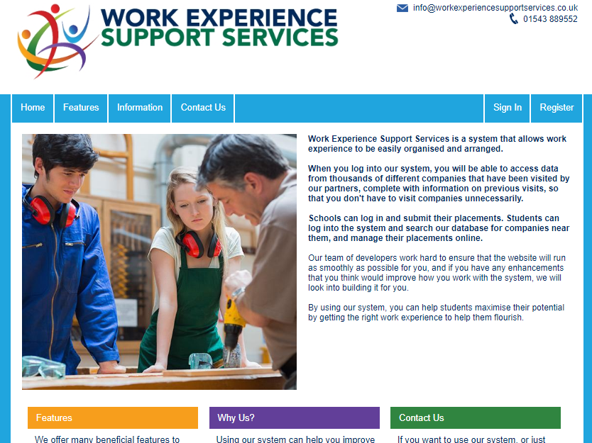
Work Experience Support Services Database
Homepage www.workexperiencesupport.co.uk

Slide 5
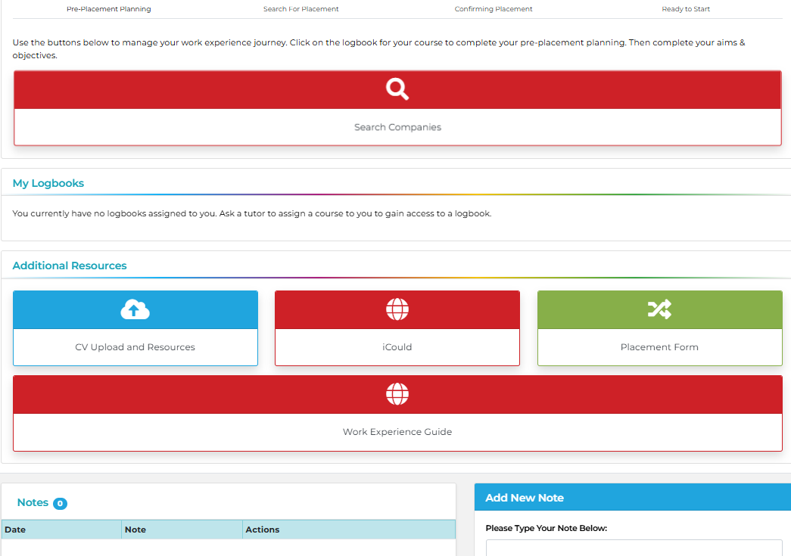

Slide 6
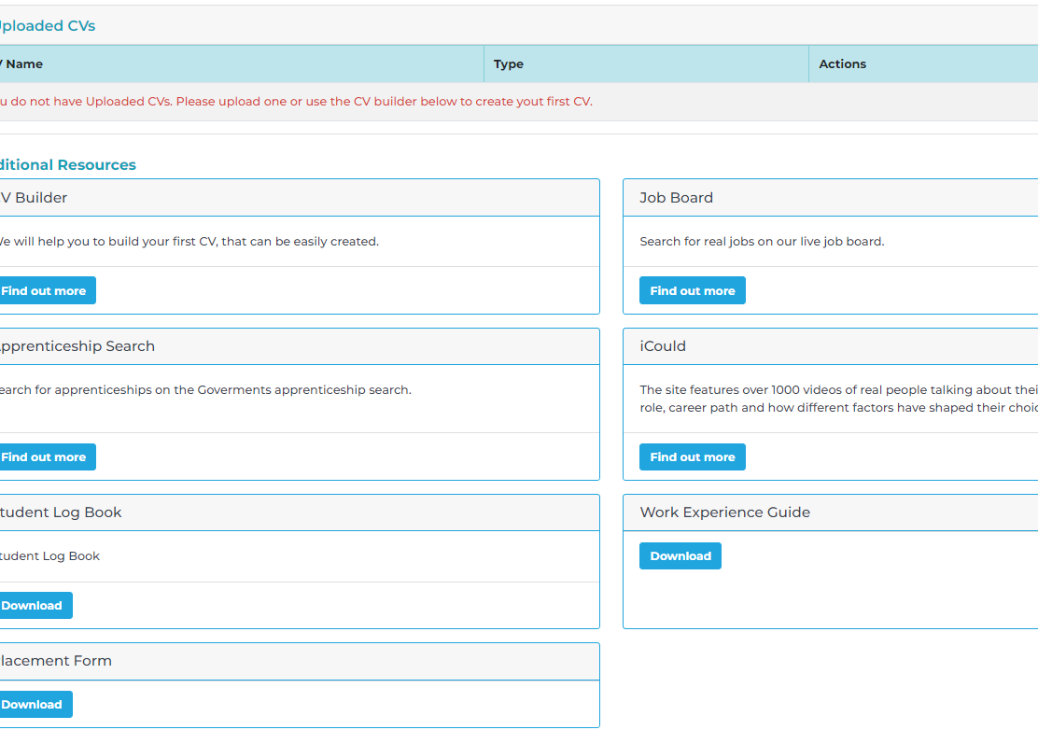

Slide 7
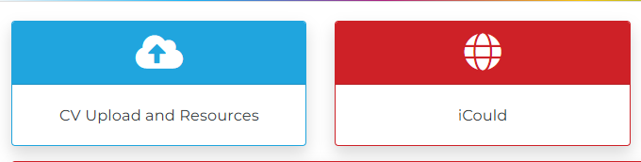
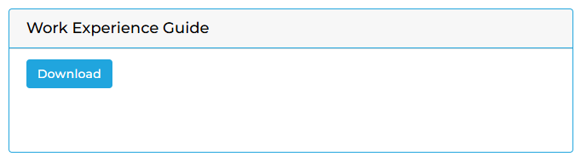

Slide 8


Slide 9


Slide 10
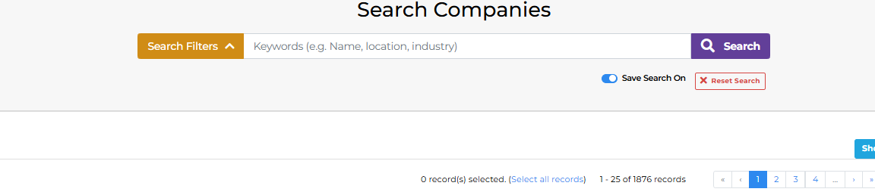
Search defaults to school postcode
Already showing 1876 companies without filtering the search

Slide 11
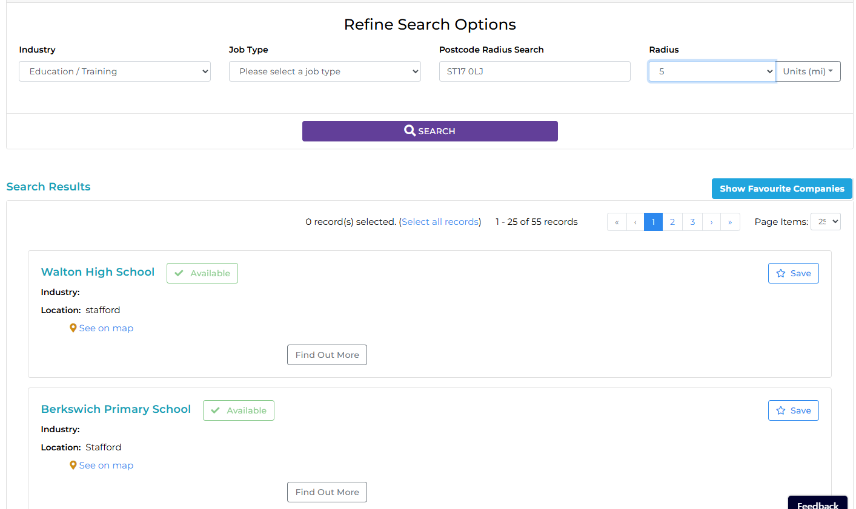

Slide 12
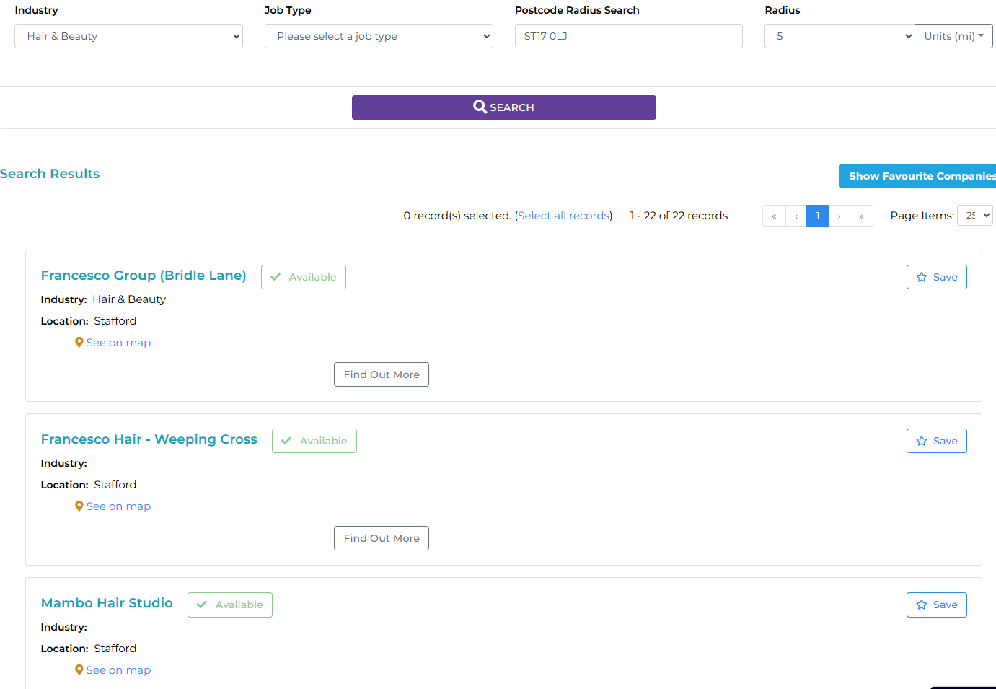

Slide 13
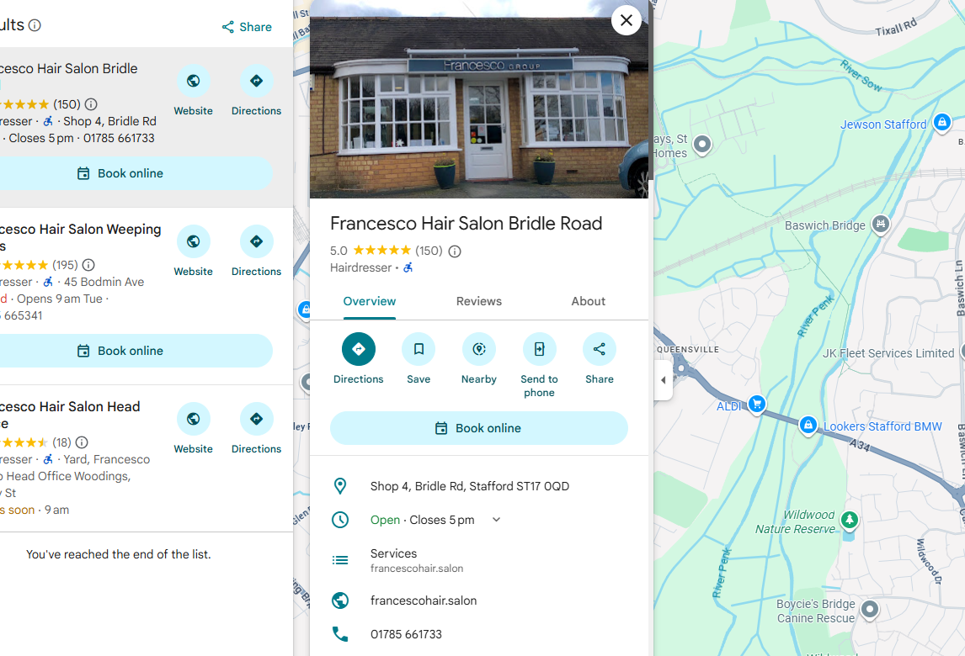

Slide 14
PLEASE NOTE:
Please do not assume that businesses will offer placements each year, you must make contact with them to ask if work experience is possible.

Slide 15
SOMETHING TO CONSIDER
travel to and from work
How are you going to get there?
Notes:
Make sure you can get to work on time
Look at the Careers Resource Centre on Frog for links to Kudos and Careerscape Online
Ask the employer what you will be doing
Medical conditions – no point in being a plasterer if you are asthmatic!

Slide 16



Making Contact
Use a personal approach
  Telephone
  personal attendance
Follow up in writing
  a letter
  email

Slide 17
USEFUL INFORMATION
Local Banks – call into the branch
NHS (Hospitals) – look on the NHS website for details on how to apply
Primary Schools – contact as soon as possilbe
Uniformed Services – family contact

