Slide 1
Welcome to our Year 12 Parents’ Information
Evening

Slide 2
Who we are and what we do
Mrs Cooper – Director of Sixth Form
Miss Weaver – Head of Year 12
Mrs Curtis – Head of Year 13
Mrs Wellings – Sixth Form Administrator
Tutor Team
Wendy Baddeley - Wellbeing counsellor
Becky Green - Careers advisor

Slide 3
Great First Week!
Positive start
Good attitudes
Working well
Getting involved

Slide 4
What we expect from you
Students to make the most of their time here – attend including tutor time daily
Commitment to their studies – complete all work and actively engage/participate in lessons
Adult levels of independence and responsibility
Enjoy and have fun! Get involved in all aspects of Sixth Form
What we expect

Slide 5
Making the most
of time spent in school
Attendance
Regular and punctual attendance maximises learning potential
Evidence shows students who attend school regularly make better progress academically and socially, but it also prepares them for adulthood and working life.
Good attendance is also linked to a student’s happiness and at Walton, we want all our students to attend school every day so that they give themselves the best chance of being successful.

Slide 6
Percentage Attendance
Above 98%: Less than 4 days absence a year
Excellent attendance! These young people will most certainly get the best grades they can, leading to better prospects for university or work.
Between 95% and 97%: 10 days absence a year
Average Attendance. These young people are likely to achieve good grades and have opportunities for college, university or work, but could still improve their attendance.
Between 90% and 94%: 19 days absence a year
Below Expected National Standard of Attendance. Young people in this group are missing a month of school per year, it will be difficult for them to achieve their best and attain their full potential.
Below 90%: Persistent Absentee
Young people in this group are missing six weeks of school per year, making it almost impossible to keep up with work.

Slide 7
Registering Absences
Students are not allowed to register their own absences – this must be done by a parent/carer and must be done through our Sixth Form Administrator, Mrs Wellings.
On Thursdays, Miss S Bowen: s.bowen@walton.staffs.sch.uk
She can be reached either by email or school phone number
Email: j.wellings@Walton.staffs.sch.uk
Number: Main school number (select option 4)
Voicemail: A voicemail can be left on option 4

Slide 8
Personalised Programme of Study
Each of you will have a tailor made programme of study for your time at Walton, which will include:
6 periods of timetabled lessons per subject per week
PSHE
Tutor time
Any extra courses (MOOCs, EPQ)
Enrichment
Work experience
Volunteering
Progress on your Programme of Study is crucial for your future and is supported and monitored.

Slide 9
Structure of the Week
-Tutor Time
As part of our Personalised Programme of Study, we have put together a registration programme which will take place during tutor time every morning of each week. (8:45-9:05)
This Programme has been designed specifically with our students’ needs in mind and in response to some of the most re-occurring needs we come across in Sixth Form.
By getting students up and in school every day, we hope to better support them into healthy habits and routines and encourage them to make the most of each day, getting the most from their sixth form experience both academically and socially.

Slide 10
-Tutor Time
Monday – VESPA (Vision, Effort, Systems, Practice and Attitude)
Tuesday – News day
Wednesday – Wellbeing
Thursday – Theme eg. study skills
Friday – Assembly (either in line with wider school theme or Sixth Form specific)

Slide 11
What the Plan looks like
-Year 12
This is the detailed plan our students will be following as a tutor group.
https://waltonhighschool809.sharepoint.com/:x:/r/sites/SixthFormTutorTeam/_layouts/15/Doc.aspx?sourcedoc=%7BFC72D231-02E4-410D-AE02-99DCFD002FF2%7D&file=2023-24%20Tutor%20Time%20Programme%20YEAR%2012.xlsx&action=default&mobileredirect=true

Slide 12
What the Plan looks
-Year 13
Tutor time is equally important in Year 13.
Students will follow a similar plan, but with added preparation for life after A Levels, whether that be completing UCAS applications with their form tutors or preparing for interviews and apprenticeships.
Getting to know tutors is important as they are the main reference writers for students and so this time spent together each morning is invaluable.

Slide 13
Structure of the Week
-Lessons
Studying 3 or 4 Subjects
Each subject holds 6 (50 minute) periods per week
Attendance and Punctuality are again key here
Students’ responsibility to complete all work and catch up with any work if absent
Students' responsibility to organise their work into folders
File Checks – completed alongside data, Pass or File grade reported home

Slide 14
Structure of the Week
-Enrichment
On top of lessons and tutor, Students are expected to take part in at least one enrichment activity each week.
This will enrich their experience in Sixth Form, challenge and develop them in ways their lessons cannot.
Provide them with opportunities and added extras to enhance their applications after A Levels
A break from studying, a chance to enjoy something, try something new, socialise and express themselves.

Slide 15
All Enrichment sessions are run during enrichment slots in the timetable or at another common time, offering equal opportunities to all students to attend whatever sessions appeal to them.
Students are encouraged to join as many as they can!

Slide 16
Structure of the Week
-Independent Study
The centre is your study zone during independent study sessions.
Centre Wifi
We have stations for laptops as well as our ‘Quiet Room’ for quiet independent study.
Laptops to borrow – see Mrs Wellings
Room 55 - often free and can be used
Bank of work provided by departments
Surrounding yourself by work and people working is motivating and we have seen some really good work in here this past week.

Slide 17
 | 1/2 | 3/4 | 5/6 | 7/8
Monday | A | Enrichment/ PSHE | E
Tuesday | E |  | B
Wednesday |  | B | Enrichment | A
Thursday | E |  |  | B
Friday |  |  | A
 | 1/2 | 3/4 | 5/6 | 7/8
Monday | A |  | E
Tuesday | E |  | B
Wednesday |  | B |  | A
Thursday | E |  |  | B
Friday |  |  | A
 | 1/2 | 3/4 | 5/6 | 7/8
Monday | A | Enrichment/ PSHE | E
Tuesday | E |  | B
Wednesday |  | B | Enrichment | A
Thursday | E | Enrichment |  | B
Friday |  |  | A

Slide 18
Retrieval Practice Interleaving Spacing

Slide 19
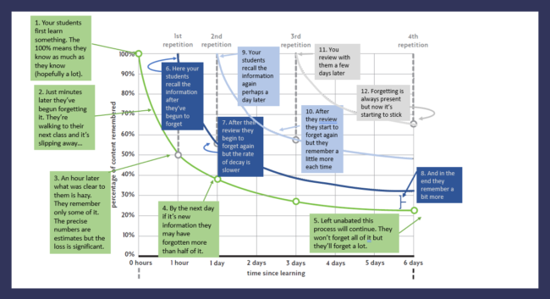
Ebbinghaus' Forgetting Curve

Slide 20
Structure of the Year
-PSHE
Another key element of our Personalised Programme of Study is PSHE
Delivered by tutor p3 every Monday
These sessions are compulsory and are again, another enhancing element of Sixth Form.
Team Building
Healthy Lifestyles and Relationships
Sexual Health
Managing Risks
Bullying, Abuse and Discrimination
Work Experience
Studying / Exams / Wellbeing

Slide 21
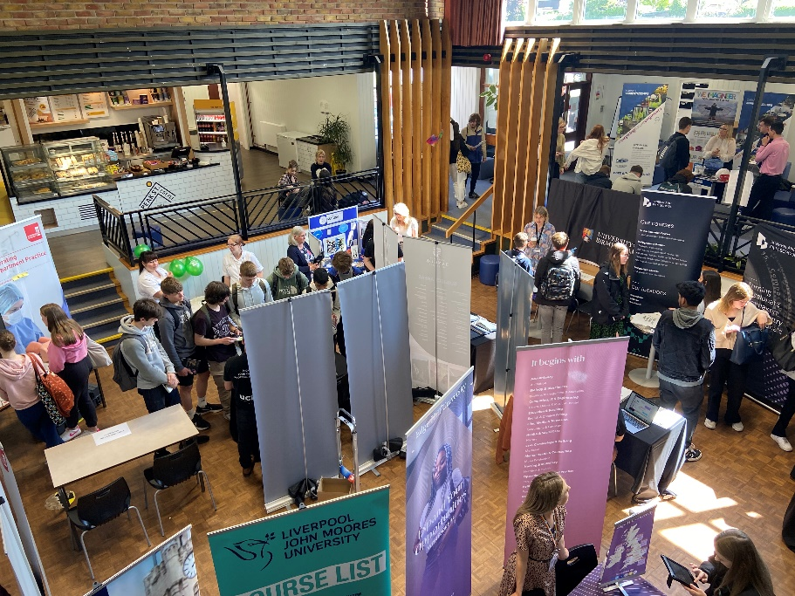
Structure of the Year
-Festival of Futures (19th May)
Beginning the UCAS and unifrog process
Apprenticeship Talks
Careers Fair

Slide 22
Unifrog
Useful for logging competencies/evidence of achievements
Careers and FE guidance
University applications
Work experience

Slide 23
UCAS
Official University Application
The Process will begin before the Summer break
Early entrants deadline is September 2025
All others deadline Jan 2026
UCAS Parents’ Information Eve in May

Slide 24
Structure of the Year
- Work Experience (w/c 23rd June)
Week of compulsory work experience
Is to be sourced and organised by students
Should be linked as closely as possible to career aspirations
Organising this as early as possible will give more options
Other Work Experience opportunities are available throughout Sixth Form and these opportunities are advertised via Instagram

Slide 25
Good Communication is Key
Between students, tutors, teachers and us
Between us and parents/carers
Between us and students:
Notice board in SFC
School Website
Email/text
Posters
Tutor notices
Assembly
Student voice – Sixth Form Council and Senior Prefects

Slide 26
Social Media
Another way that we will be communicating and sending out updates is via our Sixth Form Instagram page. Please Follow us for regular updates.

Slide 27
Extra Info
16-19 Bursary
Oxbridge/Aspire Group
Open Days (advertised on Instagram)

Slide 28
Organisation – be on time equipment for lessons Complete all homework/prep work/pre reads Files – have systems in place – there will be file checks Attendance – attend every lesson Independent study time
How to be a successful student

