Slide 1
YEAR 6 INDUCTION
Welcome to New Parents Information Evening
Notes:
Thank you Dr Rowley, welcome again to our transition information evening. My name is Mrs Turner, I am the Transition Co-Ordinator. Tonight I am going to share with you some information ahead of meeting your child’s tutor and hopefully give you an insight in what you can expect come September.

Slide 2
INDUCTION DAY
Students Induction Day = Wednesday 3rd July
In your packs you have your child tutor group and Head of Year.
You will meet your child's tutor shortly
There is also a permission slip for leaving school site tomorrow – please hand this back in to your child's tutor.
Notes:
Thursday 6th July is induction day for students and we are really looking forwards to hosting the day. So far this year already, feeder schools have had the opportunity to attend Primary School Sports morning, English workshops and a visit to watch the Expressions Dance show and smaller group tours so I hope are feeling confident to begin their journey with us.
SEND students and the majority of students from non-feeder schools have had the opportunity to come and visit us for a morning as well and had a tour of the school with the opportunity to ask any questions.
Visits to feeder and non feeder primary schools, face to face or telephone meetings with Y6 teachers and SENDCO’s have also already taken place to gather information with the aim to make this process as smooth as possible.
In your packs you will have your child’s tutor group number, house , tutor name and HOY. This is different for this year and is changing across the school, our Head of Year model will allow You will also have your set up information for ParentPay which you can set up prior to them starting in September. You will get a permission slip for you child to leave school site Thursday after induction day, from your tutor, which we would like you to complete before you leave this evening and hand in to your child tutor after this talk.

Slide 3
INDUCTION DAY – WED 3rd JULY
8.45 start
Students enter through front gates and will be shown to Reception by duty team as they make their way into the hall.
Students to make their own way to school and will be in their primary school uniform.
Assembly and meet their Head of Year
P1 and 2 in lessons
Break time (bring a snack/drink) Students will be directed to the tennis courts for break
P3 and 4 in lessons
Notes:
8.45 start – parental drop off or students make their own way with siblings etc. Should in in primary uniform.
Students enter through front gates and will be shown to Reception by duty team as they make their way into the hall.
They will meet their tutor and have an assembly.
P1 and 2 is in lessons, with break time following – I would suggest to bring a drink and or snack and Students will be directed to the tennis courts for free time.
P 3 and 4 are in different lessons with lunch time following. Prefects/TA's will be on hand to help students throughout the morning and staff will be directing through corridors and at break times – so no chance of getting lost!

Slide 4
YEAR 7 INDUCTION DAY
Lunch time
A school meal will be provided by us:
Options are:
Main meal : sausage, mash and sweetcorn, macaroni cheese or pizza and salad
Pudding : muffin, cookie or rice crispy cake.
Students can bring a packed lunch if they wish.
Free time of the Tennis courts until the end of lunch
P5 and 6 in lessons, students dismissed from the hall at 3.00pm
Please complete the permission slip and hand in to your tutor
Notes:
A school meal will be provided by us:
Options are:
Main meal : sausage and mash, macaroni cheese or pizza and salad
Pudding : muffin, cookie or rice crispy cake – all of which I highly recommend!
Students can bring a packed lunch if they wish.
P5 and 6 in lessons and students will be dismissed from the hall at 3.00pm.

Slide 5
SUMMER BOOK CLUB SCHEME
Your child's book gift - ‘Wonderscape' by Jennifer Bell
Mr Fowler 2nd in Department for English.
Notes:
Tonight you will also receive a book from us for all our Y6’s to be able to continue the excellent reading practices that go on in all feeder primaries, and to promote this as a start at Walton as well. To talk to you a little bit about this is, Mr Fowler 2nd in department for English. Thank you Sir.

Slide 7
Welcome to your Summer Book Club

Slide 8
What is Summer Book Club?
Lots of schools around the country are doing this too
Everyone is reading Wonderscape by Jennifer Bell
Your child will have all summer to read the book
Your child will receive an activities pack with questions and activities related to the book including artwork and creative writing.

Slide 9
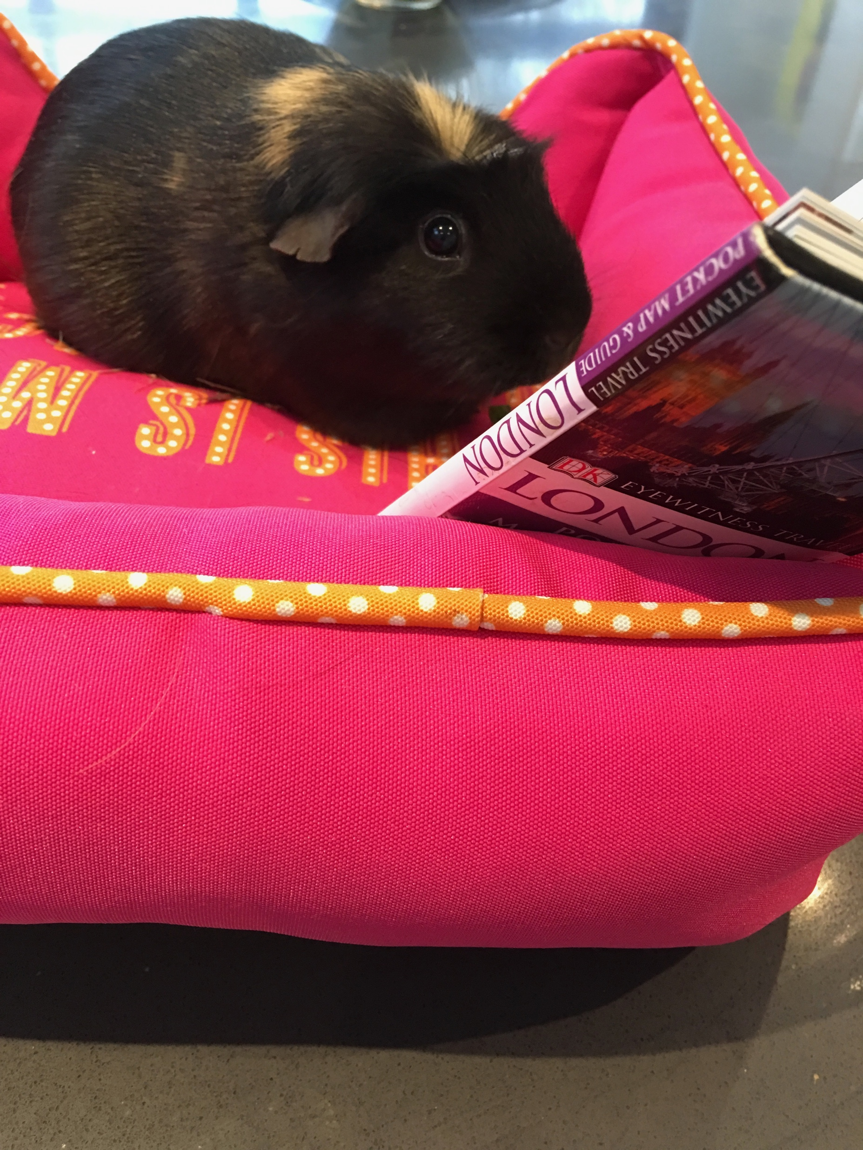
Prepare for secondary school – read, read, read!
Try to get your child reading every day
Let the read whatever they enjoy - magazines, comics, fiction, non-fiction, poetry, song lyrics
If they have a younger brother, sister or a pet get them to read to them
Read the book for Summer Book Club!
Visit your local library

Slide 10
How can you help with Summer Book Club?
We know that reading for pleasure is a key to success in secondary school. It helps pupils progress in all of their subjects and it also supports their wellbeing.
Please can you encourage and support your child with reading the book and completing the activities.
Talk to your child about the book.
Even better, read it with them so that you can discuss it.

Slide 11
What will you be doing with Summer Book Club activities?
Students who complete the Summer Book Club activity pack can bring into school during the first week of term in September.
These will be handed into the library where our librarian Miss Bowen will scour through all the excellent work completed.

Slide 12
Be Ready, Be Respectful, Be Safe
We expect all members of the school to abide by our school values.
This means that they:
Try their best and work to their best ability in lessons
Be kind and show respect for others
Care about the school they are in by respecting their surroundings
To do that we will help by:
Having high expectations of behaviour at all time
Full list of extra curricular activities
Music/Drama Productions
Positive new experiences and relationships
Notes:
Thank you Mr Fowler.
Something we are working hard on in school at present is imbedding Our school values of Be Ready, Be respectful, Be safe something new for students to consider when managing their own behaviour around school. We want to create a happy and healthy school environment with parity across the student body so that students from any and all backgrounds with any needs can access a high quality education and be supported in their learning when and where they need it, and whatever form that support might take.
We expect all members of the school to abide by our school values.
This means that they:
Try their best and work to their best ability in lessons
Be kind and show respect for others
Care about the school they are in by respecting their surroundings
And we will support this by having high expectations and being as supportive as we can.

Slide 13
Pastoral Team
Assistant Headteacher – Mrs Cashmore
Directors of Pastoral Care – Mr Curtis (Behaviour)
Mrs Turner (Culture & Ethos)
Head of Year – Mrs Downes
Supported by welfare, attendance staff and admin support.
7 tutor groups each belonging to a House, the houses will still compete in competitions/House/Sports day activities
Notes:
Heads of Yeae role is to deal with any issues arising within the year group, be that behavioural, attendance, well being or progress. Your first point of contact if you have any issues is your childs tutor, whom you’ll meet shortly. We work closely together as a team but as your child will see their tutor daily, its usually the best place to start. Our tutors will work hard to get to know your child and build that relationship so they feel confident in talking to tutors should they have any issues. Mrs Cashmore Assistant headteacher oversees this team, assisted by myself and Mr Curtis, Director of Pastoral Care for behaviour. Our overriding role is to help and support your child on their high school journey.
Our Pastoral team will also celebrate and reward the amazing things your child will do, in terms of progress, effort and praise points. Something we value an, with the introduction of our classcharts app this year, are working hard at building upon this come September.
If you have any personal information which you would like to share with your childs persons tutor please feel free to email them directly. You will get their email address a little bit later.

Slide 14
Anti Bullying
Welfare and attendance officers
School Counsellor
SENCO
Reporting any incidents is important
Notes:
We have welfare and attendance officers and school counsellor, SENCO and administrative assistants in the house team. No one wants to think of their child as unhappy in school and I think at this point it is important to note that we have robust procedures in place for dealing with bullying. Reporting any incidents of unkindness or any bullying issues is important so that staff can and will deal with it. Supporting students is a two way process and we really value that communication with parents as it is you that knows your child best and are well placed to spot changes in your childs behaviour. We have a wealth of pastoral staff, a real strength of our school and we will deal with any issues that arise. Should you have any worries or concerns, please do not hesitate to get in touch with your childs tutor in the first instance and report any continuing incidents to myself, Mr Curtis or Mrs Downes.

Slide 15
ATTENDANCE
It is essential that we can make contact with parents for safeguarding.
If your child is absent from school, please inform us on the absence phone line before 9.30 a.m. for every day of the absence. (Telephone number in Planner as well as on the website)
Please inform school immediately if there is a change of address, telephone or email address so that we can amend details on the school system.
Notes:
We always like to work with parents regarding attendance issues. Please discuss any concerns affecting your child’s attendance at school at the earliest opportunity with their tutor or Head of Year and then we can work with you and support you. School target is 96% but for children who get 100% attendance they go into a weekly prize draw and an end of year prize draw as well – you can help by booking medical appts outside school hours where possible.

Slide 16
REPORTING AND MONITORING
There are three data trawls throughout the year; two shorter reports and one longer report (which includes a comment from the tutor and HOH)
There will be one Parents' Evening, which will take place in person.
This will be in the Spring Term.
There will be a Year 7 Parent's Forum in September.
Notes:
Academically, your child will study many subjects, all of these will be reported on across the year with 3 data trawls. All teachers will give information on attainment and progress of your child.

Slide 17
REPORTING AND MONITORING
Staff will provide information on the following:
Target performance at the end of KS3 (Year 9)
Estimated performance for the end of KS3 (Year 9)
Progress towards target grade
Whether homework, effort and behaviour are exceptional, good, satisfactory or requires improvement.
Any appropriate strategies to improve.

Slide 18
REPORTING AND MONITORING
We use the ClassCharts App to publish homework and behaviour points
We use the iSAMS Parent App to publish reports.
You will receive an invitation to download the app in September.
This will provide you with updates on attendance and reporting.
Notes:
This is new this year, as some of you might be aware but it will be fully up and running by September.

Slide 19
SCHOOL UNIFORM AND PE KIT
Please ensure all items are named and be aware that all Key Stage 3 students have a tie and badge in the colour of their house.
We do not allow leggings, tube skirts, canvas/mesh trainers or round neck jumpers.
PE Kit is available to order on-line at: Crested School Wear; information has already been provided in parents’ packs.
Notes:
To show you our expectation surrounding uniform and PE kit, I’d like to introduce some of our lovely Y8 students (or should I say models!) Our expectations surrounding uniform are that students wear it smartly, with shirts tucked in and top buttons fastened. We ask pupils to remove coats or outdoor clothing in the school building. You have acceptable uniform information within the packs you received through the post to use as a guide but if you have any uniform queries please feel free to check with us.
We try to make PE kit as flexible as possible. Students must have their red Walton high polo shirt, sports trainers, football/rugby boots, shin pads, gum shield, swimming kit. Students can have any plain black sports leggings, shorts, skorts or tracksuit bottoms. We recommend PE hoodies as we are outdoor a lot but again this is optional also under layers will be helpful during the winter months. Student must always bring their PE kit, even if they are not participating due to injury as they will be part of the group, officiating and actively being involved in the lesson.

Slide 20
MOBILE PHONES AND VALUABLES
We do not allow mobile phones to be used during the day. They must remain off and in students’ bags at all times, if they are seen by staff they will be confiscated until the end of the day. Specific information about our mobile phone policy can be found on the website.
Students can wear a watch, smart watches must not be connected to phones.
Jewellery should be 1 pair of earrings studs only. No other jewellery is allowed.
No valuables or large sums of money should be brought into school.
Notes:
We do not allow mobile phones to be used during the day. They must remain off and in students’ bags at all times. Specific information about our mobile phone policy can be found on the website. They can wear a watch – smart watches are fine but cannot be connected to phones. No jewellery is allowed apart from 1 set of studs.
We use parent pay for you to pay for lunches via thumb print scanners so your child doesn’t need to bring money to school at all.

Slide 21
SCHOOL WEBSITE www.waltonstaffs.com
School twitter – @walton_staffs
Departmental Instagram/Facebook pages
The school website is a good source of information. The school calendar and letters to parents are posted on it.
There is also a dedicated section to transition where tonight's information will be uploaded, letters and general information about the school.
This will be being updated regularly.

Slide 22
CLASS OF 2024
We look forward to meeting your son/daughter in September.
Thank you
Notes:
I would like to finally say that we really care about your children we can’t wait to meet them and spend the next few years watching them flourish at Walton High School. If you do have any worries or concerns please do get in touch. That brings this section to and end, ur Tutor group meeting will follow, tutor groups 7.1, 7.2, are up the stairs in the entrance hall and 7.3 7.4, 7.5, 7.6, 7.7. are over in the David Hardman Building. If you are the parent of twins, go to one tutor and feel free to go and introduce yourself to the other afterwards. If you have anything to discuss with myself, I'll be in the hall after the meetings or any SEND concerns that haven't already been raised, Mrs Byrne our SENCO, will be in the hall after tutor meetings. I look forwards to meeting your son or daughter tomorrow and working with them come September. Enjoy the rest of your evening and thank you very much.

