Slide 1



Notes:
Thank you all for joining us.
Introduce myself.

Slide 2
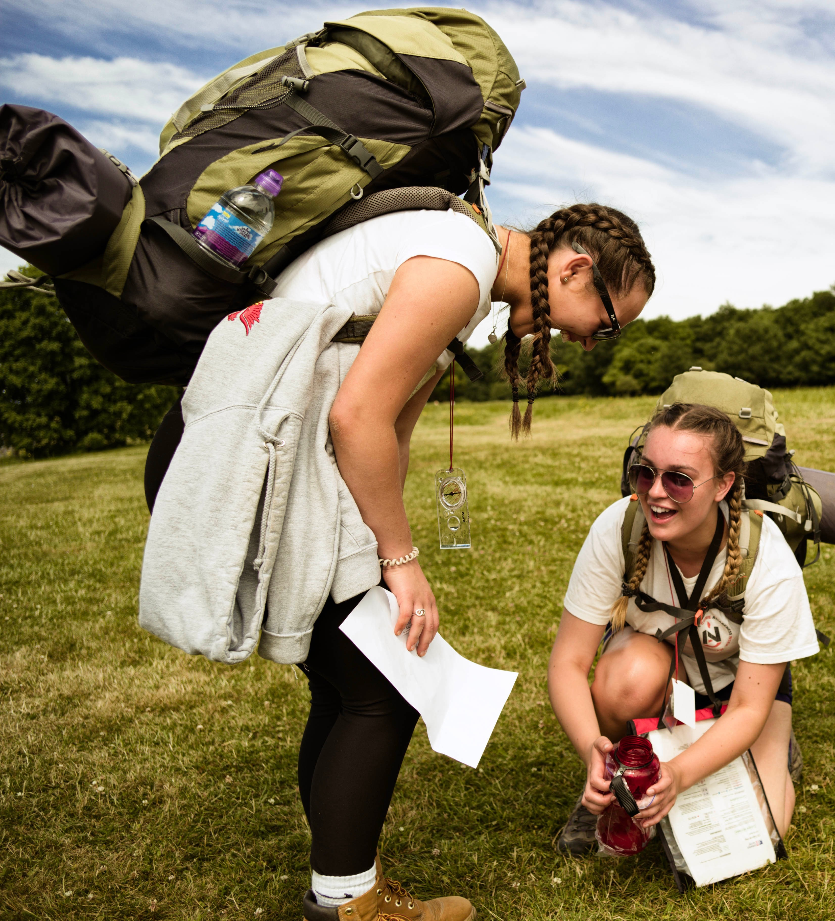

Why do the DofE?
A life-changing adventure which will help you develop the skills you need for your future life and work. ​
Helps you stand out from the crowd when applying for jobs, colleges or universities.
Notes:
Learn soft skills like communication, resilience, team work.
GCSE’s don’t require you to work as a team to get but The DofE does.

Slide 3
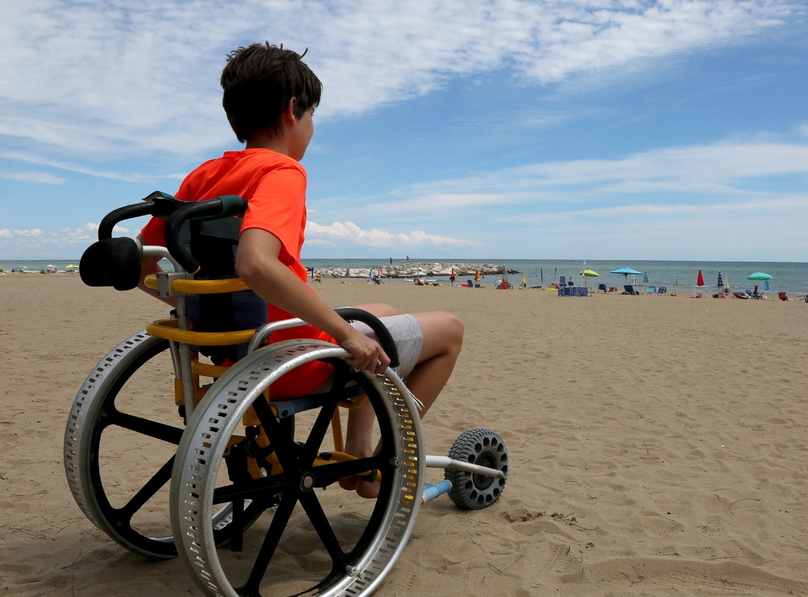

Who can do it?
-The DofE is open to everyone – No matter what your starting point, it'll be an adventure.
-You set your own goals that are achievable for you.
Notes:
​

Slide 4
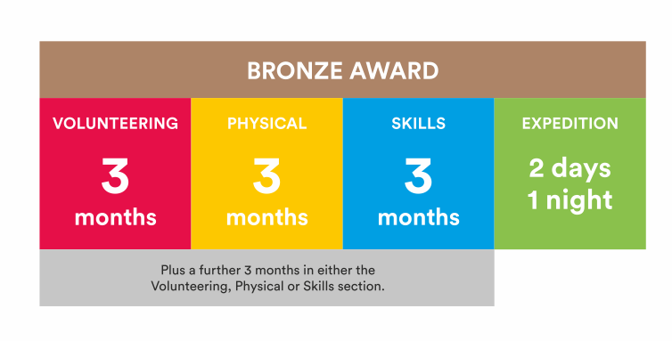
What's involved?
Notes:
​

Slide 5
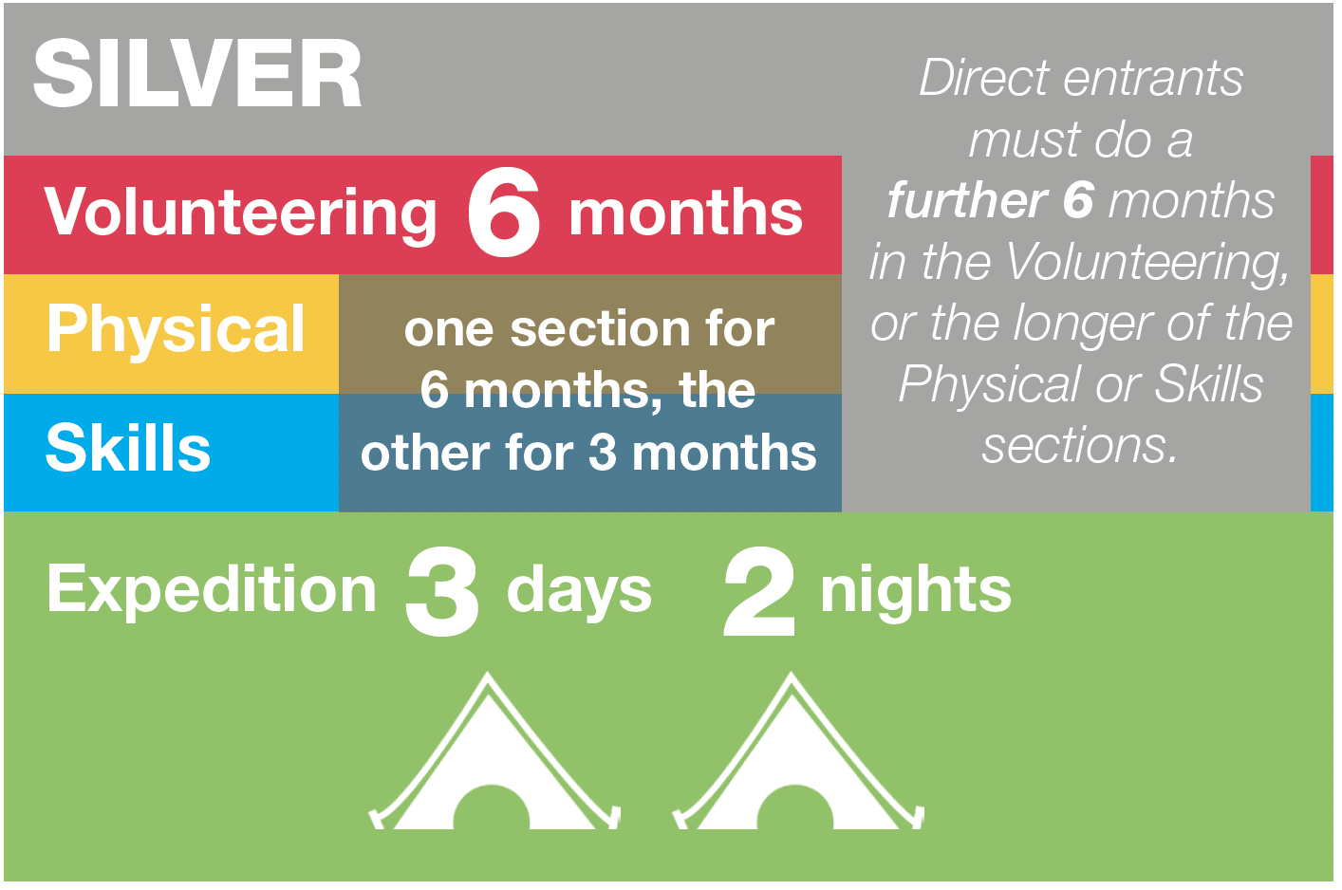
What's involved?
Notes:
​

Slide 6
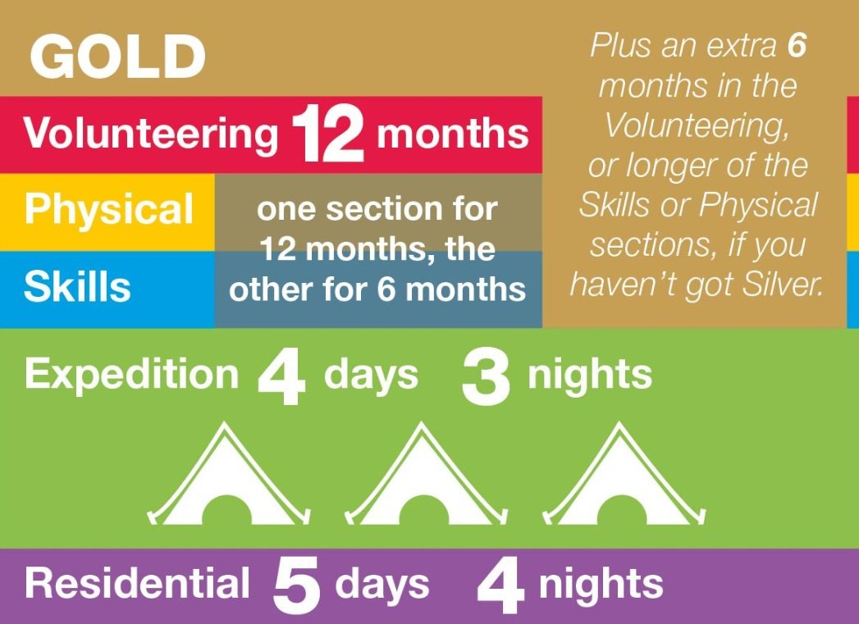
What's involved?
Notes:
​

Slide 7

Volunteering section
Take action and make a difference to the causes you care about
Help others and change things for the better
Notes:
Volunteering is a chance to help other people, and to make a difference to the causes you feel most passionate about.​
As well as changing things for the better, lots of young people find that volunteering is a great way to increase their confidence and gain new skills.​
Not a business

Slide 8
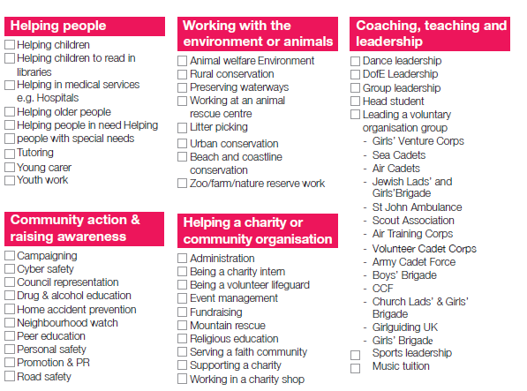
Volunteering section
- Helping older people
Raising Money
Animal Shelter
Litter Picking
Sport Coaching
Park Run
DofE Young Leader
Notes:
You can choose to volunteer in any area you would like – the only rule is that you must not be doing a job that companies would normally pay somebody for.​

Slide 9
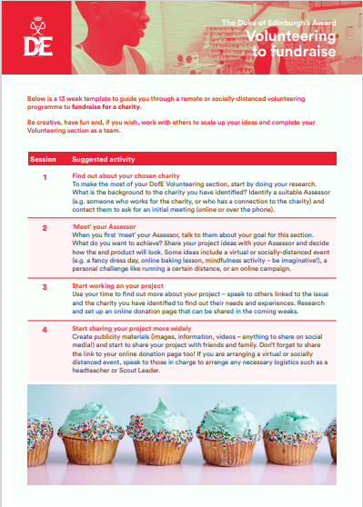
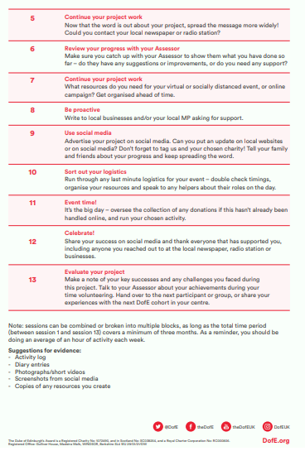

Volunteering section
Ideas and templates on our website here: Delivery toolkit - The Duke of Edinburgh's Award (dofe.org)
Could you be a DofE Young Leader?
DofE Young Leaders - information for adult Leaders - The Duke of Edinburgh's Award
Notes:
You can choose to volunteer in any area you would like – the only rule is that you must not be doing a job that companies would normally pay somebody for.​

Slide 10
Physical section
Take part in whatever
dance, sport or ﬁtness
activity you would like
Get ﬁtter and have fun
along the way!
Notes:
Becoming more active can be a huge amount of fun, and it can also help you feel happier and healthier.
​

Slide 11
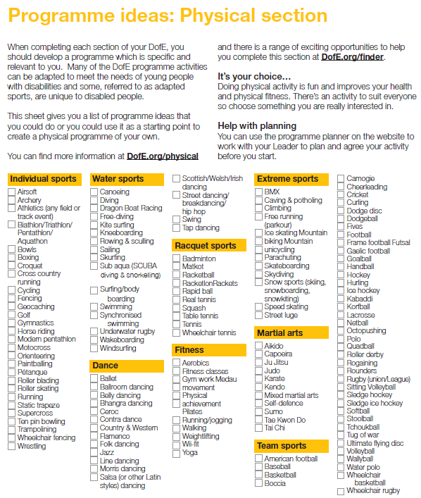
Physical section ideas
Swimming
Rugby
Gym
School clubs
Couch to 5k
Mountain Biking
Yoga
Notes:
​

Slide 12

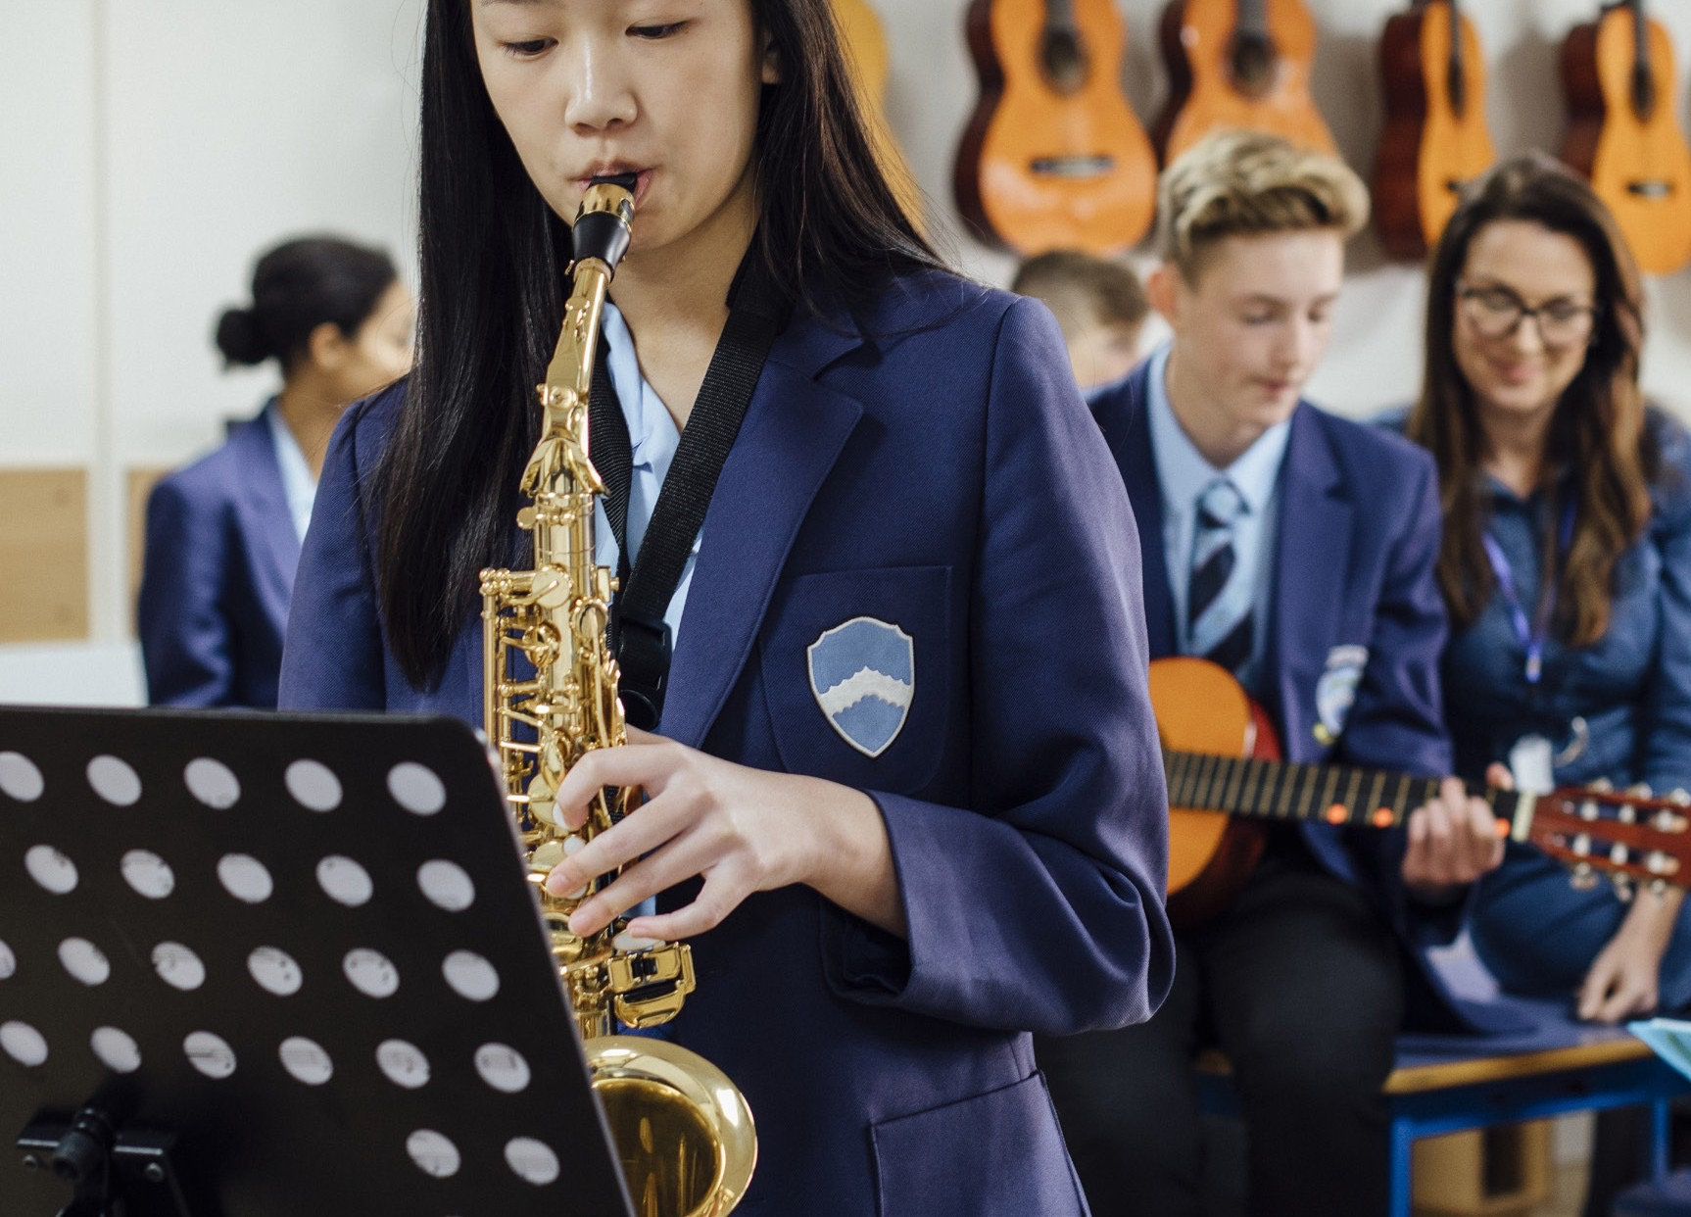
Skills section
Devote yourself to improving your skills in the things you love to do
Discover new passions and develop talents you didn’t know you had
Notes:
Skill and Physical difference
You can decide whether you will try to get better at something you already feel passionate about, or learn to do something new.
​

Slide 13
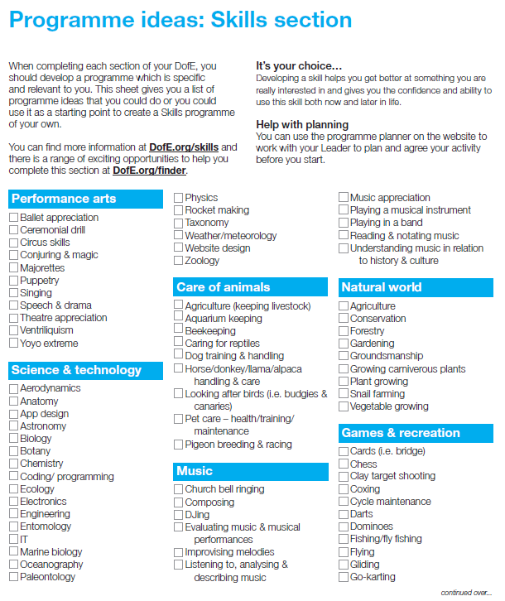
Skills section ideas
Drama, Music
Computer coding
Fishing
Photography, art, craft
Cooking
Duolingo
Reading, Writing
Driving
First Aid
Notes:
In the past, young people have done a huge range of different activities for their skills section, such as computer coding, driving and cooking.
Gaining new interests and talents is a huge amount of fun and lots of young people also feel a real sense of achievement from doing it.
Again this cant be in school time but could be a school club for example book club
​

Slide 14
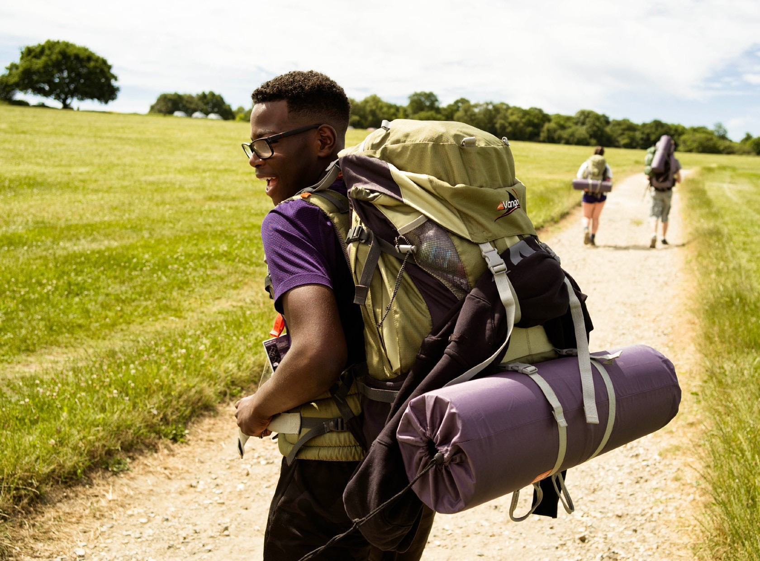

Expedition
Create memories that will last a lifetime
Planning, training for and completion of an adventurous journey
Notes:
The final section of your Bronze DofE Award is the Expedition.​
​As part of a small team, you’ll plan your aim, choose your location and do some training to make sure you’re prepared and know what you’re doing — then spend two days and one night away.​
​Your Expedition will improve your resilience, communication, teamwork and leadership skills. ​
​

Slide 15
What Will they Do?
They will work on each section on average an hour a week
Record how much time they spend on each activity
Ask someone with a good understanding of the activity to be their assessor and write an assessor's report at the end
Notes:
You will work on each section on average an hour a week
You will need to keep a record of the time you spend on each activity.
Ask someone with a good understanding of the activity to be your assessor and write an assessors report at the end
​

Slide 16


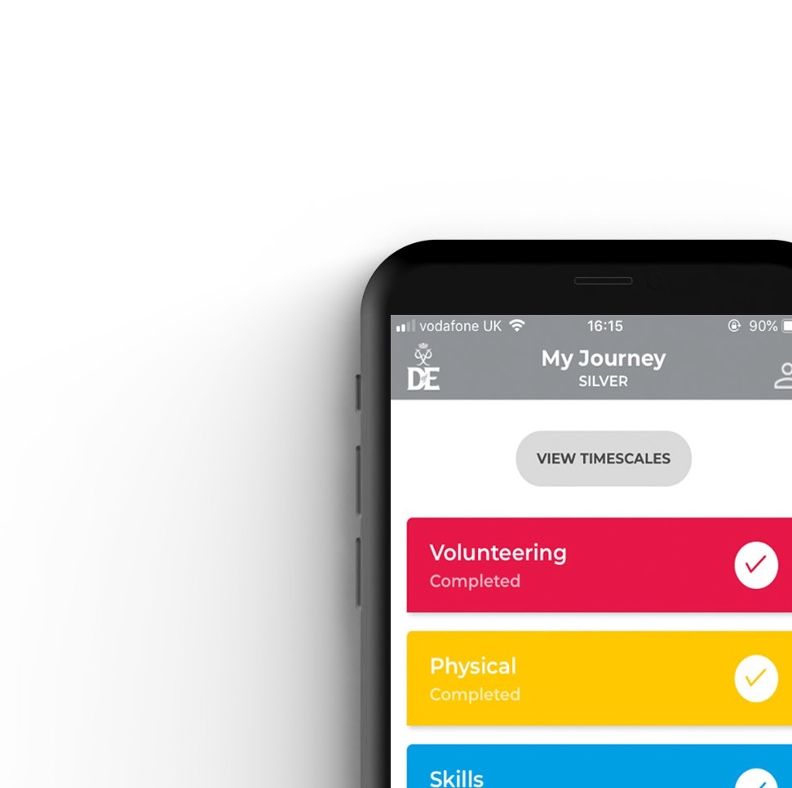


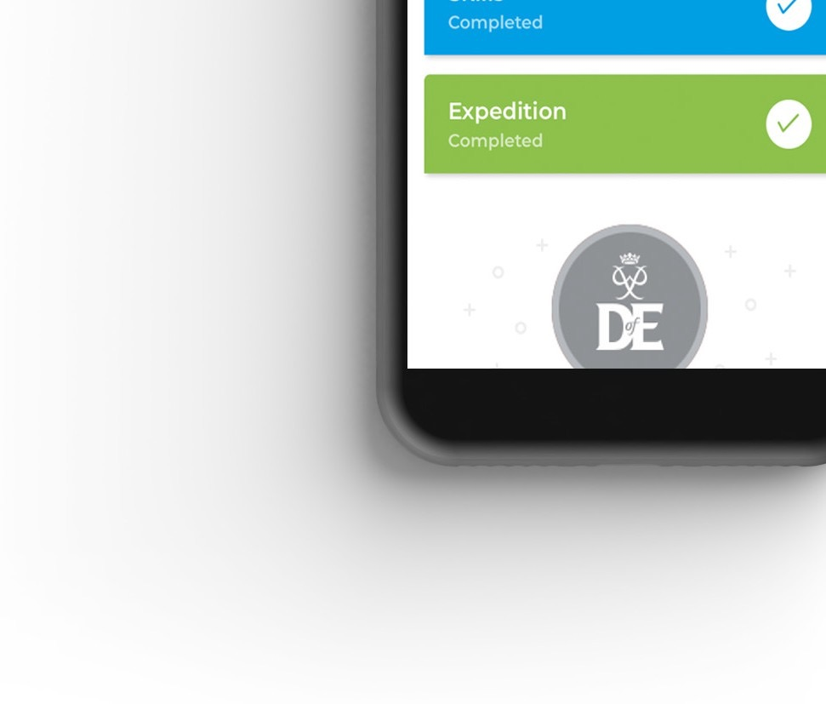
Welcome Pack and eDofE
Notes:
Once you have signed up to do your DofE, you will receive a Welcome Pack in the post which contains lots of useful information and advice. ​
​You will also get your own eDofE account so that you can plan your activities online using the free DofE app.​
​You will also receive a DofE Card which will give you and your family money off in several shops selling the sorts of equipment you may need.​

Slide 17
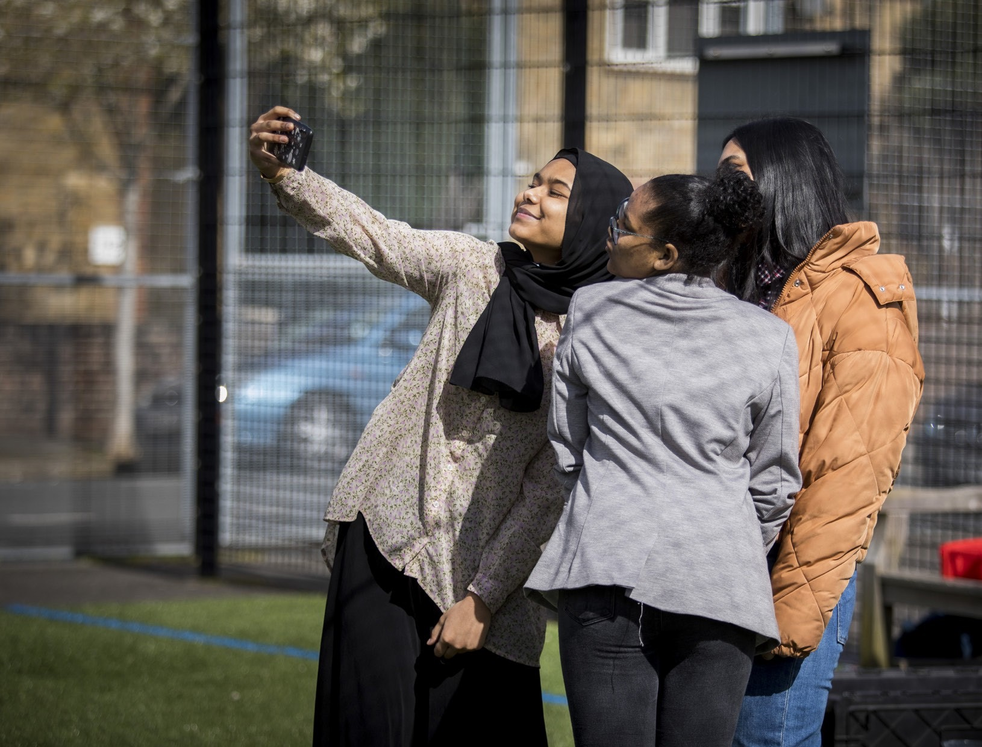
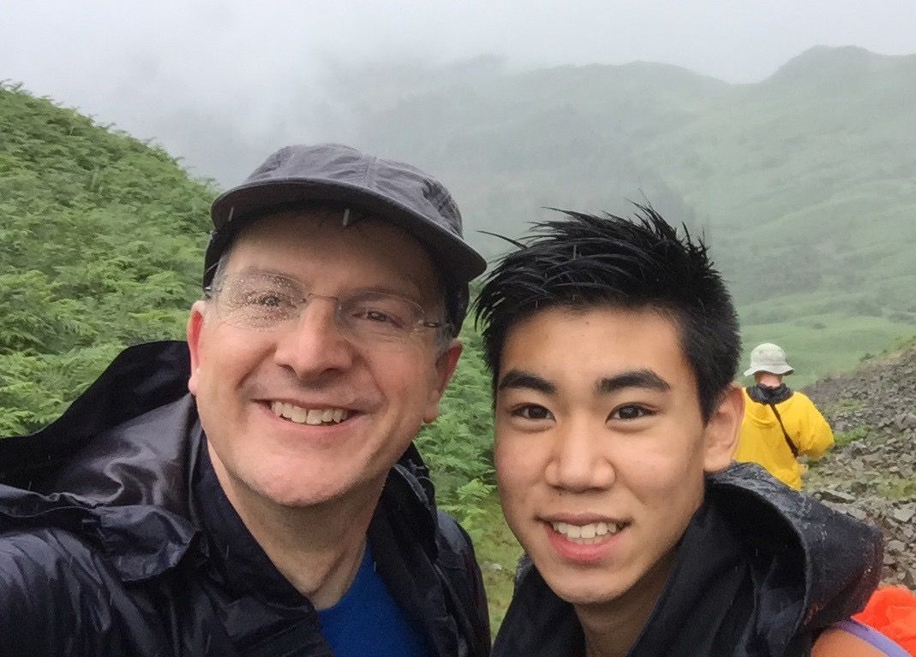
Your Role
- Guidance
- Encouragement
- Practical support
- Recognising achievement
Notes:
There are several ways you can help your young person to achieve their DofE Award.​
​You should provide guidance and advice – support them with things like choosing their activities and finding assessors.
Encouragement - It can be challenging to keep the motivation going, especially over some of the longer timeframes.​
​If they need it, help keep them on track with their activities, particularly those which are being done from home.​
​Practical support - You may be required to drop off/collect from expeditions and activities, make sure they have all the right kit and also wash the kit when it comes home! ​
​Recognising achievement - We hope all organisations will recognise the amazing achievement, and it is just as important to receive that recognition from family members. ​
​

Slide 18
Top Tip
Remember you can use activities/hobby's you're already doing towards your DofE
You don’t have to do it on your own, you can do it in a group
Notes:
You will work on each section on average an hour a week
You will need to keep a record of the time you spend on each activity.
Ask someone with a good understanding of the activity to be your assessor and write an assessors report at the end
​

Slide 19
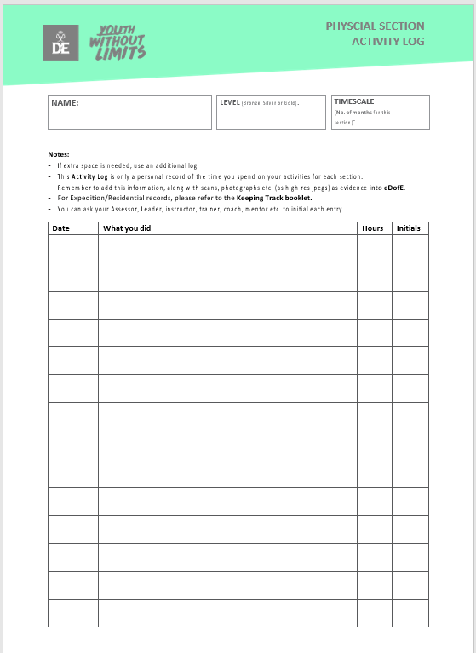
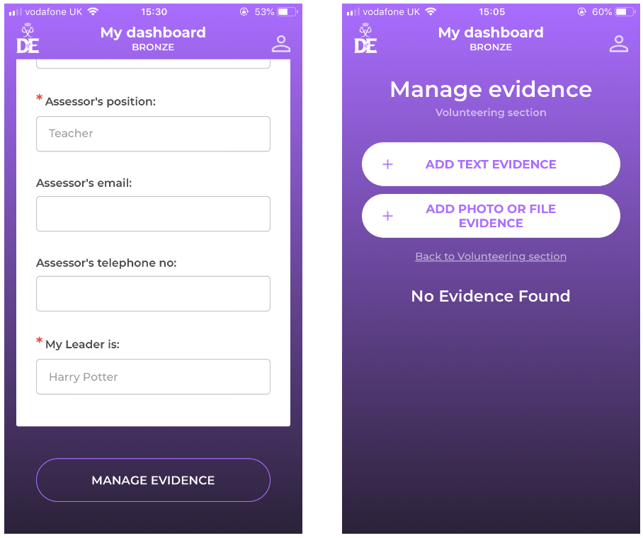
Evidence:
Students need to keep an activity log for each section to prove they have spent the right amount of time on each section. A photo of this log will then be uploaded as evidence. We also like to see lots of photo's of what the students have been up to please

Slide 20
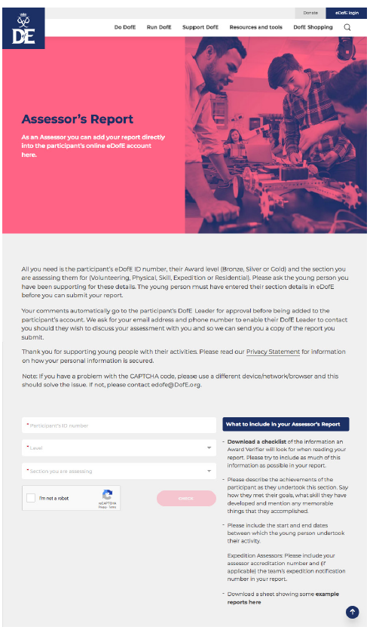
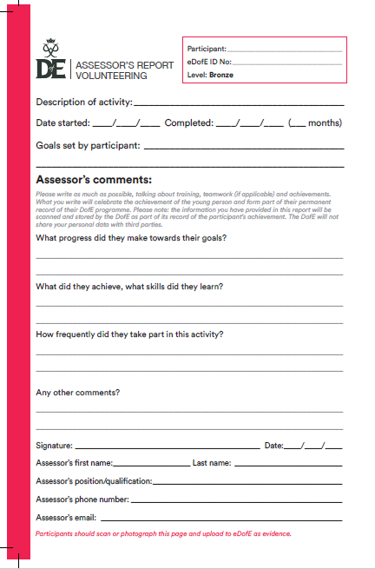
Assessor Reports:
Can’t be a family member
When your child has completed their section they will need to get an assessors report filled in. This can be using the booklet you received in the post or via the online portal

Slide 21
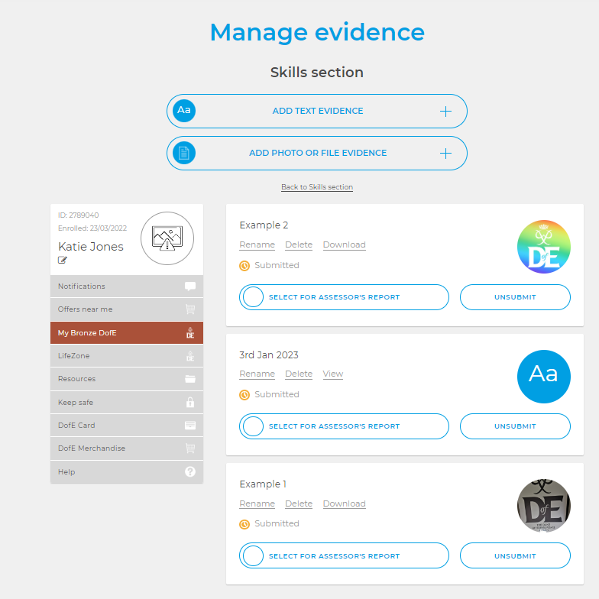
Adding Assessor Reports:
If students are using the booklet. They may add a photograph of this onto edofe. They need to mark it as their assessor report please

Slide 22
Expedition dates and cost Bronze
10th-11th May 25 – Residential Training - 2 days training and 1 overnight camp – Cannock Chase
5th – 6th July 25 - Qualifying expedition – 2 days walking and 1 overnight camp – Peak District
Information for all of the above days will be detailed closer to the time.
For payment of the DofE we will breakdown the £188 into 4 payments
Payment of the DofE registration fee £28 is to be paid on ParentPay by 15th July 2024
A non-refundable deposit of £40 is to be paid on ParentPay before 20th October 2024, this payment goes directly to the expedition providers to book your child’s place on the expedition.
A second payment of £90 will need to be paid prior to 24th February 2025 Training costs
A Final payment of £30 will need to be paid prior to 29th April 2025 Expedition costs
Payment must be made promptly to avoid participants being withdrawn. Reminder emails will be sent out. Please ensure the school has the correct contact information for you.
Notes:
You will work on each section on average an hour a week
You will need to keep a record of the time you spend on each activity.
Ask someone with a good understanding of the activity to be your assessor and write an assessors report at the end
​

Slide 23
Expedition dates and cost Silver
Fri 12th – Sun 14th Sep 25 – Navigational Training & Practise Expedition – 3 days & 2 overnight camp – Peak District
Route Planning – June/July 25 TBC – 1 morning – in school
Fri 26th – Sun 28th September 25 - Qualifying Expedition – 3 days walking and 2 overnight camp – Peak District
Information for all the above days will be detailed closer to the time.
For payment of the DofE we will breakdown the £273 into 4 payments
Payment of the DofE registration fee £28 is to be paid on ParentPay by 30th September 2024
A non-refundable deposit of £50 is to be paid on ParentPay before 20th October 2024, this payment goes straight to the expedition providers to book your child’s place on the expedition.
A second payment of £110 will need to be paid prior to 29th April 2025 Training costs
A Final payment of £85 will need to be paid prior to 1st September 2025 Expedition costs
Payment must be made promptly to avoid participants being withdrawn. Reminder emails will be sent out. Please ensure the school has the correct contact information for you.
Notes:
You will work on each section on average an hour a week
You will need to keep a record of the time you spend on each activity.
Ask someone with a good understanding of the activity to be your assessor and write an assessors report at the end
​

Slide 24
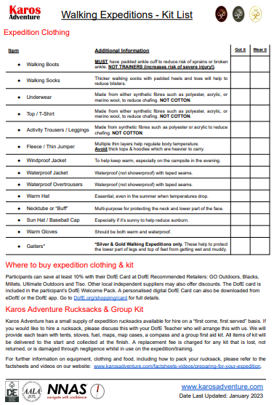
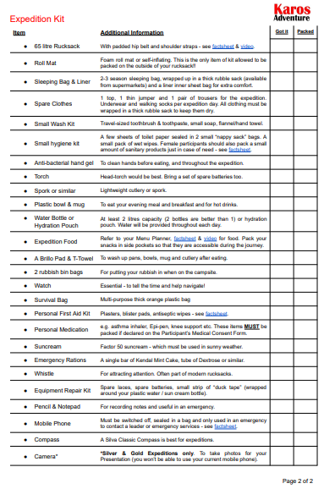
Kit List

Slide 25
Support
In order to support students with the cost of equipment for the DofE expedition some equipment is available for hire. 65L rucksack and Compass are available on a first come first reserved basis. A £10 fee will be added to ParentPay on request. ​
Look to borrow kit items from friends and family or ask if there are spare items you may borrow from the school.
Tents and cooking equipment are provided by Karos ​
​
If you have any queries please email dofe@walton.staffs.sch.uk. ​
​
Yours sincerely, ​
​
​
Miss K Abrahams ​
​
Duke of Edinburgh coordinator

Slide 26
Following on from this evening
Dear Parents/guardians
Thank you for attending the DofE information evening. If your child would like to complete the award with Walton then the following steps are necessary to register your child.
Letters will go out to tutors to take home to parents. On this letter there will be a reply slip for you to sign. Please ensure your child returns the slip to me
Once I have received this slip I will ask finance to set up the Registration fee on ParentPay for you. Please pay the registration fee promptly
Your child will be registered with DofE. I will organise a lunch session to help students get logged in and fill in what they wish to do for each section. Therefore, it would be great if you could discuss sections with your child and decide what they may wish to do for each section. I will provide section planners for all participants. They should bring these to the first meeting.

Slide 27
Resources:
DofE YouTube
DofE Website
DofE Opportunity Finder
Any Questions?
Notes:
Presenter: Please customise this slide with the contact details of your DofE leader/administrator.
​Explain the next steps.
​
​

