Slide 1
Year 10 Mock Exam
Revision
Food
Preparation & Nutrition
AQA
Walton High School

Slide 2
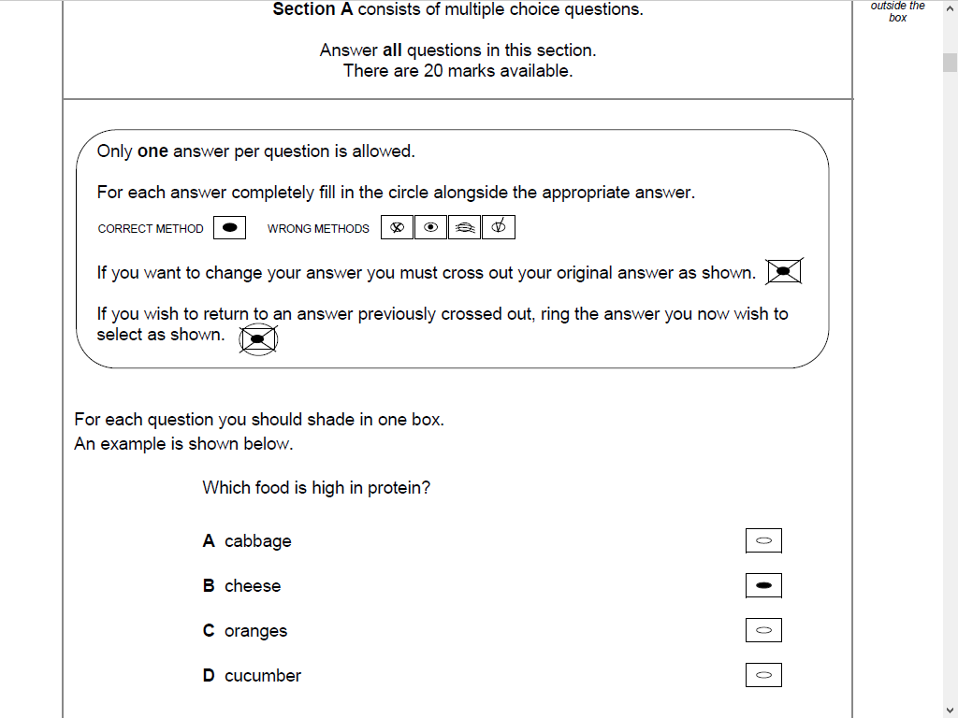

Section A –
Multiple Choice Questions

Slide 3

Section B – Core knowledge
This section will test your core knowledge and may include questions on:
Food, Nutrition and health
Food Science
Food Safety
Food Choice
Food Provenance
Food preparation and cooking
techniques

Slide 4
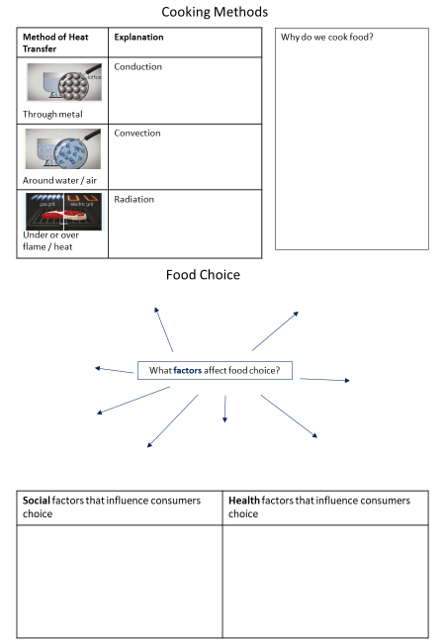
Topics on revision sheet…
Different cooking methods and effect they have on food and nutrients
Food choice and different lifestyles
Healthy eating, nutrition and energy balance
Micronutrients examples and functions
Food science terms denaturation, enzymic browning, coagulation
Dietary related health problems

Slide 5
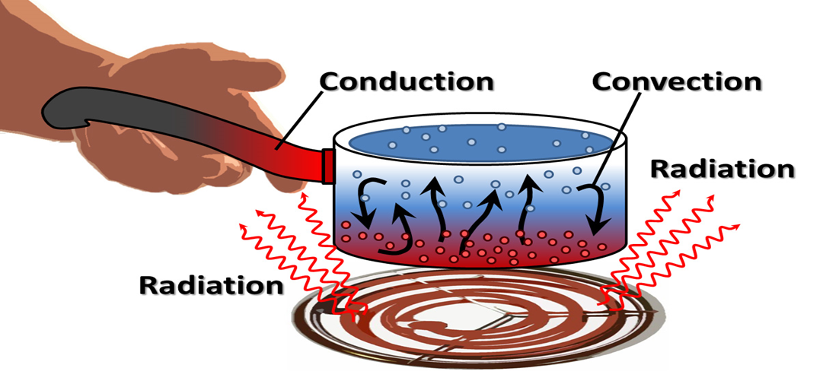
Cooking Methods

Slide 6
Why do we cook food?
Cooking Methods
To make food easier to digest
To make food look and smell and taste better
To make food safer to eat
To prevent spoilage and increase its keeping qualities
There are 2 main methods:-
Cooking in water or fat (moist heat)
Cooking in an oven (dry heat)

Slide 7
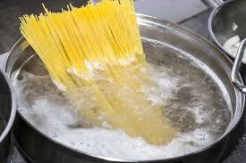
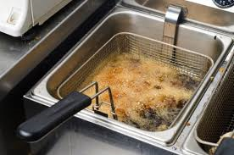
Cooking in water
  Simmering/Boiling
  Steaming
  Poaching
  Pressure cooking
  Stewing/Braising
  Blanching
Cooking in fat
  Shallow frying
  Deep frying
  Stir frying

Slide 8
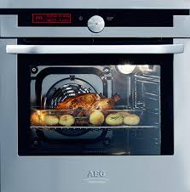
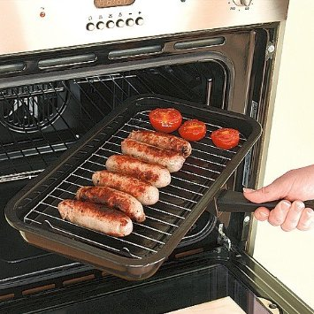
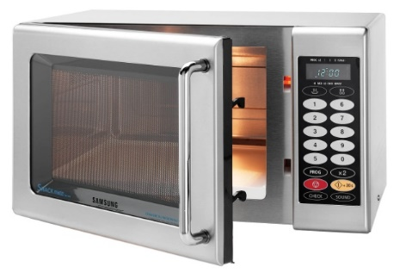
Cooking with dry heat (oven/grill)
  Baking
  Roasting
  Casseroling
  Grilling
  Microwaving

Slide 9
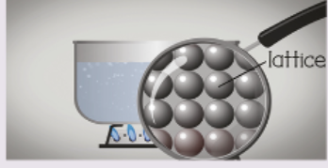
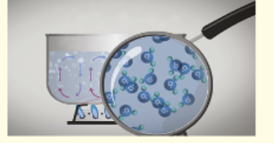
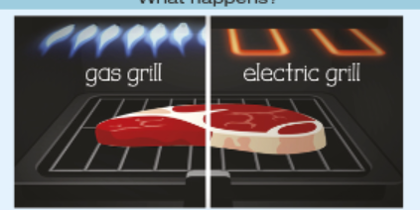
Heat Transference – 3 basic methods
Conduction –
boiling, baking, frying, microwaving, roasting – heat is transferred by contact with heat
Convection –
baking, boiling, frying, roasting, steaming – heat moves through the convection currents. The hot air rises and cool air falls.
Radiation –
grilling, BBQ, microwaving – direct rays pass from the heat source to the food

Slide 10
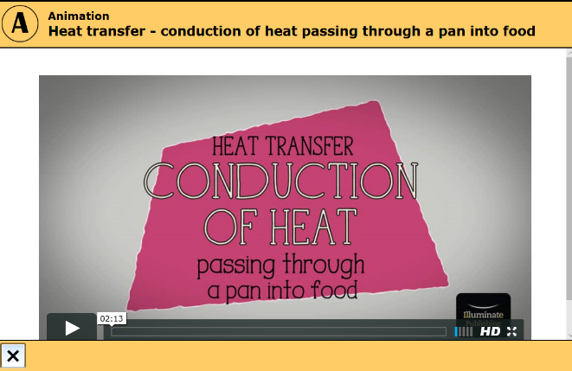

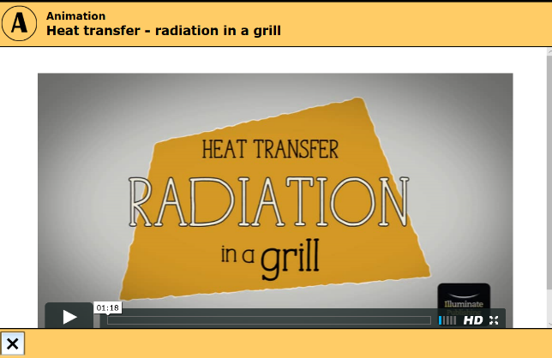
Conduction
www.illuminate.digital/aqafood
Student Username: SWALTON3
Student Password: STUDENT3
Watch cooking methods videos for further explanation
Convection
Radiation
Watch the video in the AQA text book on page 85
Watch the video in the AQA text book on page 86
Watch the video in the AQA text book on page 87

Slide 11
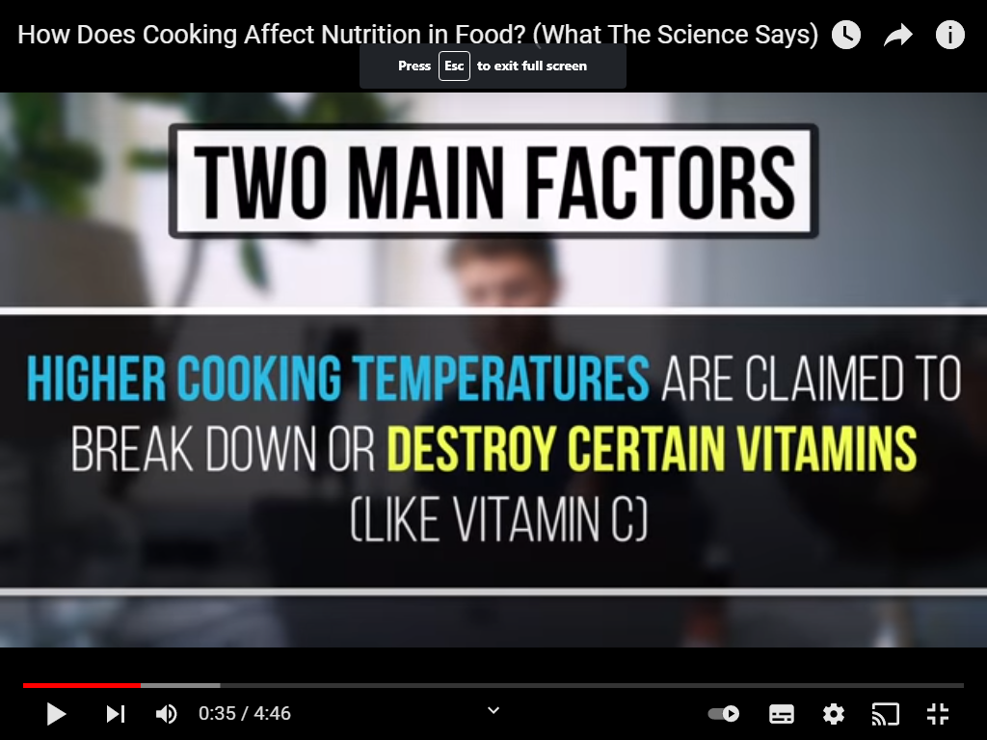

Food Production Methods Affecting Nutritional Value
Watch video and make notes on how cooking affects the nutrient content of foods
Click on pic to open hyperlink

Slide 12
How cooking affects the nutrient content of foods nutrient content of foods….
Eating nutritious foods can improve your health and energy levels.
Surprisingly, the way you cook your food has a major effect on the amount of nutrients it contains.
Nutrient content is often altered during cooking
Cooking food improves digestion and increases the absorption of many nutrients

Slide 13
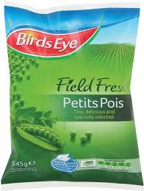

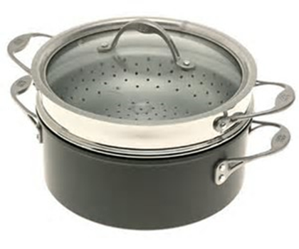
Food Production & Nutrition
Freezing fresh food quickly can help maintain the nutrients they have before being picked. The nutrients can then be further maintained through the cooking process. Steaming is the best technique to maintain nutritional value of food.
Foods can also have nutritional value added to the during production – this is called fortification

Slide 14
Quiz.
The answer spells out a method of cooking. Name the method and 3 foods you can cook that way.
Which is a moist method of cooking? A Grill S Poach C Bake | 2. Which is a dry method of cooking? U Steam L Pressure cook T Bake | 3. In a grill where does the heat come from? O Top & bottom R Bottom E Top | 4. Which method of cooking does not brown food? I Baking T Grilling A Microwaving
5. Which method is better for reducing fat intake? M Stir frying A Deep frying T Shallow frying | 6. Which method kills most vitamin C? I Boiling A Steaming | 7. Which method is quickest? I Stewing N Pressure cooking R Casseroling | 8. Which meal uses most energy R Beans on toast P Cheese on toast G Boiled egg & toast soldiers

Slide 15
Quiz.
The answer spells out a method of cooking. Name the method and 3 foods you can cook that way.
Which is a moist method of cooking? A Grill S Poach C Bake | 2. Which is a dry method of cooking? U Steam L Pressure cook T Bake | 3. In a grill where does the heat come from? O Top & bottom R Bottom E Top | 4. Which method of cooking does not brown food? I Baking T Grilling A Microwaving
5. Which method is better for reducing fat intake? M Stir frying A Deep frying T Shallow frying | 6. Which method kills most vitamin C? I Boiling A Steaming | 7. Which method is quickest? I Stewing N Pressure cooking R Casseroling | 8. Which meal uses most energy R Beans on toast P Cheese on toast G Boiled egg & toast soldiers
S | T | E | A | M | I | N | G

Slide 16

Food Choices

Slide 17
Availability and Seasonality
Sensory analysis
Medical conditions
What factors affect food choice?
Marketing & advertising
Cost of food and food poverty
Culture & religion
Ethical choices
Labelling
Exam tip:
This may come up as a longer question. If it does – you need to EXPAND/EXPLAIN these in more depth.
Example. One of the factors affecting food choice is ethical reasons. Many people are concerned these days about how their food is produced and so choose foods such as organic produce (which means its has been grown or reared naturally, farm assured , Fairtrade (which means the workers have been given a fair wage) and foods with a low carbon footprint meaning it hasn’t got as many foods miles and therefore impacts lesson on the environment.

Slide 18
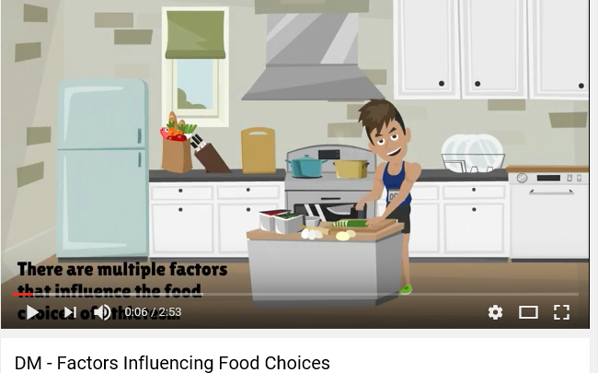
Watch the video for more information on how factors affect athletes food choices.
Click on pic to open hyperlink

Slide 19
Possible answers………..
Discuss Social and health factors that influence consumers’ choice of food products. (10 marks)
Key points to include - social | Key points to include - health
Family size, structure, ageing population | Eatwell plate/reduce fat, salt, sugar, increase fibre, 5 a day
Lifestyle/Hobbies/Work patterns | Allergies/Intolerances
Social class – money available | Diabetes
Travel/Multicultural diet | Vegan/Vegetarian
Eat on the go/Eat out | Food scares – mad cow, horse meat

Slide 20
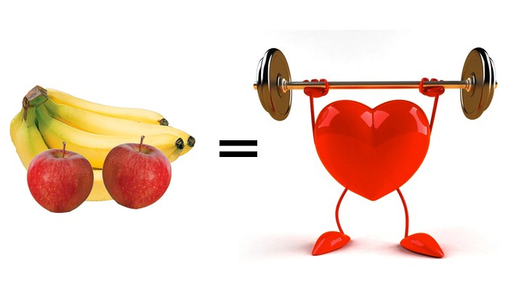
Diet, Nutrition & Health

Slide 21
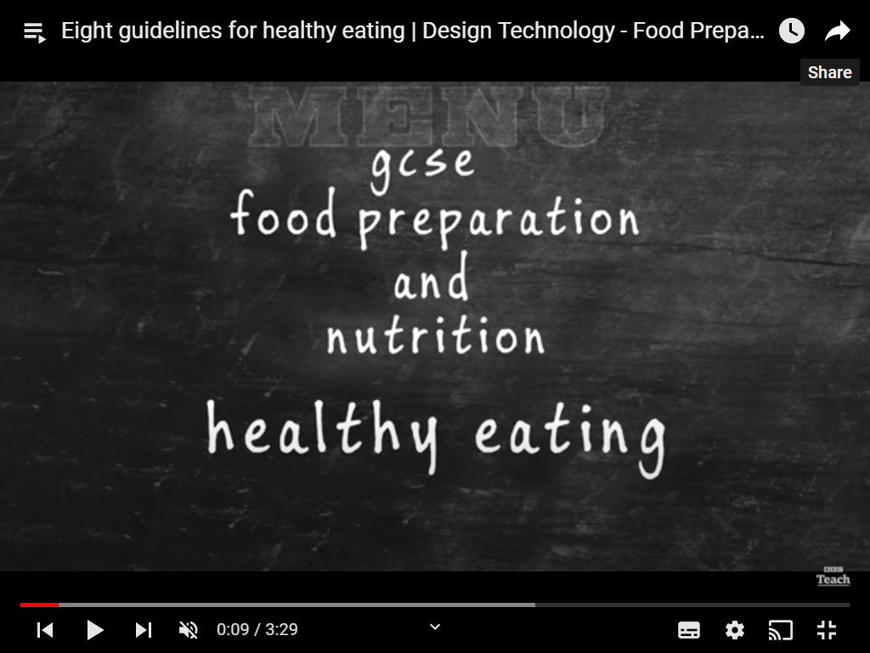
Eight guidelines for healthy eating | Design Technology - Food Preparation and Nutrition

Slide 22
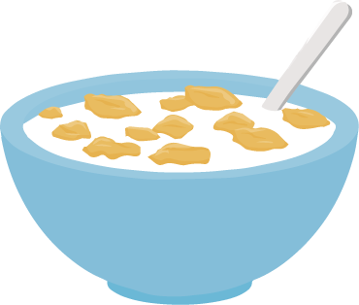


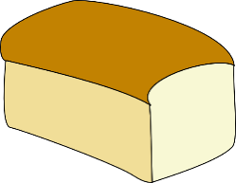

Nutrition
Macro nutrients – FAT, PROTEIN, CARBOHYDRATE. All need in large amounts and measured in grams.
Micro nutrients – Vitamins & minerals. Needed in very small amounts and measured in in mg (milligrams).
Key things to remember:
Protein – For growth, repair, maintenance of body cells. Made from amino acid chains found in animal and vegetable sources. Animals sources are HBV (High Biological Value), Vegetable are LBV (low biological value).
Fat – For Insulation, body warmth, protecting vital organs, act as a carrier for fat soluble vitamins (A,D,E & K), hormone production, supplying essential fatty acids. Saturated fats – mainly found in animals fats are or can be linked to CHD. Examples of saturated fats are butter, ghee, cheese and meat fat. Unsaturated fat (monounsaturated or polyunsaturated) found in vegetable based products – olive oil, avocado etc. This fat helps to reduce bad blood cholesterol and CHD.
All diets must contain fat. A fat deficiency can mean a lack of vitamin A,D,E & K as these can not be absorbed.
Carbohydrate – two types - Complex/starch (pasta, bread, potatoes etc), these give slower releasing energy , help us feel fuller for longer. Simple/sugar ( fruit, veg, honey, sugary drinks ) release glucose very fast , giving us short bursts of energy.
Dietary Fibre (NSP) – 2 types. Soluble – found in oats, peas, beans, carrots and apples IS digested, helping lower blood cholesterol. Insoluble – found in wholegrains, nuts, many fruit & veg. Travels through the digestive system WITHOUT being digested. It is needed absorb water and bulk out poo making it softer and easier to pass. Keeps the colon and bowel healthy by preventing disease.
A diet high in fibre keeps us feeling fuller for longer, which stops people fro snacking and helps maintain a healthy weight. Fibre also helps control blood sugar levels.

Slide 23

Vitamins & Minerals
Vitamins – 2 types.
Fat soluble (Vit A, D, E & K). These are found in fats and foods naturally containing fats. These vitamins can be stored in the liver and fat reserves for later use- when the body needs it.
Water soluble (Vit C and B group). These CANNOT be stored in the body so must be eaten daily. Too much of these are flushed away in urine. These Vitamins are the ones that are easily destroyed by heat & water. Best way to get these is by eating fruit & veg raw!
Minerals
Calcium – Needed to form, strengthen and maintain bones and teeth, blood clotting and for muscles and nerves of the heart. Found in dairy produce, dark green leafy veg. Not enough – rickets and osteoporosis – weak bones!
Iron – Makes haemoglobin, which carries oxygen to cells. Found in red meat, liver, wholegrain cereals, beans, nuts, dark green leafy veg. Not enough? – Anaemia (tired, lethargic etc).
Sodium – Helps maintain water levels in all cells. Controls nerves and muscles. Can often be ‘hidden’ in many processed foods. Too can contribute to high blood pressure and strokes.

Slide 24


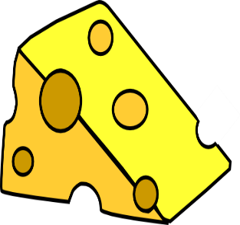

Nutrients working together.
Don’t forget some nutrients work hand in hand.
Vitamin C & Iron – Vitamin C HELPS with the absorption of Iron into the body.
Vitamin D & Calcium – Vitamin D is essential for you to absorb calcium into the body – without Vit D it can’t be absorbed.
Fortification – means when a nutrients such as Iron is added to a food to make it more nutritious. For example , calcium is added
to white bread.
Water
Is not a nutrient but is essential for life because it:
Regulates body temperature
Transports nutrients in the blood
Removes waste from cells
Aids digestion
Can be obtained from all the food and drink we consume. A lack of water caused dehydration resulting in headaches, thirst, dizziness and
poor concentration.

Slide 25
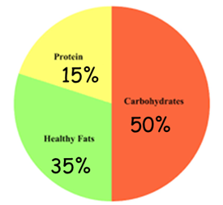
Macro nutrients

Slide 26
Nutrient | Function in the body | Food source
Macro nutrients
Fat
Protein
Carbohydrate (Starch/sugar/Fibre or NSP)
Micro nutrients
Minerals
Iron
Calcium
Sodium
Vitamins
Vitamin A
Vitamin B
Vitamin C
Vitamin D

Slide 27
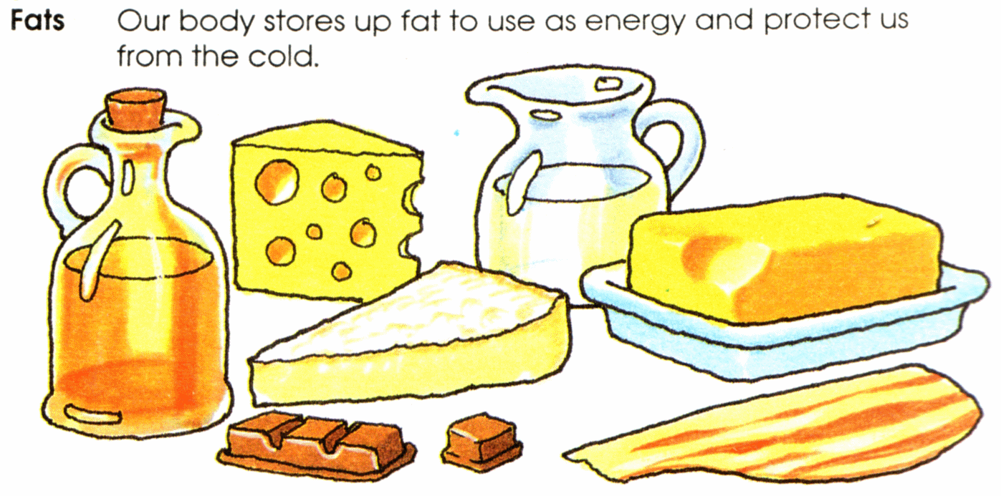
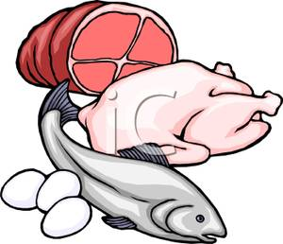
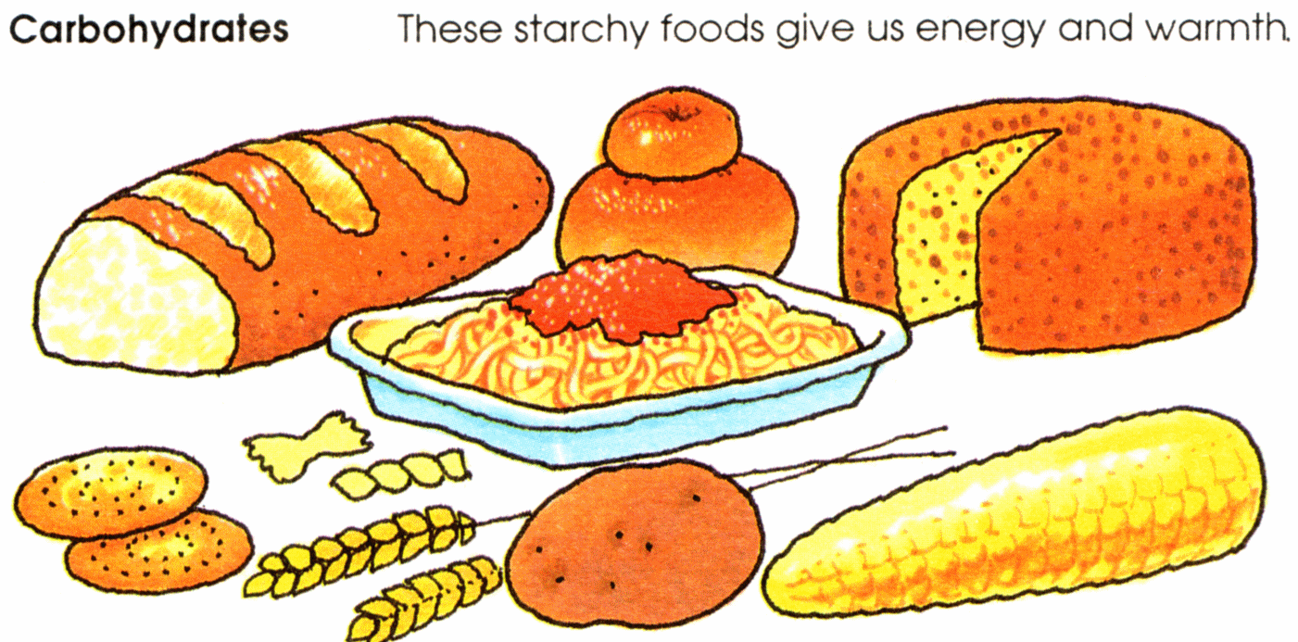
Nutrient | Why we need it (function) | Food it is in (sources) | CHALLENGE Effect of deficiency
FAT | Insulates the body (keep it warm). Protect organs—liver, kidney Gives energy Provides Fat soluble Vits A,D,E and K | Animal (saturated) fat—lard, butter Vegetable (unsaturated) —oil, margarine Too much saturated fat, leads to high cholesterol which could lead to heart disease.
PROTEIN | Growth and Repair of ALL cells in our body. A source of energy. For the production of enzymes. (HBV—High Biological value LBV –Low Biological value) | Made of Amino Acids Animal (HBV)—meat, fish, egg, dairy foods Vegetable (LBV) —nuts, beans, lentils, quorn.
CARBOHY- DRATE | Sugar-simple carb for quick release energy. Starch-complex carb for slow release energy. Fibre helps digestion | Starch— pasta, rice, potato Fibre (NSP) - fruit/veg, whole-wheat bread, rice, pasta. Sugar—sugar, honey, fruit.
Macro nutrients

Slide 28
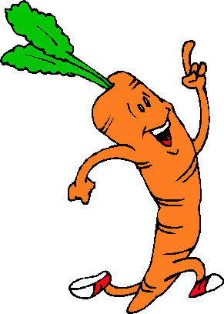


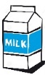


VIT A | Eye sight in dim light. Healthy immune system | Carrot & other yellow/red/orange fruit or veg. Egg, milk, cheese. Liver, oily fish.
VIT B group | To release energy from food. Healthy nervous system | B1 B2 B3 Folic acid Cereal, milk, egg. Meat, green leafy veg.
VIT C | Heal wounds, fight infection. Helps the body absorb iron. | Orange, lemon, green veg, Potato, tomatoes, peppers.
VIT D | Works with Calcium to build strong bones/teeth. | Dairy food, cereals, oily fish, eggs, liver, Sunshine.
IRON | Healthy red blood cells to prevent anaemia. | Red meat, liver, green veg. Beans, wholegrain cereal.
CALCIUM | Strong bones and teeth. For the clotting of blood. | Dairy food, green veg, nuts.
SODIUM (in salt) | Maintains fluid levels in the body. | Salt. Added to bacon, cheese Crisps.
WATER | Regulate body temperature & prevent dehydration. | Tap water, fruit/veg.
Micro nutrients
CHALLENGE – Effect of deficiency

Slide 29
Nutrient |  |  | Function in the body | Food source
Fat |  |  | Gives energy & insulates the body (keep it warm). Protect organs—liver, kidney Deficiency – weight loss/cold | Animal (saturated) fat—lard, butter Vegetable (unsaturated) —oil, margarine
Protein Amino Acids |  |  | Growth. Repair of cells. A source of energy. (HBV—High Biological value LBV –Low Biological value) Deficiency- lack of growth | Animal (HBV)—meat, fish, egg Vegetable (LBV) nuts, beans, lentils, quorn, cereals
Carbs Starch Sugar Fibre(NSP) |  |  | For energy. Sugar is a simple carb for quick release. Starch is a complex carb for slow release energy. Fibre helps digestion, prevents constipation, bowel cancer Deficiency- lack of energy, bowel disorders | Starch— pasta, rice, potato, cereals Fibre (NSP) - fruit/veg, whole-wheat bread, rice, pasta, cereals. Sugar—sugar, honey, fruit.
Minerals
Iron |  | Healthy red blood cells Deficiency- anaemia. | Healthy red blood cells Deficiency- anaemia. | Red meat, liver, green veg. | Red meat, liver, green veg.
Calcium |  | Strong bones and teeth. Deficiency- lack of growth | Strong bones and teeth. Deficiency- lack of growth | Dairy food, green veg, nuts. | Dairy food, green veg, nuts.
Sodium |  | Maintain fluid levels in body. Deficiency- muscle cramp, dizzy | Maintain fluid levels in body. Deficiency- muscle cramp, dizzy | Salt. Added to bacon, cheese Crisps. | Salt. Added to bacon, cheese Crisps.
Vitamins
Vit A | Eye sight in dim light, immune systme. Deficiency- night blindness Fat soluble | Eye sight in dim light, immune systme. Deficiency- night blindness | Eye sight in dim light, immune systme. Deficiency- night blindness | Carrot, tomato, egg, milk, cheese. | Carrot, tomato, egg, milk, cheese.
Vit B | To release energy from food. Healthy nervous system Deficiency- fatigue, B12 – spina bifida in babies Water soluble | To release energy from food. Healthy nervous system Deficiency- fatigue, B12 – spina bifida in babies | To release energy from food. Healthy nervous system Deficiency- lack of growth | B1 B2 B3 Folic acid Cereal, milk, meat. | B1 B2 B3 Folic acid Cereal, milk, meat.
Vit C | Heal wounds, fight infection, help absorb iron. Def – bleeding, bruising, muscle pain Water soluble | Heal wounds, fight infection, help absorb iron. Def – bleeding, bruising, muscle pain | Heal wounds, fight infection. Helps absorb iron. | Orange, lemon, green veg, potato. | Orange, lemon, green veg, potato.
Vit D | Works with Calcium to build strong bones/teeth. Deficiency- bone & muscle pain Water soluble | Works with Calcium to build strong bones/teeth. Deficiency- bone & muscle pain | Works with Calcium to build strong bones/teeth. | Dairy food, cereals. Sunshine. | Dairy food, cereals. Sunshine.

Slide 30

Dietary related health problems

Slide 31
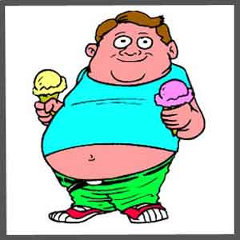
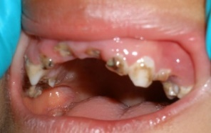

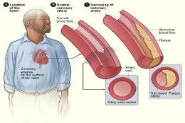
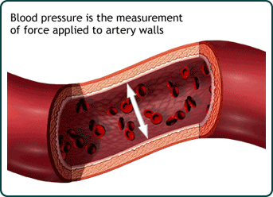

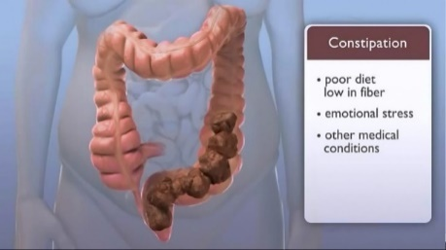
 | Leads to…….. | How to change diet to prevent this
Too much sugar | Obesity Tooth decay Risk of diabetes | Use sweeteners Replace sugar in a recipe with dried fruit Put a bit less sugar in the recipe
Too much fat | High cholesterol Blocked arteries Heart disease. Obesity | Use reduced fat spread, cheese, sausages etc Cut fat off meat e.g. rind off bacon Grill, boil or bake rather than fry
Too much salt | High blood pressure which puts a strain on the heart. | Replace salt with herbs Use a bit less salt in a recipe Eat less salty foods – nuts, bacon or buy a “Low salt “ version.
Too little fibre | Constipation Diverticular disease Risk of bowel cancer | Eat more fruit and veg – especially skins. Switch to “wholemeal” bread, pasta, rice. Increase insoluble fibre intake

Slide 32
Special Diets
Special diets
Diabetic
Low fat/Low Calorie
Low salt
High Fibre
Lactose intolerant
Coeliac
Pregnancy
Nut allergy

Slide 33
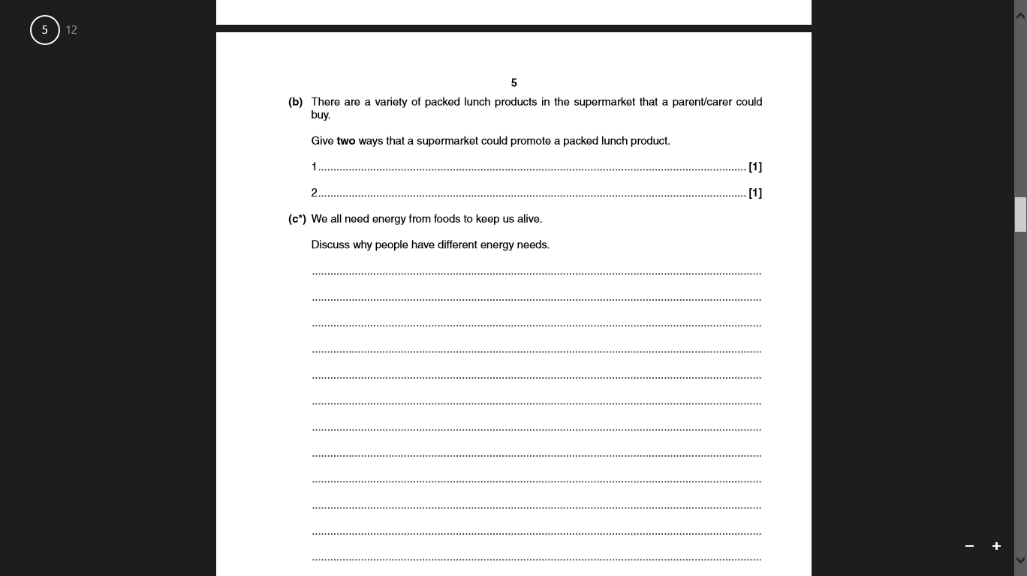
We all need energy from food to keep us alive.
Discuss why people have different energy needs.
What 3 (or 4) points would you include?
How would you explain each?
What examples would you give?
6 marks

Slide 34
Age
Energy input should be greater than energy out put in children. • Older people: tend to use less energy as metabolism slows down due to reduced physical activity.
Gender/Sex
Males tend to use more energy than females as they are bigger and have more muscle tissue.
State of the body
Pregnancy needs extra energy for the growth of the baby. Energy input should be greater than energy out put. • Lactation needs extra energy for the production of milk. • Illness and after operations the metabolism may be reduced due to less physical activity. •
Physical activity/occupation
• People who have physically demanding jobs or take lots of exercise use more energy than people who sit down all day. • energetic jobs like builders or athletes need more energy from their food compared to office workers
Basic Metabolic Rate
This is the rate we burn up calories and it differs with each person. BMR is high in times of growth.
It is affected by, body size, shape, weight, sex, age, rate of growth, amount of sleep, and state of nutrition. •

Slide 35
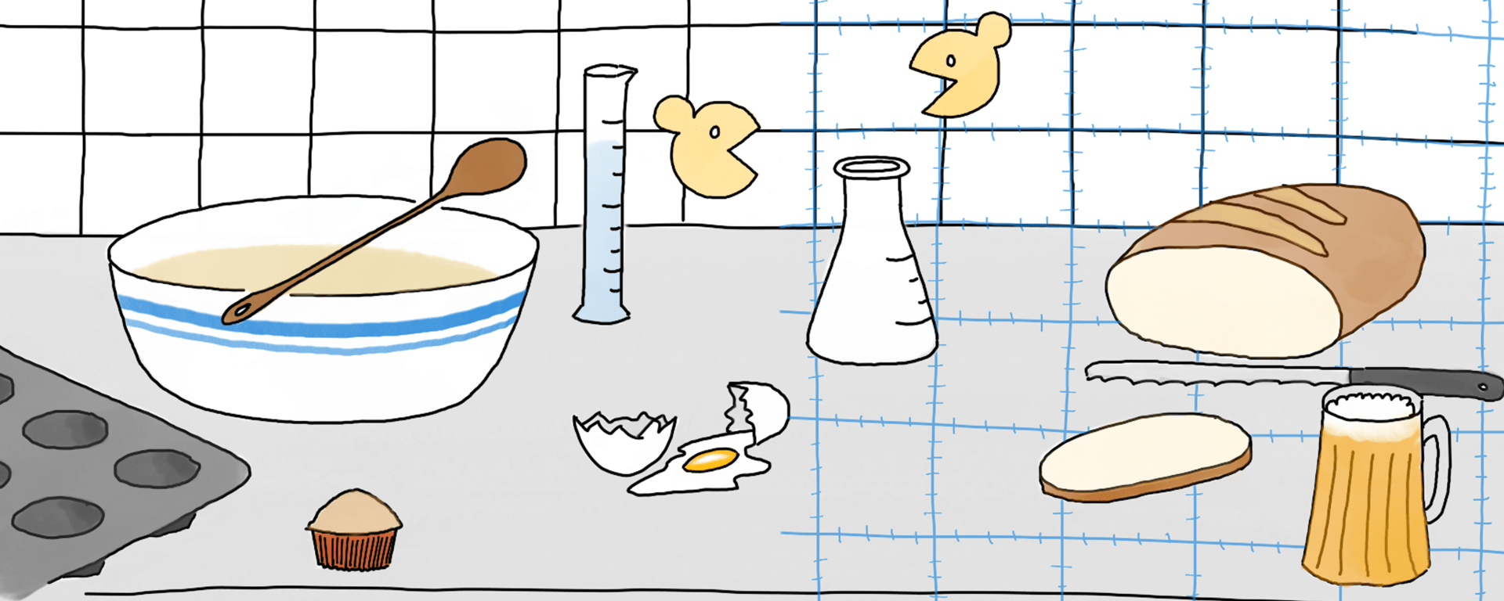
Food Science

Slide 36
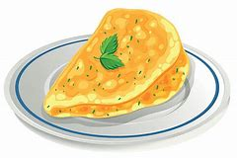
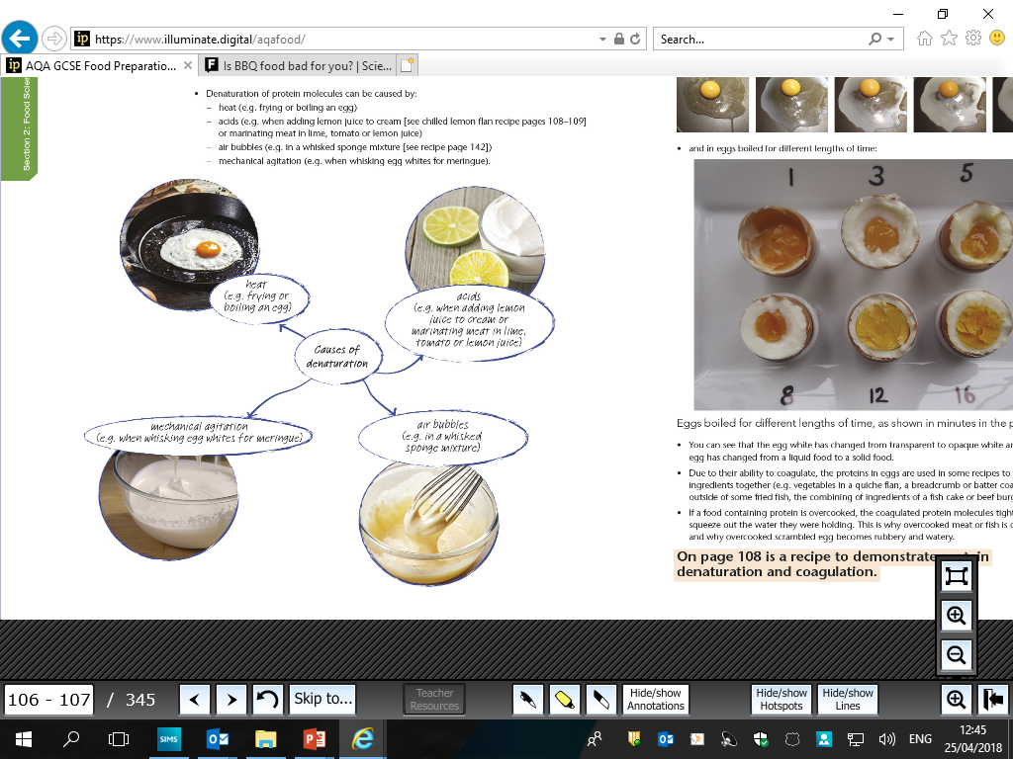

Denaturation & Coagulation

Slide 37
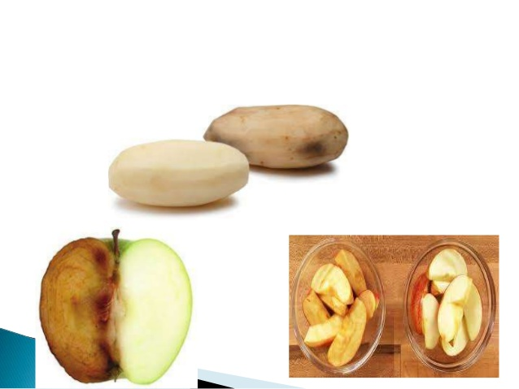
Oxygen
Oxygen can have a negative effect on many foods.
Fruit and vegetables – cut surfaces go brown due to oxidising of enzymes – Enzymatic browning
Meat – the red surface becomes brown/grey due to oxygen affecting the myoglobin.
Fish – oxygen works with fish enzymes
making it spoil rapidly and smell very fishy.
Fats and oils – oxygen turns fats and oils rancid.

Slide 38
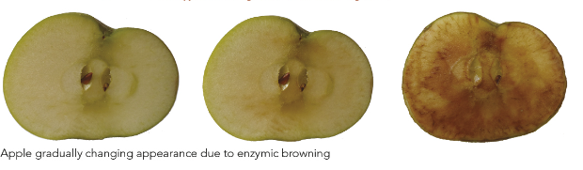


ENZYMIC BROWNING - facts
What causes enzymic browning?
Watch the video in the AQA text book on page 162 on enzymic browning and prevention
Plant cells contain storage vacuoles (spaces) in the centre, which may contain a variety of natural substances. Around the outside of the vacuole is cytoplasm which contains substances called enzymes.
When the cell in broken up, the enzymes in the cytoplasm and oxygen from the air mix with the substances in the vacuole. When substances combine with (pick up) oxygen it is called oxidation. This makes the substances join together and change colour.

Slide 39
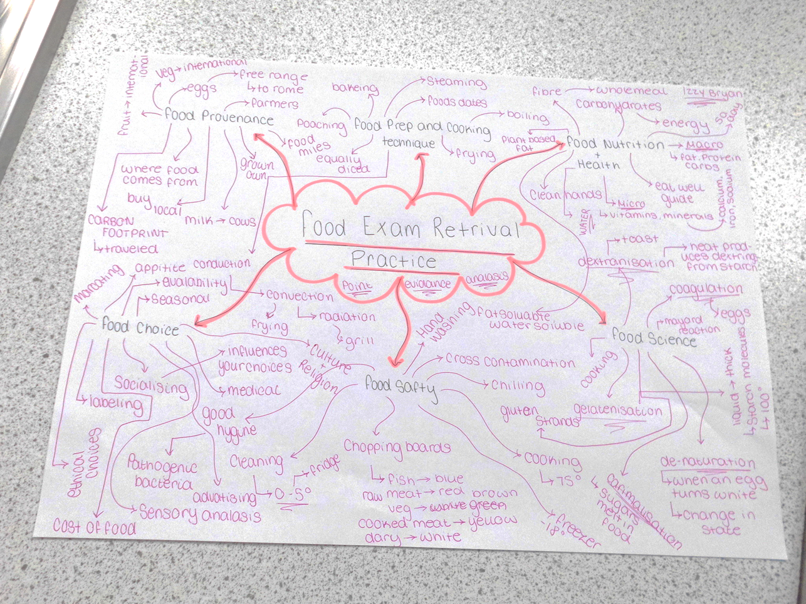
Further Revision Topics
Complete a retrieval mind map based on these topics
Vegetarian Diets
Sensory Testing
Food Production Systems
Seasonal Foods
Food Waste and packaging
The function of Ingredients

Slide 40


What do these terms mean?
Term | Description
Lacto-ovo-vegetarian
Pescatarian
Vegan

Slide 41
What do these terms mean?
Term | Description
Lacto-ovo-vegetarian | Don’t eat meat, fish and poultry; but will eat dairy products and eggs (usually free range).
Pescatarian | Don’t eat meat but will eat fish, eggs and dairy produce
Vegan | Don’t eat any foods of animal origin (will not eat dairy products either); diets comprise vegetables, vegetable oils, cereals, pulses such as beans and lentils, nuts, fruit and seeds

Slide 42
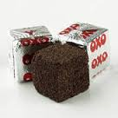
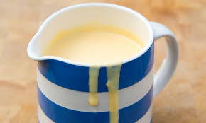
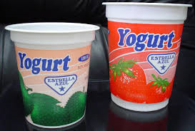
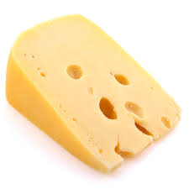
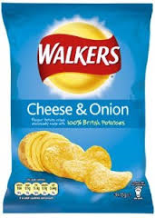
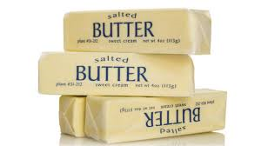
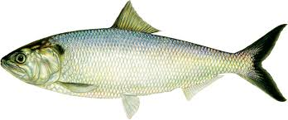
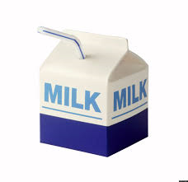
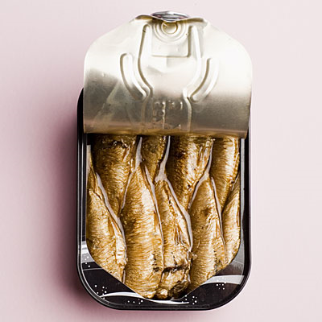

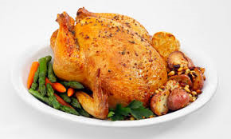

VEGETARIANS & VEGANS
Which of these foods do vegetarians not eat?
Which of these foods do vegans not eat?

Slide 43



Lacto-ovo VEGETARIANS avoid these foods | VEGANS avoid these foods

Slide 44





Vegetarian Alternatives
Many teenagers are adopting a vegetarian style of eating. These need to be well planned to ensure they provide the nutrients needed for growth and health. Such diets can be particularly problematic if they are also low in energy.
Special attention should be given to the iron intake of girls, as iron deficiency anaemia is three times more common in vegetarian teenagers compared with non-vegetarians.
A vegetarian diet that maintains good health in adulthood may not necessarily be appropriate for infants and young children.
Alternatives for protein

Slide 45
Why do people choose a vegetarian diet?
There are many reasons why people choose to follow a vegetarian diet.
Religion – vegetarianism is the dietary choice for several religions.
Animal welfare – some people believe that it is wrong to kill animals for food or they may object to the way animals are reared and kept in intensive farming.
Taste – some people don’t like the taste and texture of meat or fish. Allergy or intolerance is not usually a reason.
Health – some people think that a diet which includes cereals, fruits, vegetables, pulses and nuts, possibly with the addition of milk products and eggs, is healthier than one that contains meat and meat products.
Environmental issues – people may feel that meat production is expensive compared with cereal and crop production, and that it is wasteful in resources and pollutes the environment

Slide 46
Adapting recipes
How could you adapt the following dishes to make them suitable for vegetarians?
DISH | ADAPTATION
Chicken curry
Lasagne
Fish Cakes

Slide 47



Adapting recipes.
Original recipe
Ingredients
2 chicken breasts
2 cloves garlic
2cm root of fresh ginger or 1 tsp dried
1 TBSP oil
2 vegetables of choice
2-4 TBSP soy sauce
The meat can be swapped for Quorn
Could be a vegetable stirfry by using adding more vegetables and no meat
Could be a vegetable stirfry by using adding more vegetables and no meat
The recipe can be halved.
Can miss out some of the herbs and spices
Chicken stirfry

Slide 48

Sensory Taste Testing
LO – To know how to produce accurate and fair results when carrying out sensory analysis.
LO – To learn about the different types of tests which can be used in sensory analysis.
When describing food for sensory analysis what 2 words can you not use?
NICE
Urgh, I don’t like this!
STARTER
HORRIBLE
This is because they do not tell you any detail about the product being tasted – for example, how you could make it nicer or less horrible.
Instead, descriptive adjectives should be used to describe the product.
If food is being tasted as part of research to help develop food products, such statements should not be used – in fact they are banned!

Slide 49





What sensory organs are used?
Hear the snap of a crunchy biscuit and the fizz of a drink.
Touch a ripe pear and crusty bread.
Taste lemons, chocolate and blue cheese.
Smell coffee and bread freshly made.
See a ripe banana and a trifle decorated with piped cream.
When tasting food and describing what the food is like, descriptive adjectives should be used. This is done by using all five sensory organs.

Slide 50





Can you guess the food being described?
a crumbly and fatty base with a yellow, smooth, tangy and sweet filling as well as a light, sweet, fluffy and eggy topping
rich, fatty, sweet, light brown with a bit of a crunch but then smooth
a fragrant, juicy, orange, sweet and oval fruit
juicy, meaty, a little spicy, a little chewy, a long thin shape
yeasty, crumbly, doughy
lemon meringue pie
bread
mango
chocolate
sausage

Slide 51

How is sensory analysis carried out?
How can sensory analysis be carried out so that it is fair?
Three different types of test (preference, discrimination, grading) are used in sensory analysis.
Notes:
How can sensory analysis be carried out so that it is fair?
Individual booths so that the testers are not distracted or influenced in any way
Controlled lighting
Identically-sized food samples served in dishes of the same colour
Water or lime juice for drinking between foods and crackers for eating
Clear instructions on how to carry out the sensory test

Slide 52



Slide 53
Types of Sensory Tests
Sensory tests can be split into 3 categories.
Preference (used to see whether people enjoy a food)
Discrimination (check if people can tell the difference)
Grading (used to compare food characteristics)

Slide 54
How is sensory analysis used in industry?
Food manufacturers use sensory analysis to develop new products and check the quality of existing products. Sensory analysis is used to:
monitor regular samples from the production line
measure the shelf life of a product
find out if people can distinguish between a ‘new improved’ product and the original one
monitor the development of a new product
check that a new product is liked by consumers.

Slide 55

Food Production Systems
www.illuminate.digital/aqafood
Student Username: SWALTON3
Student Password: STUDENT3
Use your online textbook to research Food Production Systems page 274

Slide 56


Seasonal Food
Unscramble the following words.
Why is it important to try to eat seasonal food?

Slide 57





Slide 58

What does seasonal food mean?
Different foods grow better at different times of the year.

Slide 59

Food Waste
Watch BBC bitesize video’s to find out more

Slide 60

The function of Ingredients

Slide 61


Have a go at the bacteria quiz in the Mock exam File
There are 10 questions.
Write down numbers 1-10

Slide 62


ONLINE TEXT BOOKS
Use the online textbook to complete a quiz for each main topic to help with your revision
www.illuminate.digital/aqafood
Student Username: SWALTON3
Student Password: STUDENT3

