Slide 2
Why choose Select?
At Select, successful school trips are our business - we have a collective 150 years’ of experience within school educational and ski tours, ensuring the best team to take care of you.
Our commitment to health and safety is inherent in everything we do. We have rigorous procedures in place to ensure consistent standards are achieved and adhered to for all of our travelling guests.
24 hour emergency contact number and medical assistance service.
Fully Comprehensive Winter Sports Travel Insurance and Snow Guarantee Insurance included.
We are 100% financially protected with ABTA, ATOL and members of STF with LOtC badge.

Slide 3
What’s included:
6 nights full board accommodation including packed lunches. 30 hours of ski tuition – 5 hours per day 6 days hire of skis, boots, poles and helmets
6 day lift pass
Fully Comprehensive Winter Sports Travel Insurance
Dedicated Resort Représentative
Transport
24 hour emergency contact number & medical assistance service
Snow Guarantee Insurance
In-house evening entertainment programme organised by dedicated resort representative

Slide 4
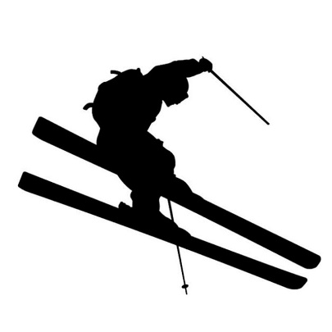
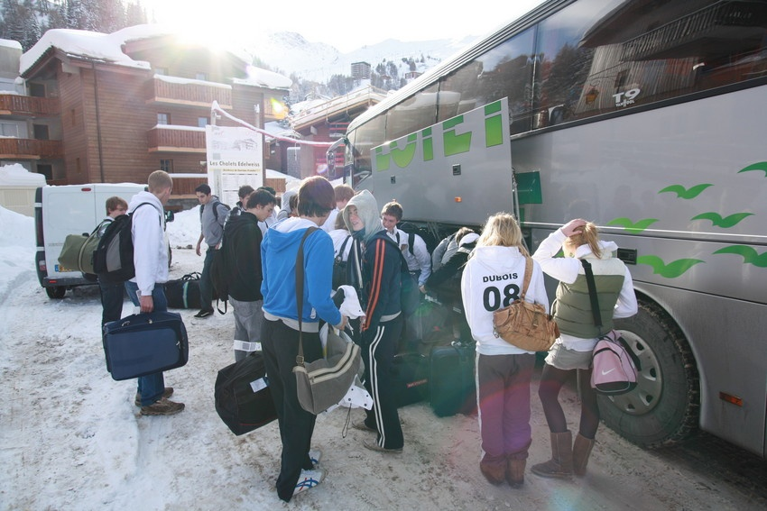
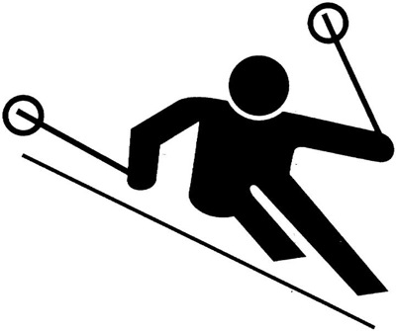
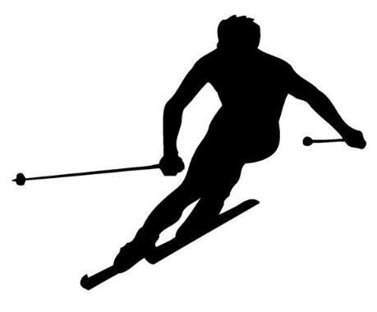
Travelling By Coach
Departing on 9th February 2024
Full specification luxury coach
Featuring seatbelts, toilet and
Video/DVD machine
Cross channel ferry
from Dover to Calais

Slide 6
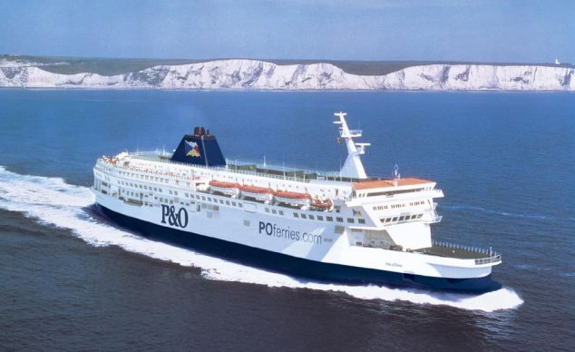

Slide 7
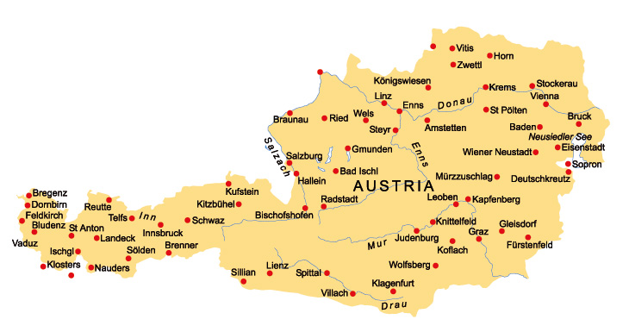

Slide 8
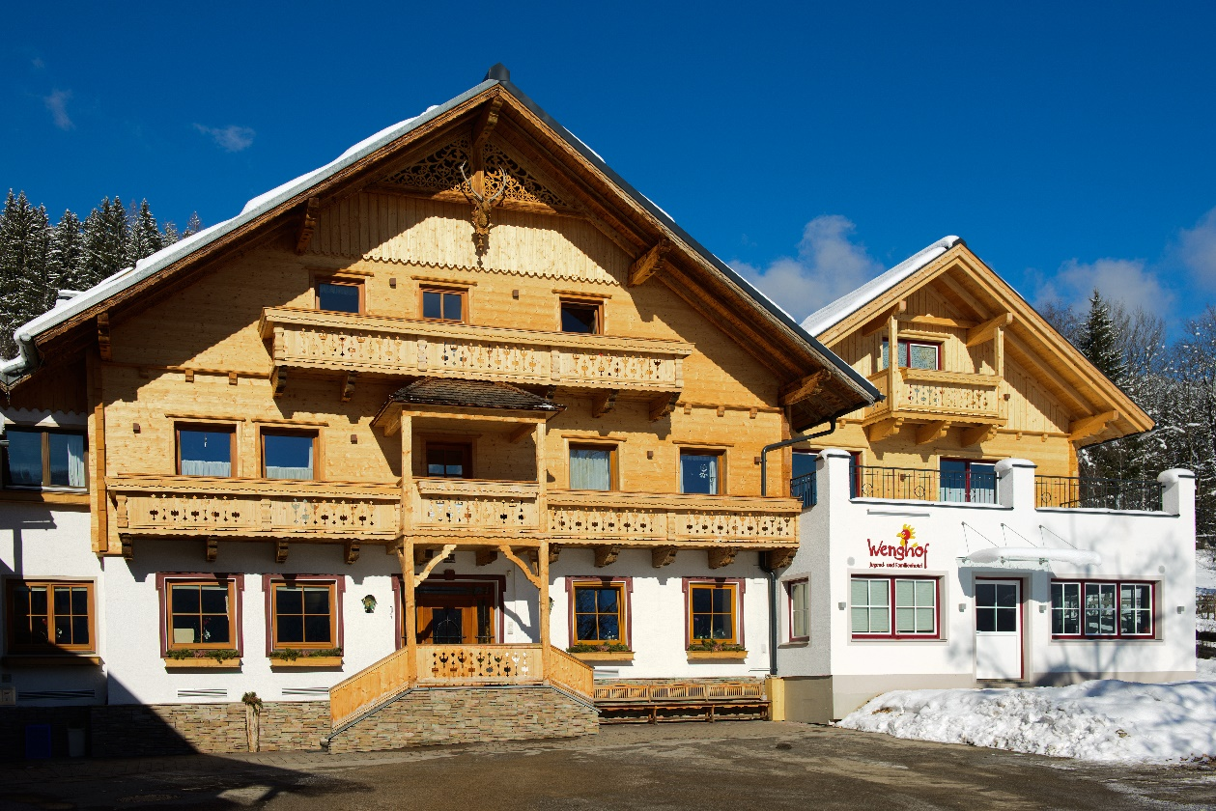
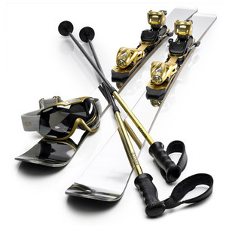
Amade – Pension Wenghof
This property offers a high standard of accommodation and a great welcome from the friendly Steiner family.
Facilities include a large dining room excellent games room with table tennis / table football and disco facilities
Groups are accommodated in 2 - 6 bedded rooms all with ensuite facilities

Slide 10
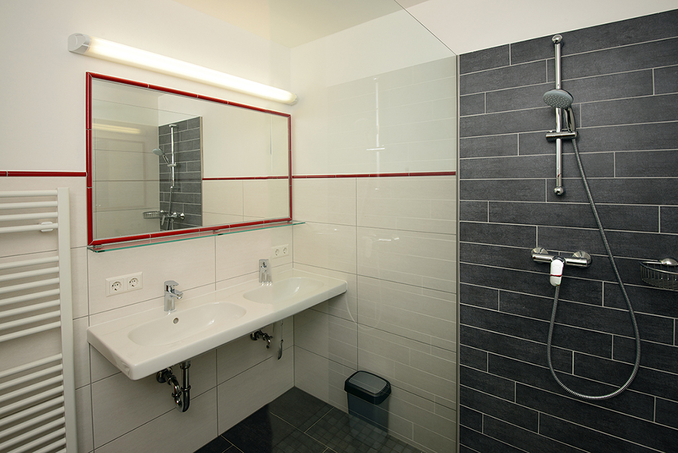
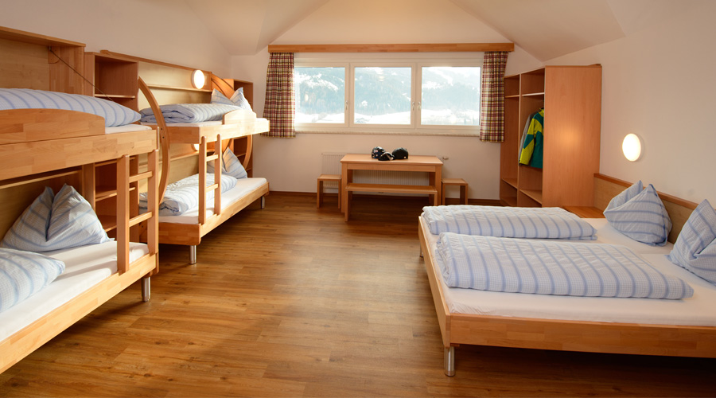
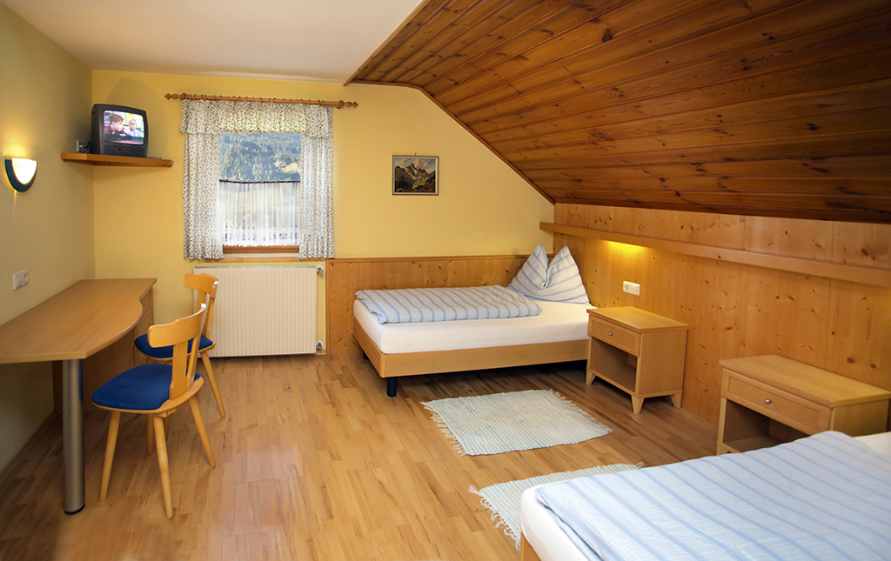

Slide 11
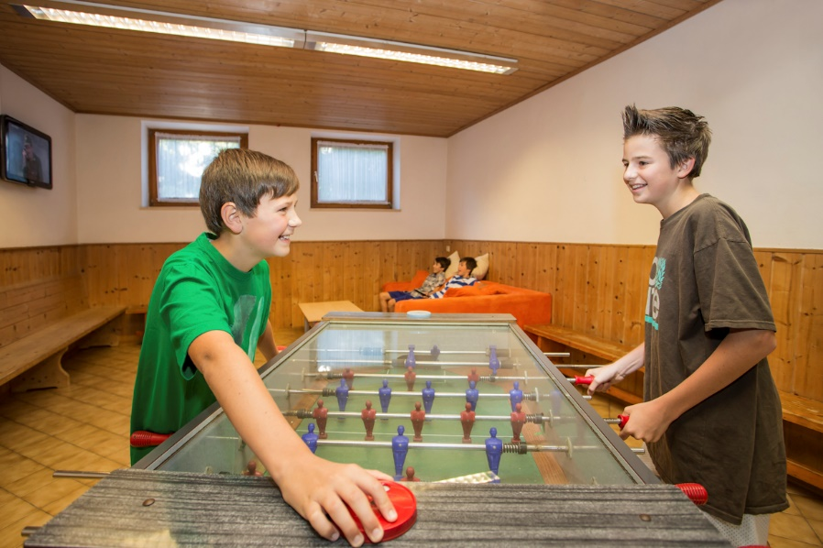
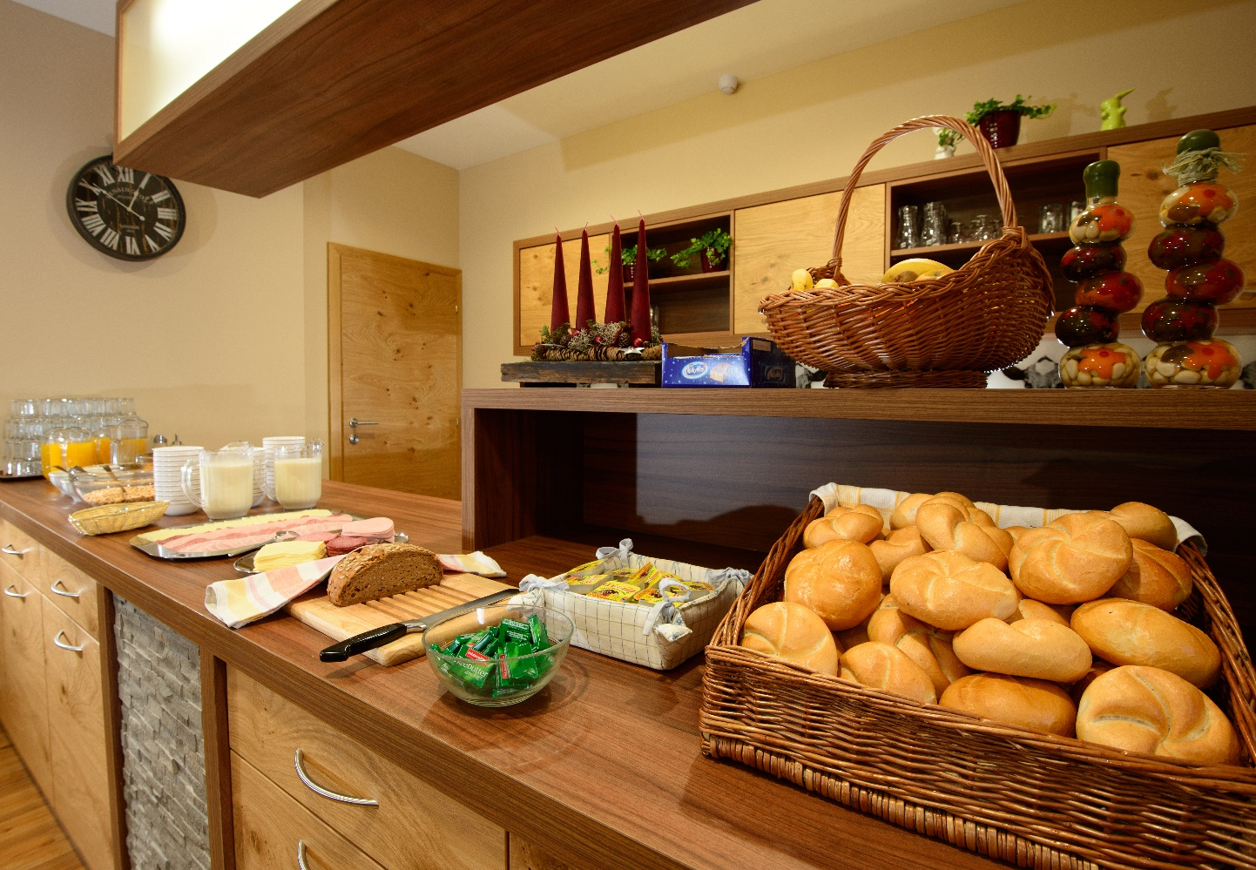
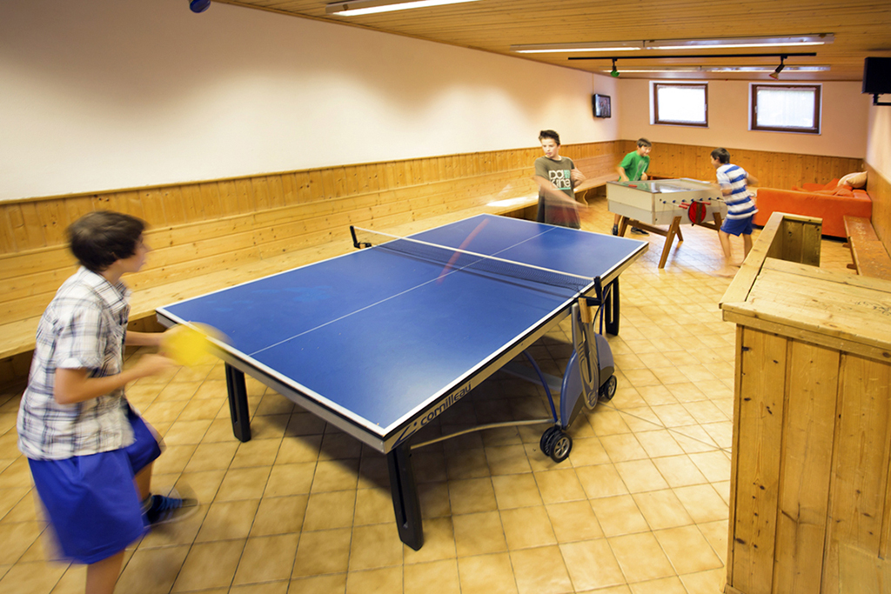

Slide 12
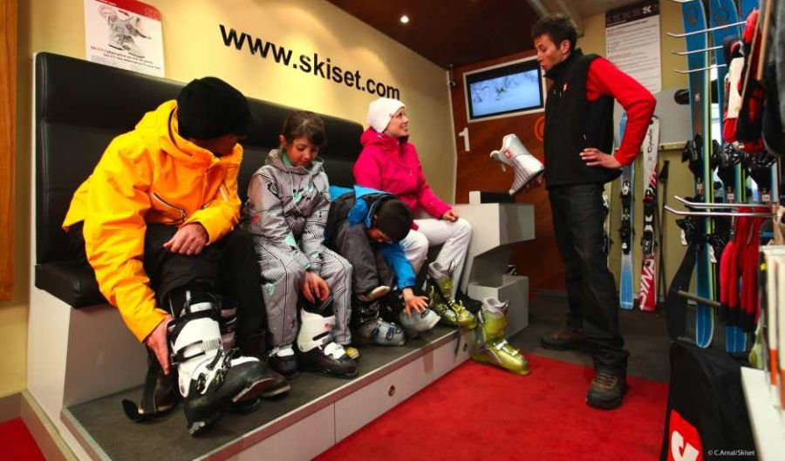
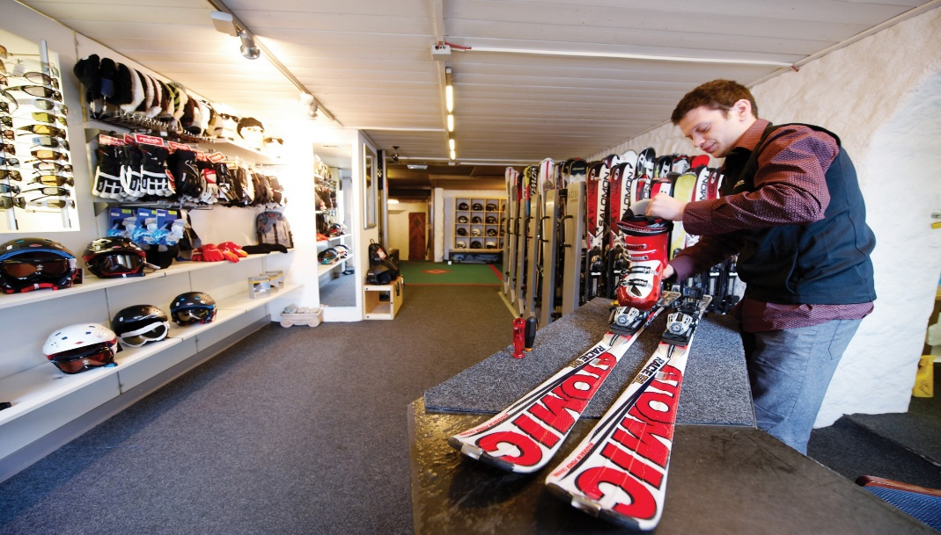
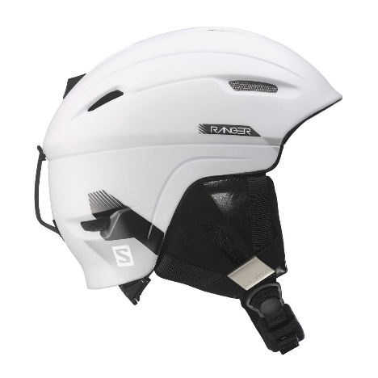
SKI FIT
We use high quality ski equipment
Ski fit will be carried out at a local ski fit shop
We use high quality ski equipment
Ski fit will be done at the local ski fit shop

Slide 13
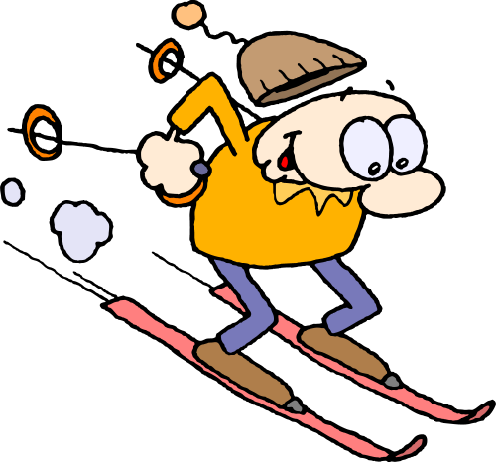
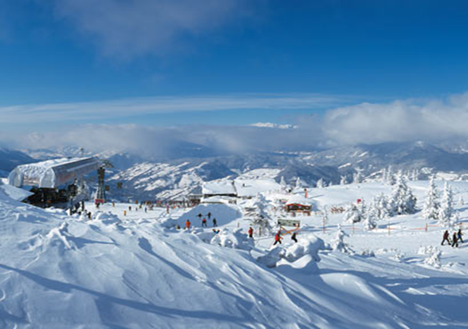
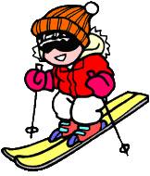
Amade Ski Area
Salzburger Sportwelt – 350km piste whole Amade ski region – 860km piste
140 blue, 170 red, 40 black runs
Highest lift – Salzburger Sportwelt 2188m whole Amade region 2700m
Number of lifts 99 Salzburger Sportwelt, 252 Whole Area
90% of the ski area has snow cannons
Longest run 8km
Great resort for all abilities

Slide 14
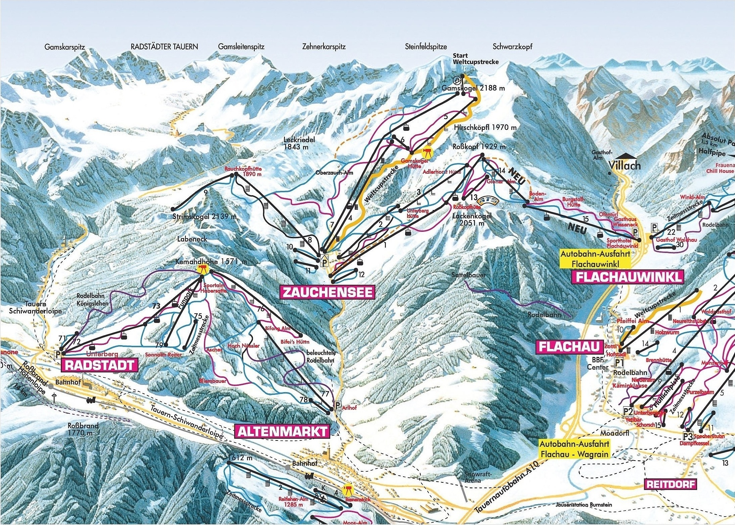

Slide 15
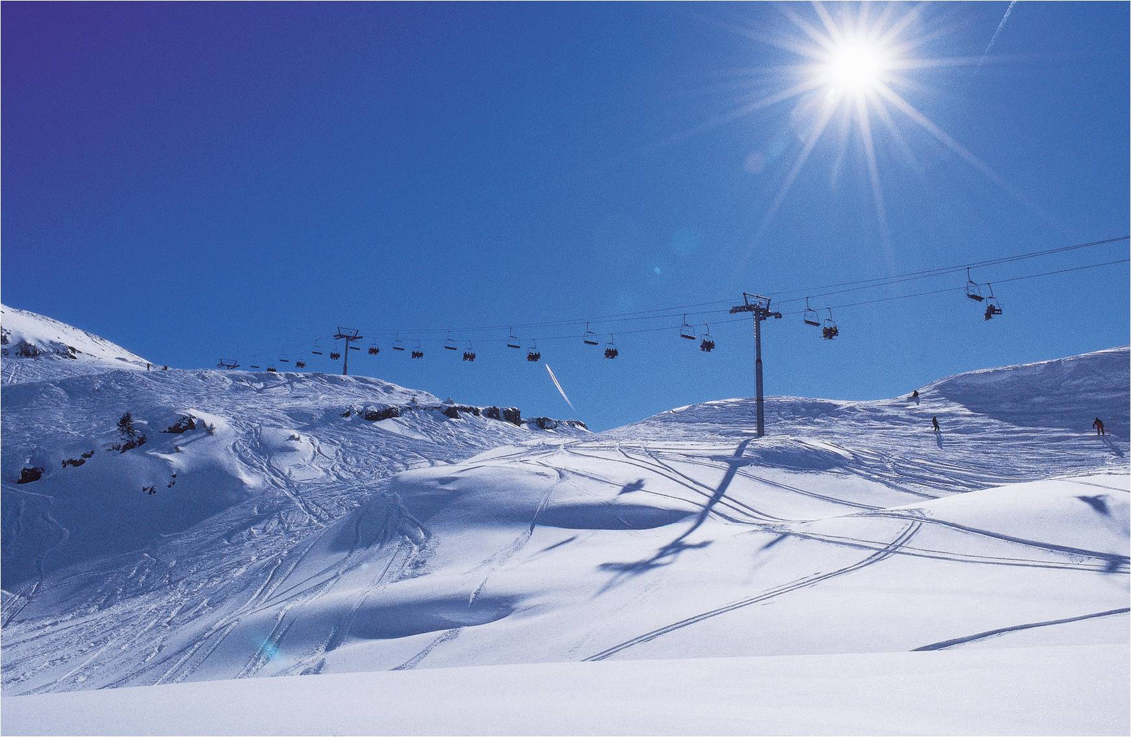
Salzburger Area:
350 Km Pistes
100+ ski lifts
125,000 skiers per hour!
Dachstein Glacier 18Km away

Slide 16
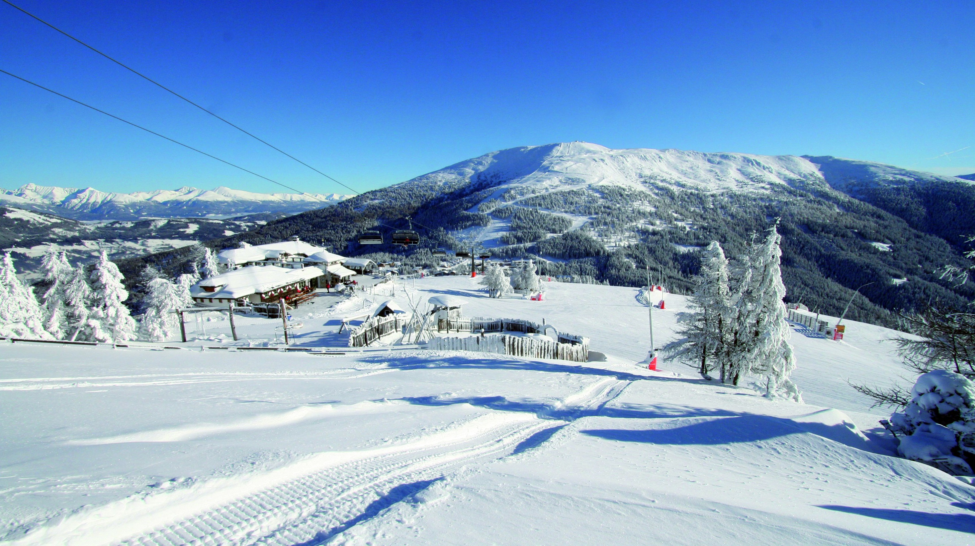
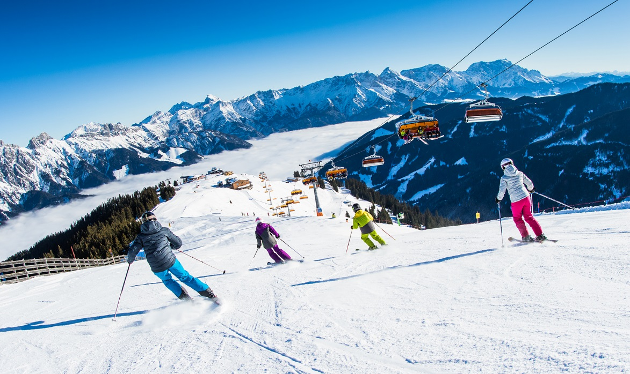

Slide 17
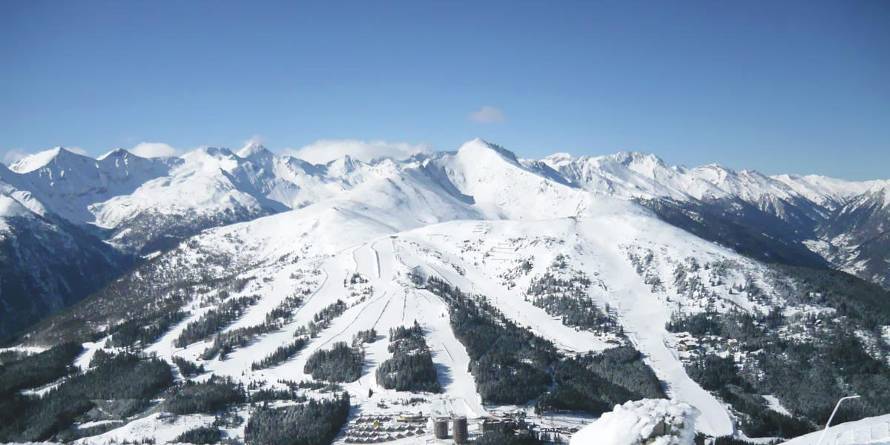

Slide 18
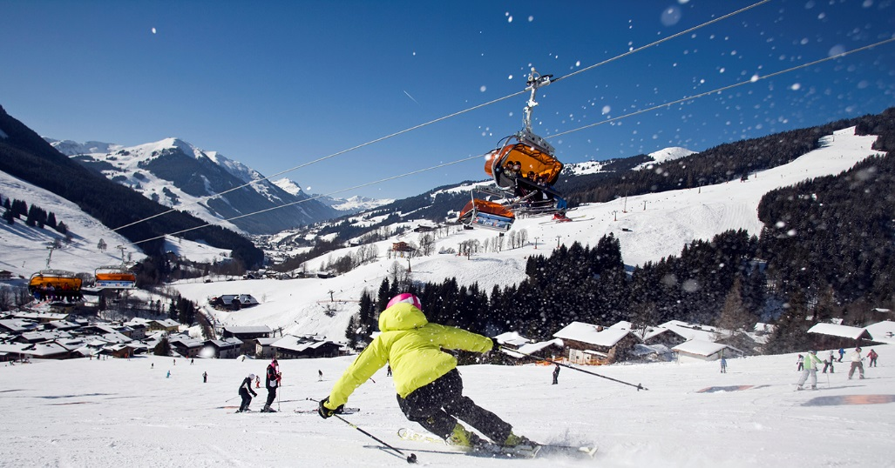

Slide 19
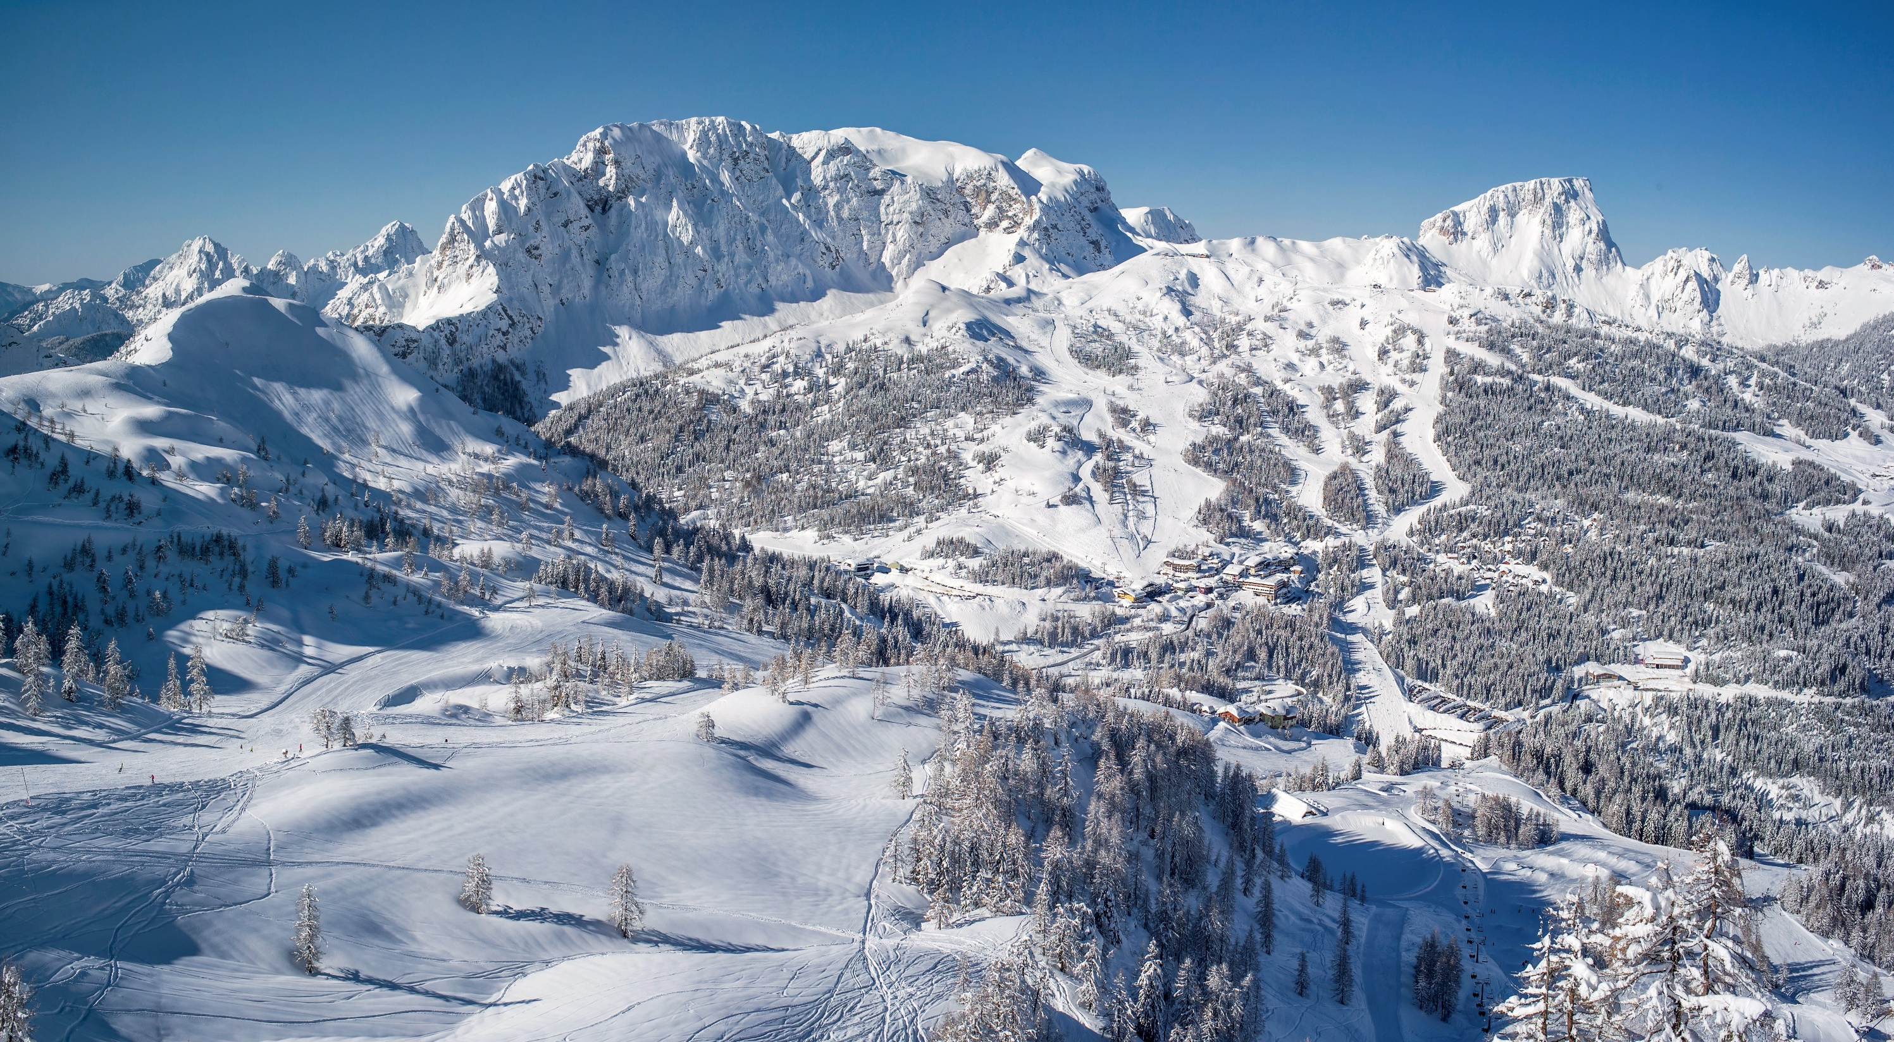

Slide 20
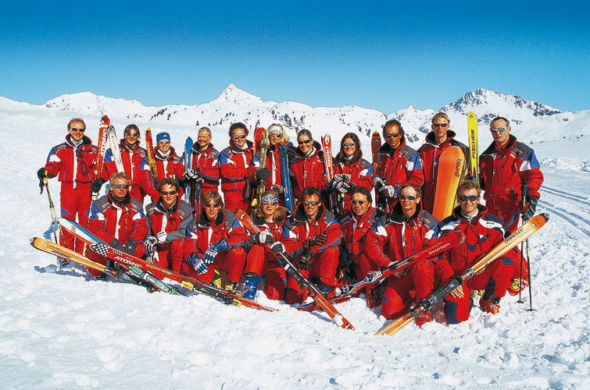
AUSTRIAN SKI SCHOOL

Slide 21
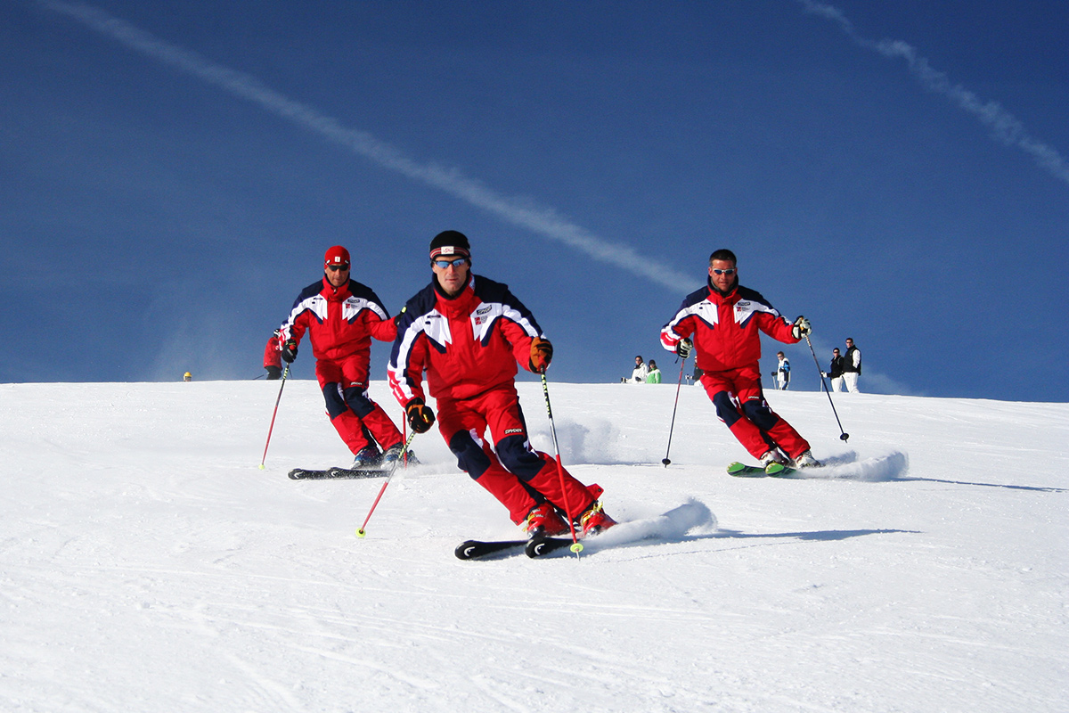
5 x Hours Daily Instruction

Slide 22
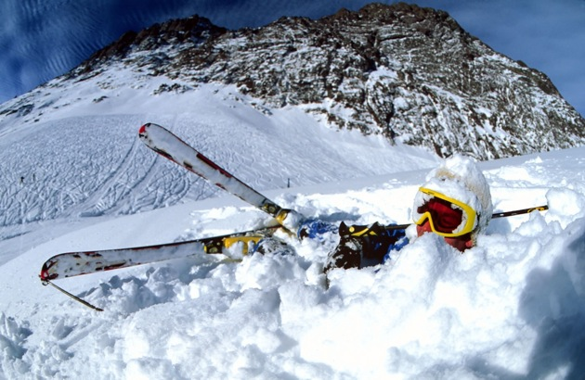
Day 1!!

Slide 23
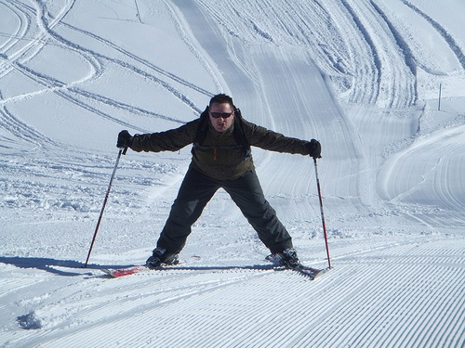
DAY 2

Slide 24
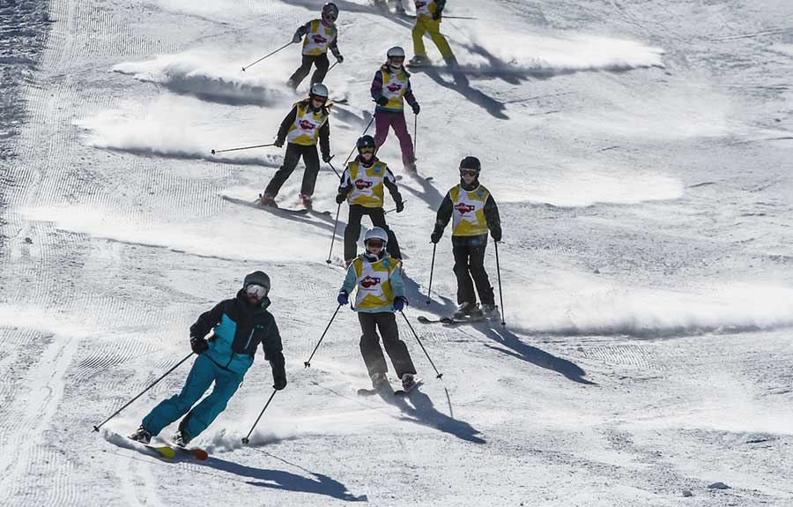
DAY 2
Day 3

Slide 25
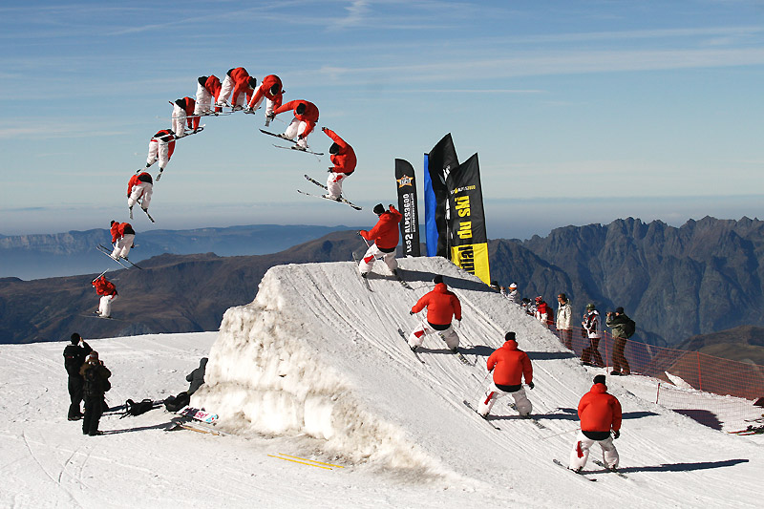
DAY 4!!

Slide 27
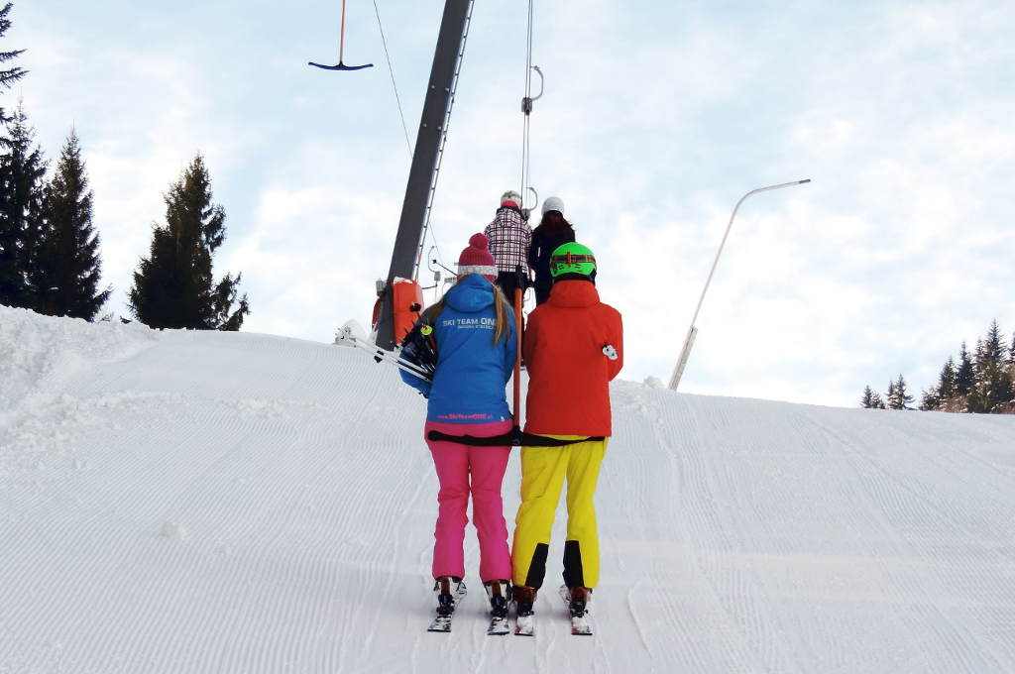
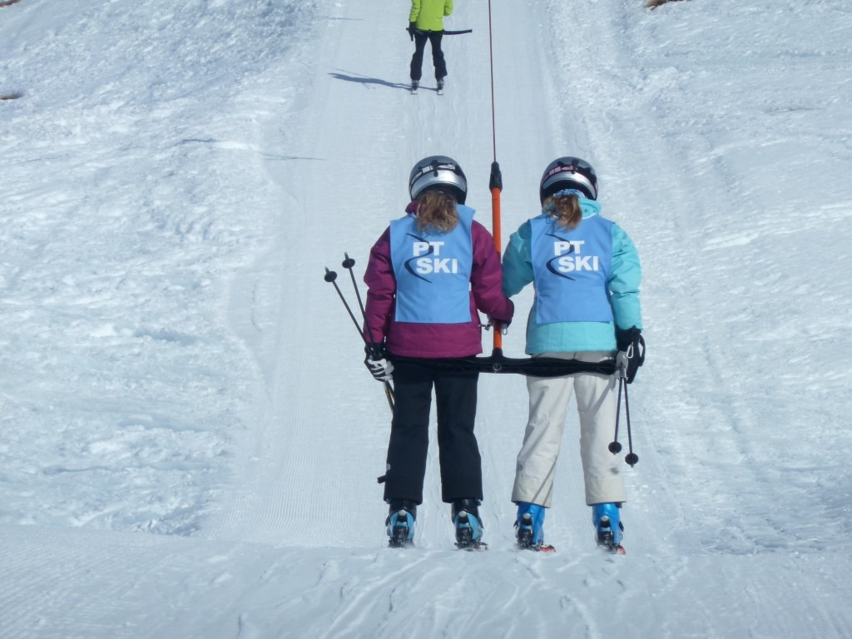

Slide 28
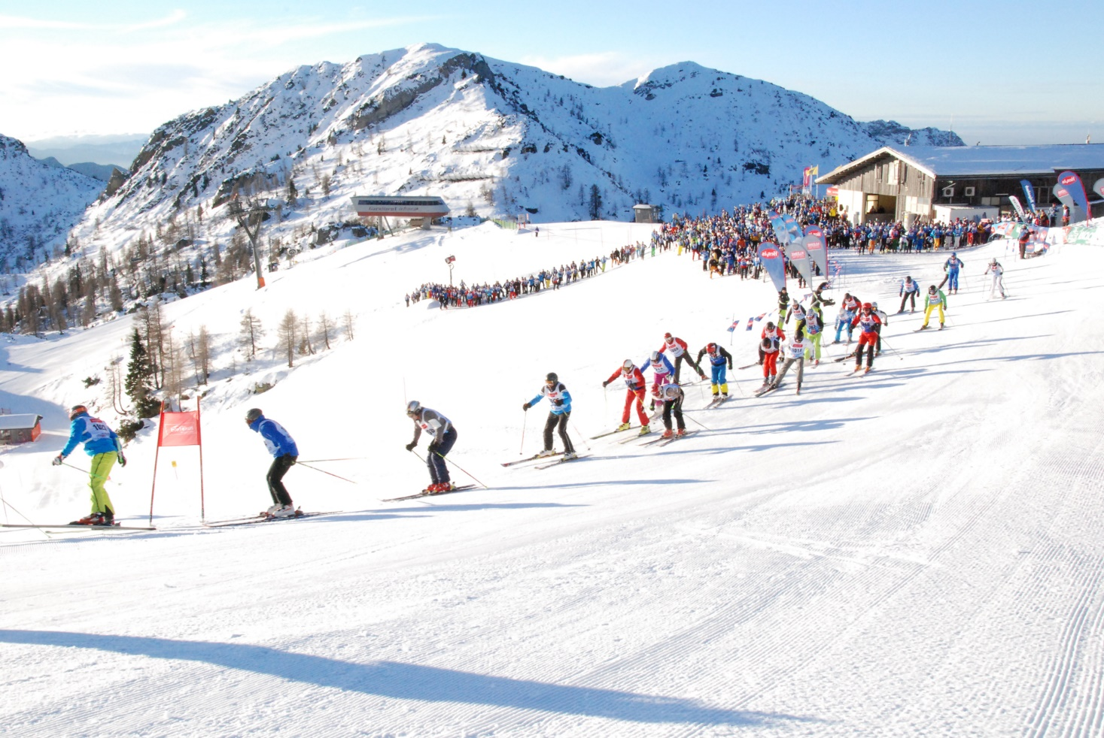

Slide 29
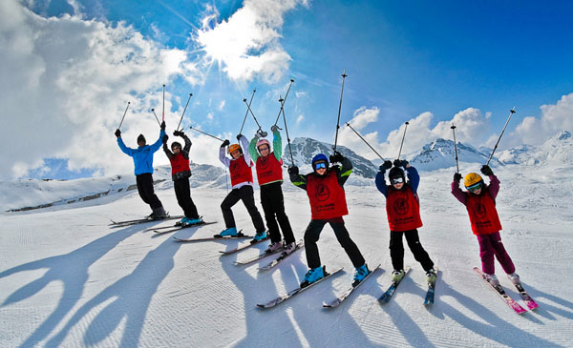
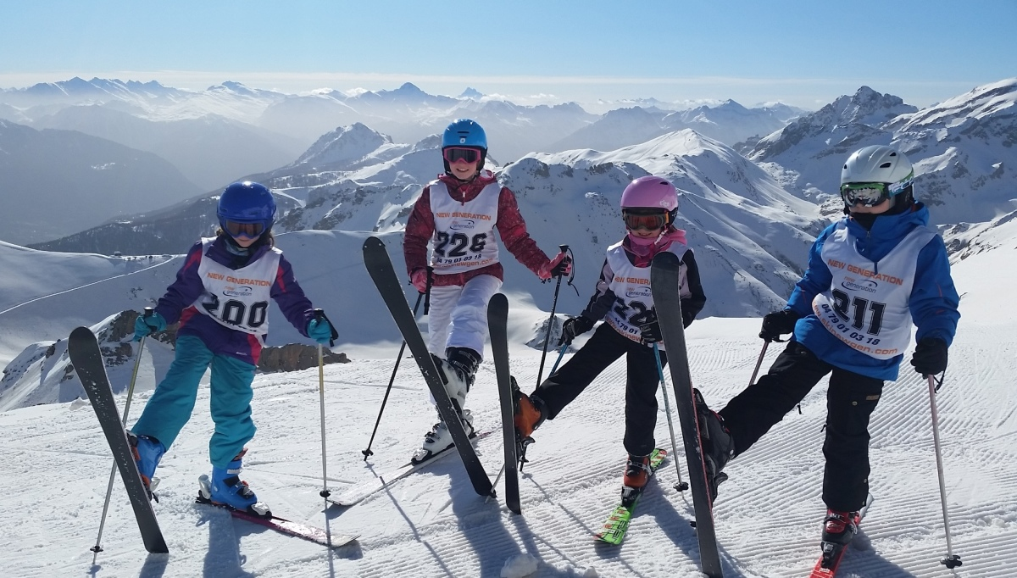
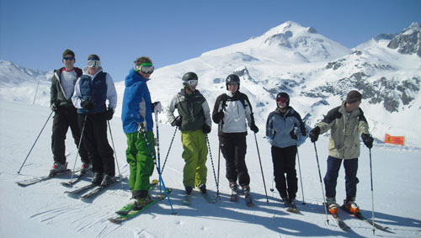
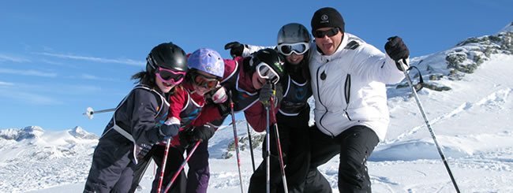

Slide 30
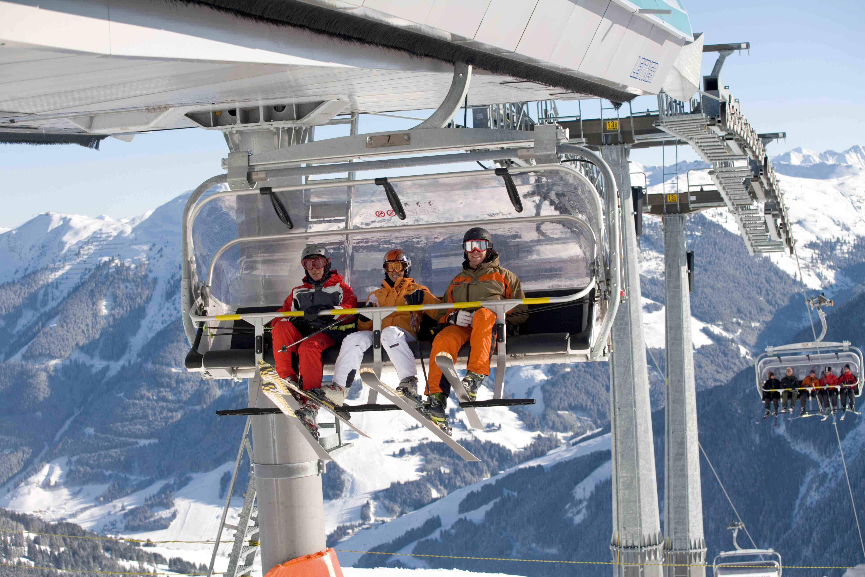

Slide 32
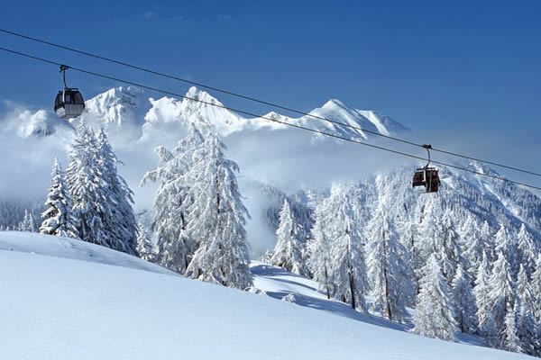

Slide 33
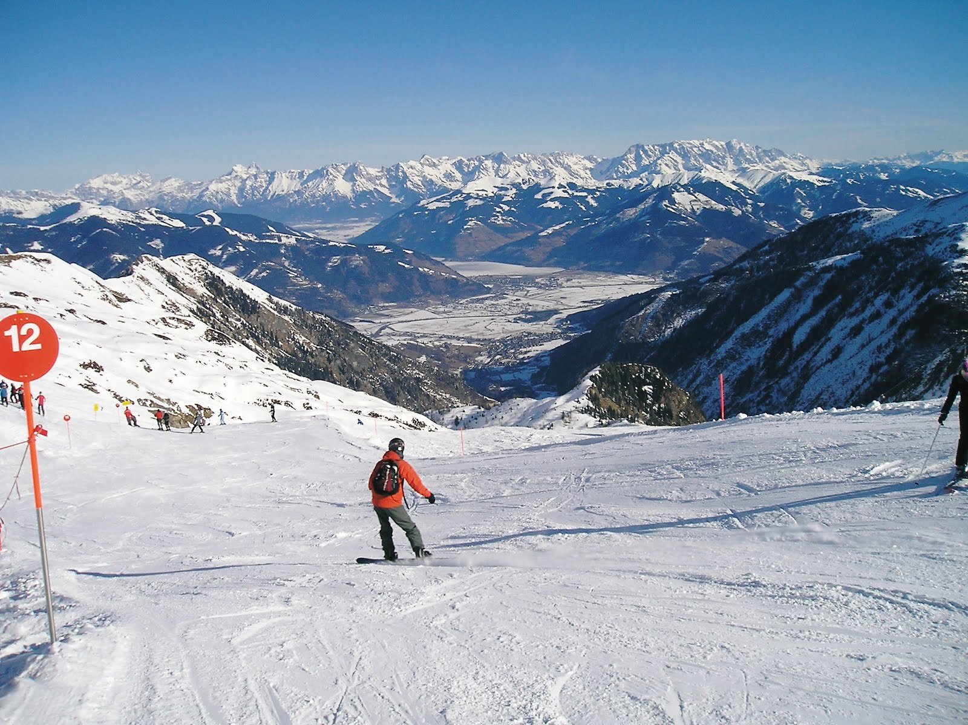

Slide 34
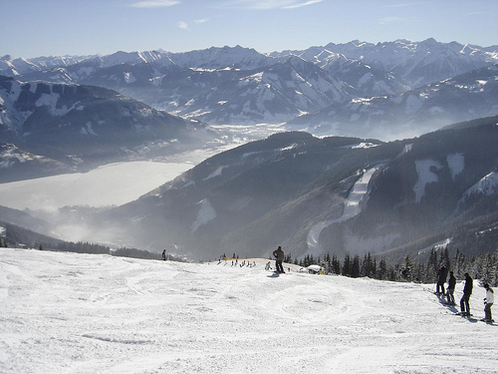
“TAKE CAMERAS”

Slide 35
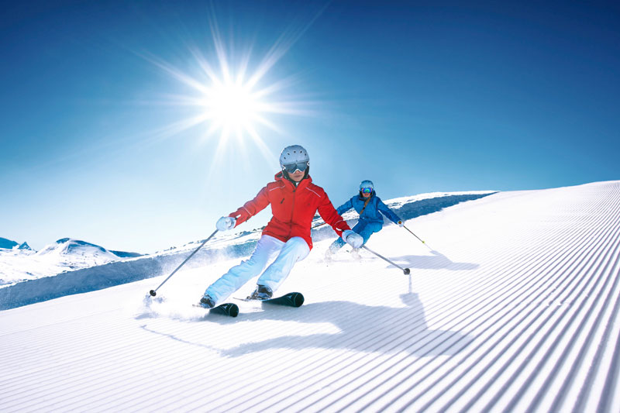

Slide 36
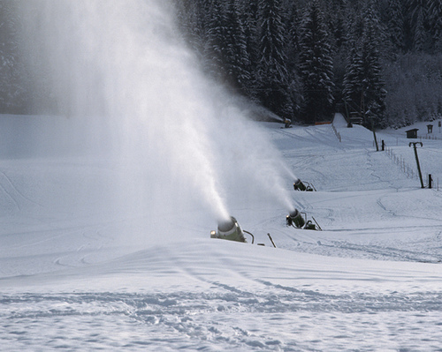
90% COVERED WITH SNOW CANNONS

Slide 37
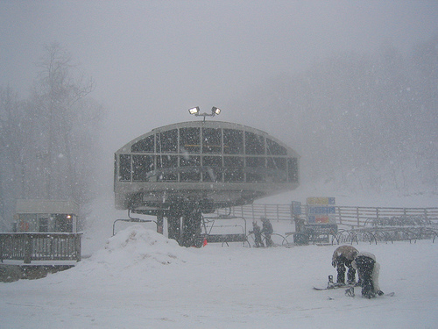
NOT ALWAYS BLUE SKIES!!

Slide 38
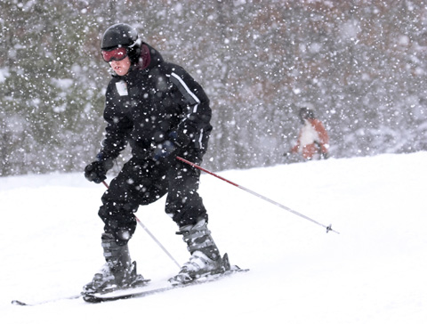

Slide 39
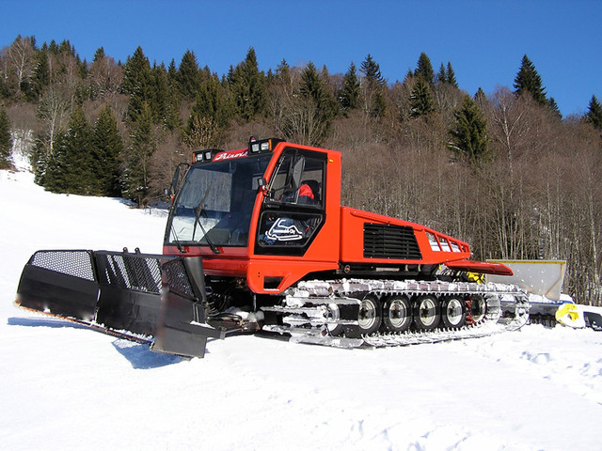

Slide 40
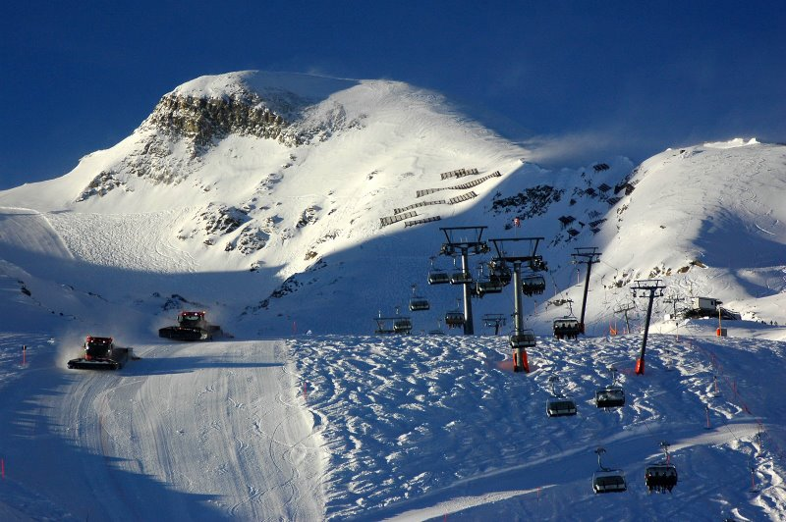

Slide 41
Après Ski
Apres Ski activities Quiz swimming, disco, ski show , pizza night, bowling, curling, ice hockey match

Slide 42
Any questions?

