Slide 1
Walton Sixth Form
Open evening

Slide 2
Meet the Team!
Director of Sixth Form - Mrs Cooper
Heads of Sixth Form – Miss Weaver, Mr Baker, Miss Melling
Sixth Form Administrator – Mrs Wellings; sixthform@walton.staffs.sch.uk
Form Tutors
Subject staff
Wellbeing counsellor – Wendy Baddeley
Careers adviser – Becky Green
Current and Alumni students
Parents

Slide 3
What is on offer?
A Personalised Programme of Study
A broad range of courses
Enrichment and extra opportunities
A well equipped Sixth Form study centre and café
Lots of support!

Slide 4
How many subjects?
We recommend 3 A Levels – Some students start on 4
An opportunity to do an AS in French or German and others
Potential for a mix of A level and other qualifications
Enrichment – some of which are extra qualifications

Slide 5
Entry Criteria
Every prospective student is considered on their merits.
Typically - 5 GCSE passes at Grade 5 - 9 in at least four subject areas including Maths and English Language grade 4
Many individual subjects have further specific entry requirements – please refer to the Course Guide

Slide 6
ART
BIOLOGY
BUSINESS STUDIES
CHEMISTRY
COMPUTER SCIENCE
CORE MATHEMATICS
DESIGN AND TECHNOLOGY (PRODUCT DESIGN)
DESIGN AND TECHNOLOGY (FOOD SCIENCE & NUTRITION)
DESIGN TECHNOLOGY (FASHION & TEXTILES)
DRAMA & THEATRE
ECONOMICS
ENGLISH LANGUAGE & LITERATURE
ENGLISH LITERATURE
EXTENDED PROJECT
FILM STUDIES
FORENSIC SCIENCE & CRIMINAL INVESTIGATIONS
FRENCH
GEOGRAPHY
GERMAN
HISTORY
MATHEMATICS
FURTHER MATHEMATICS
MEDIA STUDIES
MUSIC
PHOTOGRAPHY
PHYSICAL EDUCATION
PHYSICS
PSYCHOLOGY
RELIGIOUS STUDIES (PHILOSOPHY & ETHICS)
SPORT BTEC
SOCIOLOGY

Slide 7
Which subjects should students choose?
Subjects which you enjoy and which interest you
Play to your strengths – subjects which you are good at
The desire to study something new
Subjects that will help you with your next move

Slide 8
What subjects should you take?
“Choosing a handful of subjects to take at A-level isn't a decision you should take lightly. The A-levels you pick now can impact what you do later, namely the courses you can apply to at university (and which universities will consider you). That said, if you don't know what you want to do in the future, you can still make smart choices now that will leave you in the best position in two years' time”.

Slide 9
Enrichment
Volunteering
Work Experience – calendared week and throughout the year
Wellbeing walk
Classroom support
English Speaking Board
Sixth Form Society
D of E Award
No Planet B
Spanish
Core maths
Sport
Extended Project Qualification (EPQ)
STEM
Youth Parliament
Creative writing
Arts Award
VESPA programme

Slide 10
Why choose Walton Sixth Form?
We take time to get to know you, the students. We offer:
advice on appropriate courses
great teaching and results
a large range of courses
excellent pastoral support

Slide 11
Why choose Walton Sixth Form?
We care about student progress and welfare
We monitor regularly using Alps Connect, data collection, reports, tutor time, parents’ evening
We involve students, staff and parents in the process
Data from Tracking used to identify issues and offer intervention and support, short reports via isams Parent app
Majority of our students go on to Higher Education
An excellent Sixth Form Centre

Slide 12
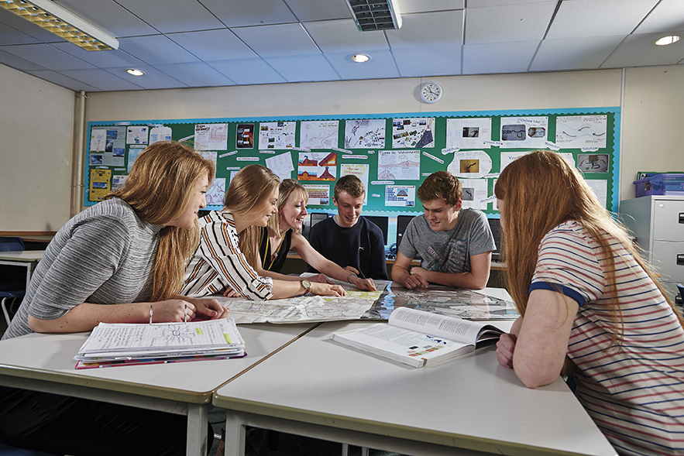
Why choose Walton Sixth Form?

Slide 13
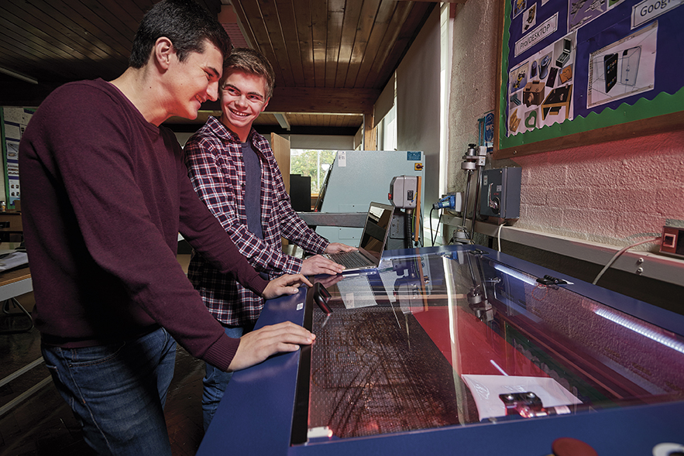

Slide 14
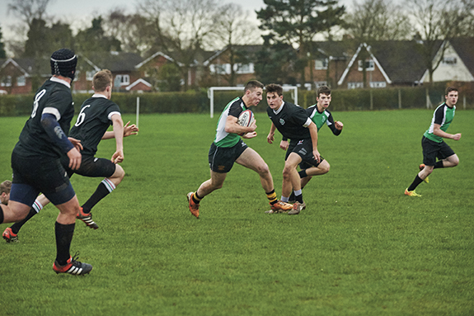

Slide 15
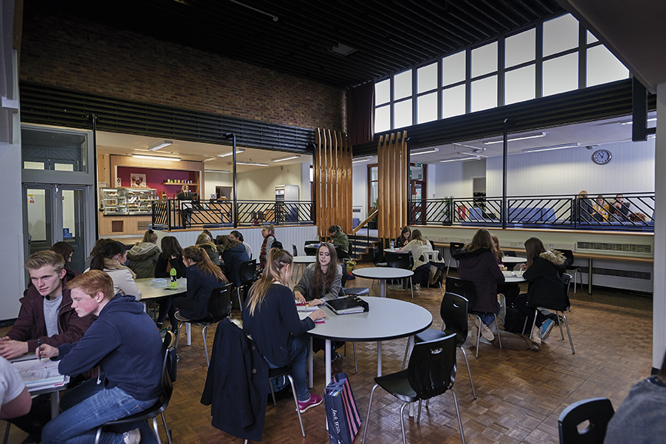

Slide 16
The Application Process
For all Walton students, the application process is via our online Application Form ‘Options Tools’
For all new students, the Application Form is in your welcome pack
A Course Guide is available to you online
Please complete application forms by the end of January

Slide 17
What happens next?
Attend subject areas this evening
Visits to sixth form centre
Guidance meetings
Subject mini taster lessons in tutor time
Complete application form before 31st January
Each applicant will be interviewed from 1st February onwards
Interviews will focus on: Suitability of choices Current performance and likely exam results Future aspirations Discussion of any areas of uncertainty
If needed, make alterations to options

Slide 18
Parent voice
Overall a great Sixth Form!
I would like to thank the Sixth form team for their support and advice over the last 2 years. It is very much appreciated.
A really good couple of years, good support for uni applications and options for the future. Thankyou to the 6th form team.
Good teaching, excellent support from pastoral side, Mrs Wellings is a real asset to the Sixth Form, always helpful and very responsive.
As well as truly excellent academic performance, I would also like to place on record my gratitude to the Sixth Form team for their brilliant emotional support and safeguarding of the students.
My son enjoyed being treated as a young adult, I think this motivated him to learn
Many staff have gone above and beyond to support my child in the UCAS application process and preparations are already in place for supporting her when exam results are released. Many teachers have offered support during study leave.

Slide 19
Walton Sixth Form
Thank you and Enjoy exploring the subjects on offer!

