Slide 1
Social Context Knowledge
Film Industry Knowledge
Cultural Context Knowledge

Slide 2
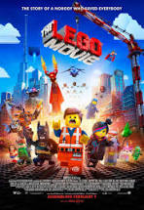
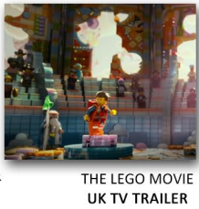
Language
Language
Representation
Representation
Audience
Audeince

Slide 3
Watch the Lego Movie Ad Break
Use the internet to help you if you are stuck or look back at the notes in your books.
https://www.youtube.com/watch?v=HSbYBzUEQlc&ab_channel=WarnerBros.UK%26Ireland
How is this a form of synergy?
Why did they screen the advert at this time on this channel?
How would it appeal to the target audiences?
What benefit are the character introductions between the adverts?
How does the trailer follow Todorov’s narrative structure?
How does it introduce some of Propp’s set characters?

