Slide 1
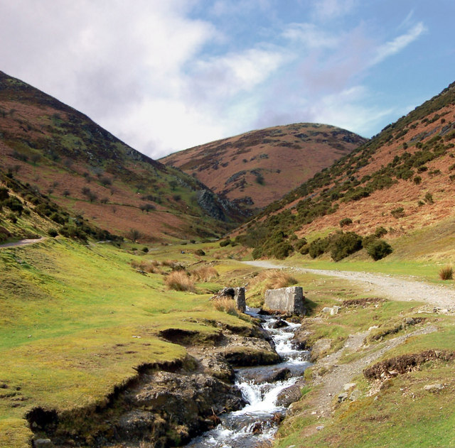
Why is CMV a good investigation site?

Slide 2
Why is CMV a good investigation site?
Accessible - CMV is 55 miles away from school – 70 mins by coach.
The river characteristics change considerably in a short period of time.
There are human interventions along the river e.g. channel straightening.
The river is long enough to have a variety of investigation points.
The investigation sites along the Cound Brook are easily accessible and so risks are reduced.
The water level of the Cound Brook is safe for investigations with a low risk of drowning.
Examples of questions:
State the title of your fieldwork enquiry in which physical geography data were collected.
Explain the advantage(s) of the location(s) used for your fieldwork enquiry. (2)
[2 marks:

Slide 3
Potential risks when completing fieldwork.
Before we took you out to Carding Mill Valley a risk assessment had to be carried out. This is where possible risks where identified and precautionary measures put in place to keep people safe.
The exam board expect you to be able to identify these risks and explain how you would reduce the risk to stay safe.
Risk?
Why?
Precaution?

Slide 4
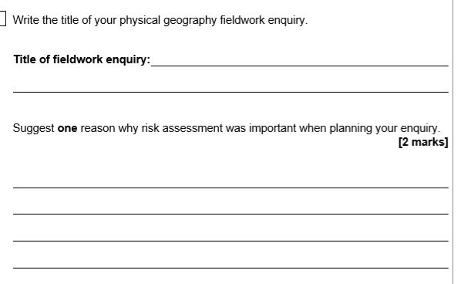

Slide 5
What is sampling?
SAMPLING = A means of collecting data that is representative of a particular issue or subject area without actually having to record every bit of data.
At Cardingmill Valley we would not have time to measure the width of every section of the river from the waterfall to the carpark.
How did we combat this problem?
We used point sampling or stratified sampling to collect our data. We identified 6 areas of the river to collect our data. Why would we do this?

Slide 6
clinometer
Leave this section blank for now.
List all equipment you used.
Random, stratified, biased, systematic or pragmatic.
Leave this section blank for now.
Leave this section blank for now.

Slide 7
Method | Positive | Negative | Improvements
Width | Easy to complete as only 1 piece of equipment is needed – a tape measure. | On very wide channel sections (5&6) the tape measure bowed in the middle. This gives inaccurate results. | Repeat measuring three times to get an accurate measurement. Have a third person to support the middle of the tape measure to get accurate results.
Depth | Easy to complete as once the width has been measured out the depth is easy to measure. | Dividing the width /3 was tricky. The water rode up the ruler if the ruler was placed in the wrong direction. | Use a calculator to work out the depth intervals. Always place the ruler in the channel sideways so that you get an accurate result.
Velocity | Completing the test 3 times meant that we could get an average time. This allows for inaccurate data. The bamboo was easy to see and the method was easy to follow. | Involved a lot of people. The lack of water in the channel meant that the bamboo got stuck behind rocks and it needed to be “freed” which gives inaccurate results. Also the bamboo did not travel in a straight line so may have travelled further than the 5m we measured out. | Use a flowmeter to gain accurate results as the equipment measures the water flowing past a certain point.

Slide 8
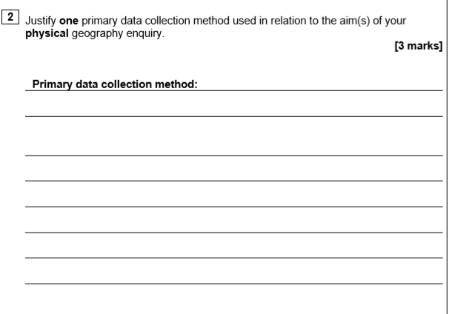

Slide 9
Method | Method | Were the results valid and reliable? | How did the results help conclude overall linking to the conclusion?
Width
Depth
Velocity

Slide 10
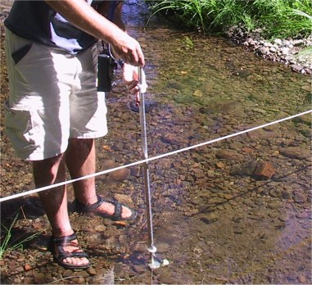
The amount of times the propeller is turned is recorded on the black box. A timer is attached so you can time the propeller turns over a 30 second or 1 min time period.
Improvement:
A propeller is attached to a metal rod. The propeller turns when water flows past it.
The faster the water the more the propeller turns.

Slide 11
Types of data presentation.
Visual- diagrams, sketches and photographs.
Graphical- line graphs, bar charts, pie charts, pictograms, histograms, divided bar charts, scattergraphs, population pyramids and dispersion graphs.
Cartographic- sketch maps, choropleth maps, isoline maps, dot maps. Desire lines on maps, proportional symbols located onto base maps and flow lines on maps.

Slide 12
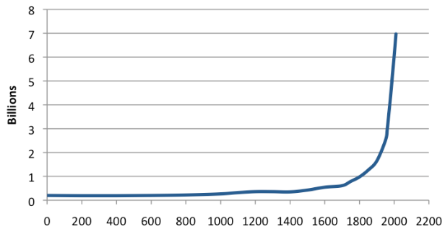
Line Graph
What type of graph is this:
Line graph
Isoline graph
Desire line map
Bar chart.
Used to show continuous changes over a period of time.
Continous data:
Temp
Weight /mass
Prices
Months / time
Distance

Slide 13
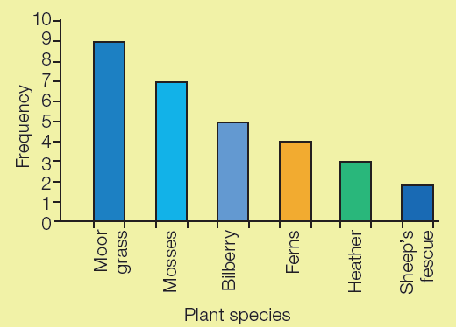
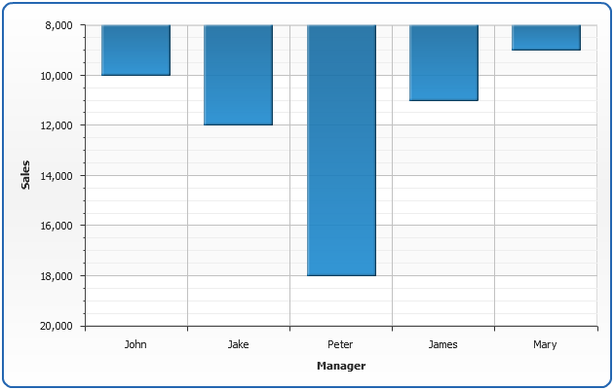
What type of graph is this:
Histogram
Bar chart
Divided Bar chart
Pie chart
Bar Chart
Used to compare quantities or frequencies in different categories

Slide 14
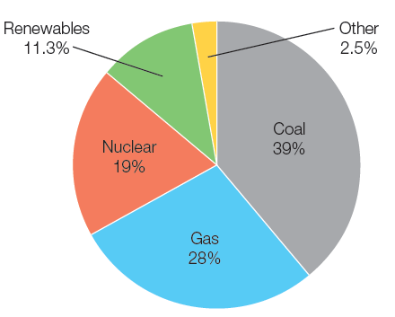
What is the purpose of a pie chart?
a. Shows percentages as a circle, divided into segments
b. Used to compare quantities or frequencies in different categories
a. Shows percentages as a circle, divided into segments
c. Use to compare quantities or frequencies in continuous data. NO GAPS IN BETWEEN BARS!
d. Used to show the relationship between two sets of data

Slide 15
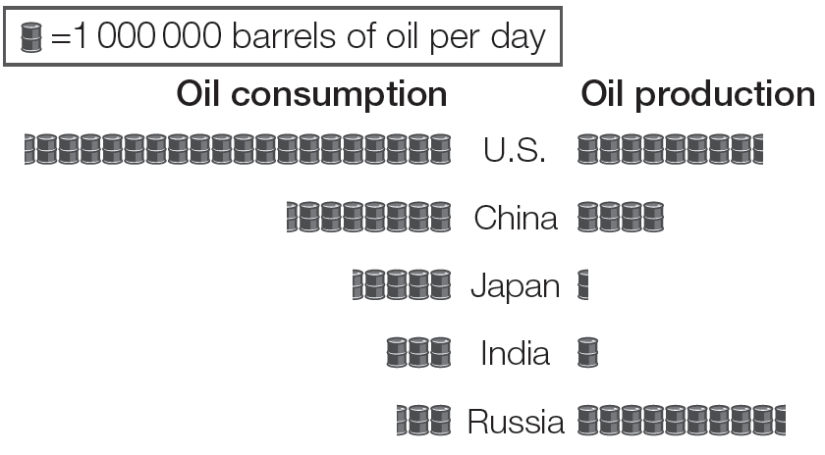
What type of graph is this:
Barchart
Symbols chart
Pictogram
Histogram
Pictogram
Uses symbols or icons to compare data, needs a key!

Slide 16
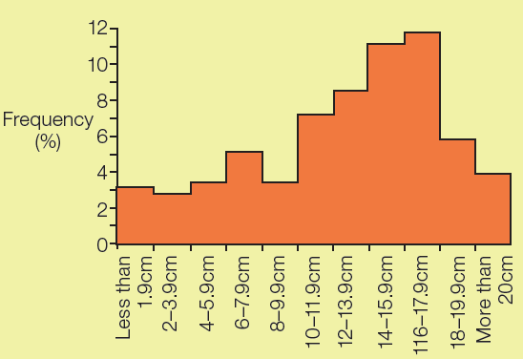
Histogram
What type of graph is this:
Line graph
Histogram
Divided bar chart
Bar chart.
Use to compare quantities or frequencies in continuous data. NO GAPS IN BETWEEN BARS!

Slide 17
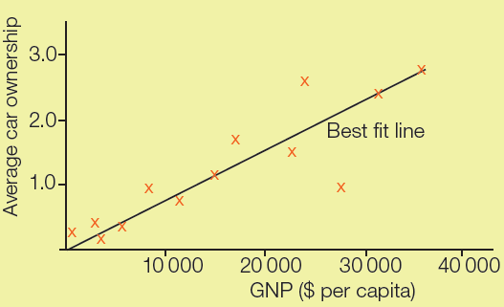
What type of graph is this:
Line graph
Scatter graph
Desire line map
Cross diagram
Scatter Graph
Used to show the relationship between two sets of data

Slide 18
Which graph is Best for…..
Histogram
Compares how much food a country imports v’s exports:
Bar chart
Pictogram
Scatter graph
Pie chart
The distance people have travelled to shop in Stafford:
Bar chart
Pictogram
Histogram
Pie chart
Shows global temperature change over time.:
Bar chart
Line graph
Scatter graph
Pie chart
How people have travelled to Stafford to shop e.g. car, train, bike, walk:
Bar chart
Pictogram
Histogram
Pie chart
Show pebble shape in % form.
Bar chart
Pictogram
Scatter graph
Pie chart
Comparing the relationship vetween gradient and speed of a river:
Bar chart
Line graph
Scatter graph
Pie chart
Pie chart
Bar chart
Pictogram
Scattergraph
Line graph

Slide 19
Located cross sections of the sites along the Cound Brook
Why is this an appropriate method of data presentation?
Challenge: How could we improve this method?
Visual.
Graphical
Cartographic

Slide 20
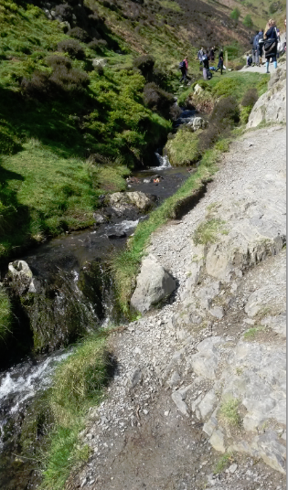
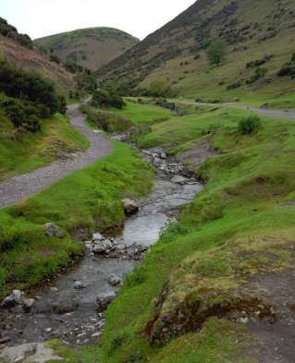
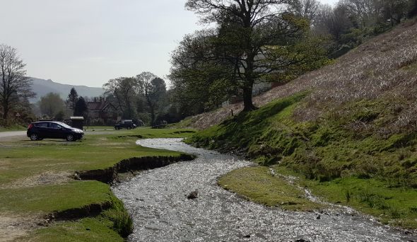
Photo Analysis
How can these photos help us prove / disprove our hypothesis?
Site 3
Site 1
Site 5
Challenge:
Are these photos accurate? How do you know?
How would this influence your results?
1. List site 1, 3 and 5 and write a description about each site - Width , depth , velocity.
2. Did they match the Bradshaw model?

Slide 21
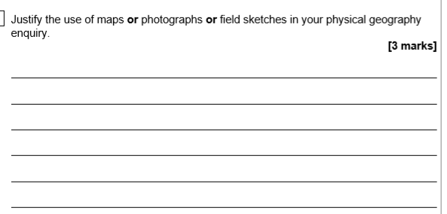

Slide 22
Relationship between data sets
 | Site 1 | Site 2 | Site 3 | Site 4 | Site 5
Width | 200 | 170 | 155 | 370 | 400
Velocity | 25.9 | 29.7 | 13.3 | 15.4 | 14.5
 | Site 1 | Site 2 | Site 3 | Site 4 | Site 5
Depth | 660 | 540 | 900 | 620 | 460
Velocity | 25.9 | 29.7 | 13.3 | 15.4 | 14.5
Complete the graph and plot on site 2
Complete the graph and plot on site 4
Does this show a Positive correlation?
WHAT WE SHOULD HAVE FOUND!
Overall there is a positive correlation and as the river widens downstream the faster it flows. This is because the river has greater energy to erode the banks laterally through hydraulic action and abrasion.
WHAT WE SHOULD HAVE FOUND!
Overall there is a positive correlation and as the river deepens downstream the faster it flows. This is because tributaries have joined the river adding more discharge (water). There is less friction along the river bed as erosion has reduced the size of the sediment.

Slide 23
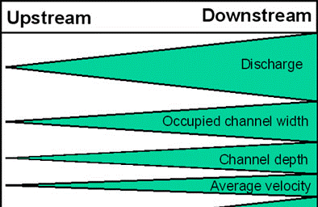
Depth
WHAT WE SHOULD HAVE FOUND!
Overall there is a positive correlation and as the river deepens downstream the faster it flows. This is because tributaries have joined the river adding more discharge (water). There is less friction along the river bed as erosion has reduced the size of the sediment.
Results don’t match the Bradshaw Model. Depth and velocity do not increase as we progress downstream. The data is unclear about the general trend so there is no correlation.
Width
WHAT WE SHOULD HAVE FOUND!
Overall there is a positive correlation and as the river widens downstream the faster it flows. This is because the river has greater energy to erode the banks laterally through hydraulic action and abrasion.
Reasons for this?
The velocity was very high in sites 1 and 2 due to the steeper gradient.
The discharge was very low on the day we visited.
We only measured a very small proportion of the upper course of the river.
The width does increase as expected in the Bradshaw Model. But velocity does NOT increase. Therefore the relationship is not what we expected to find (negative not positive).

Slide 24
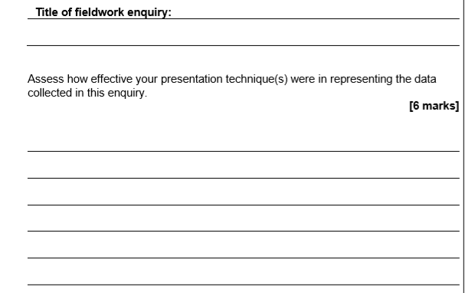
Which of the following methods are the most helpful in presenting your data? Why?
Located Cross sections (river profiles) were helpful because…….
Photo analysis were / were not helpful because….
Scatter graphs were / were not helpful because….

Slide 25
Mark Scheme 6 marks
The command word ‘Assess’ so candidates must provide an informed judgement relating to the overall effectiveness of their techniques.
Answers may refer to:
Types of presentation techniques
Data presented
Variables involved and how represented, such as units and values on axis, scales employed, categories used, sectors of graphs such as pie charts, cross sections etc. applied data so that it could be presented on a map to show variation and distribution.
Features within the presentation techniques will be discussed in terms of effectiveness in displaying results; sectors of bar charts accurately showing proportion, data plots on scatter graphs clearly indicating trends in relationships between variables.
Over all judgements in relation to the features and the effectiveness of techniques used will be clear and substantiated.
Level 3 | Detailed | Overall effectiveness discussed of named presentation techniques. Substantiated evaluation.
Level 2 | Clear | Clear statements not fully developed for effectiveness.
Level 1 | Basic | Evaluation comments are limited and vague. Effectiveness is generic or incomplete. Examples of methods may not be provided.

Slide 26
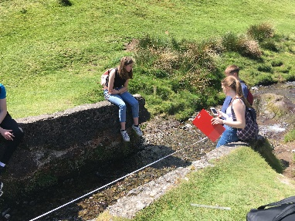
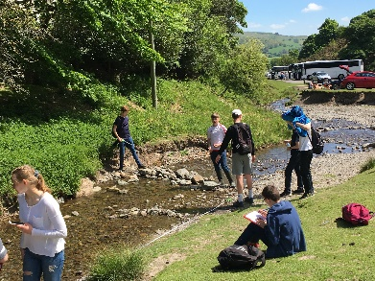
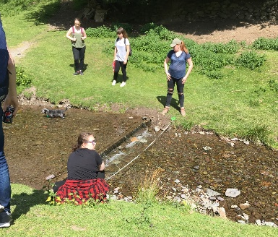
Human intervention
Rock lines along sites 3-5.
Aimed to slow the river down in order to reduce the risk of flooding in Church Stretton.
The velocity was affected greatly especially at the lower sites due to the intervals of the lines being greater making the velocity results not fully match the BM.
Rocks can be moved especially during floods so not permanent.
Old concrete bridge remains of the walls at site 3.
Narrowed the river and prevented the sides getting eroded so the width was set.
Due t it being upstream it didn’t affect the results too much so the results still represented the Bradshaw model.
Small weir at site 4.
Velocity control structure which cannot be altered does slow the river down but doesn’t trap sediment as much as the rock lines.
WHAT
WHERE
HOW
Straightening and narrowing of the river between site 3 and 4 at the visitors centre.
Width and depth here do not match the BM as the channel has been artificially changed. This would also have an affect on the velocity of the river.

Slide 27
Evaluation How did methods affect the results and therefore the conclusion?
Width and Depth measuring -Potential problems Low rainfall so river levels low | Velocity recording - Potential Problem Human adaptions to the flow
How might this have impacted the results? | How might this have impacted the results?
How might this have impacted the conclusions? | How might this have impacted the conclusions?
How would you improve it for next time and why? | How would you improve it for next time and why?

