Slide 1
Thursday, 26 April 2018 Binary
LO: To be able to Identify the purpose of binary and demonstrate the ability to perform simple conversions from denary to binary.
Success Criteria:
I can identify the purpose of binary and what it is used for.
I can explain how digital computers use binary to represent numbers.
I can perform simple conversions from denary to binary.

Slide 2
Computers are not as smart as you think, in fact, they only know 2 things…
0 and 1
Everything else is told to the computer by a human, this is called programming.
Keywords: Binary, bits, bytes, transistor, circuit, CPU, denary.

Slide 3
So, what actually is binary?
The CPU contains millions of tiny little wires. Information shoots through these wires and transistors when a user instructs the computer to do something.
The transistors act like miniature gates. They either let electricity pass through a wire, or it doesn’t.
The information that the user gives to the computer is encoded to become either 0 or 1, which means ON or OFF and carries out the instructions and decodes the output into whatever the user requested.
For a computer
0 means turn a circuit off
1 means turn a circuit on
Keywords: Binary, bits, bytes, transistor, circuit, CPU, denary.

Slide 4
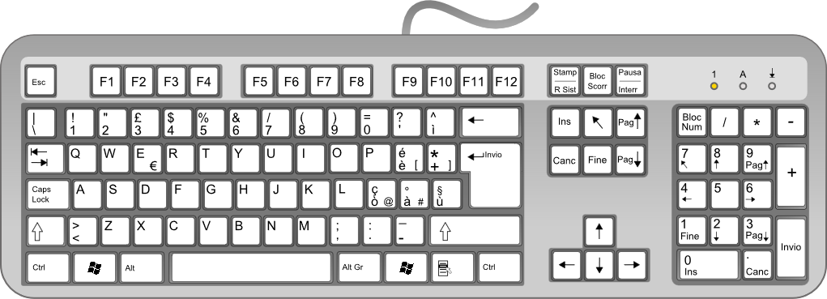
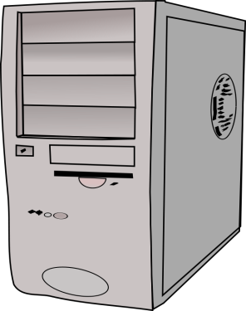
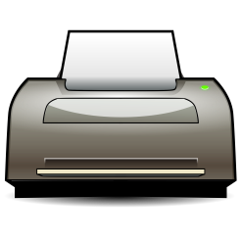
How binary works…
L
H
L
O
E
Inputs
Outputs
Keywords: Binary, bits, bytes, transistor, circuit, CPU, denary.

Slide 5
So, what is stored in binary?
Everything!
Numbers
Character sets (e.g. ASCII)
Images
Audio
Digital Video
✔
Keywords: Binary, bits, bytes, transistor, circuit, CPU, denary.

Slide 6
Binary Numbers
We use number 0-9 (Base 10) or in Computing terms “denary”.
Computers use 0 or 1 (Base 2) or “binary”.
When we type numbers into a computer system, this is translated into binary so that the computer understands it.
Example:
Denary number 5 is Binary number 101.
Keywords: Binary, bits, bytes, transistor, circuit, CPU, denary.
Let’s see how its worked out…

Slide 7
Binary Numbers Explained
Denary numbers – keep doubling!
Make a table like this..
128 | 64 | 32 | 16 | 8 | 4 | 2 | 1
To make the number 5, place a 1 under the numbers that you need and a 0 under the numbers that you don’t…
This is Binary
128 | 64 | 32 | 16 | 8 | 4 | 2 | 1
0 | 0 | 0 | 0 | 0 | 1 | 0 | 1
5 = 101
Keywords: Binary, bits, bytes, transistor, circuit, CPU, denary.

Slide 8
Converting Binary to Denary
Converting binary into denary is simply working backwards.
Example:
Converting the binary number 1101010.
128 | 64 | 32 | 16 | 8 | 4 | 2 | 1
 | 1 | 1 | 0 | 1 | 0 | 1 | 0
Tip: Work backwards from number 1.
Lets practise these as a class:
1011
11000001
 | 64 | +32 |  | +8 |  | +2
=108
11
✔
✔
✔
193
Keywords: Binary, bits, bytes, transistor, circuit, CPU, denary.

