Slide 1
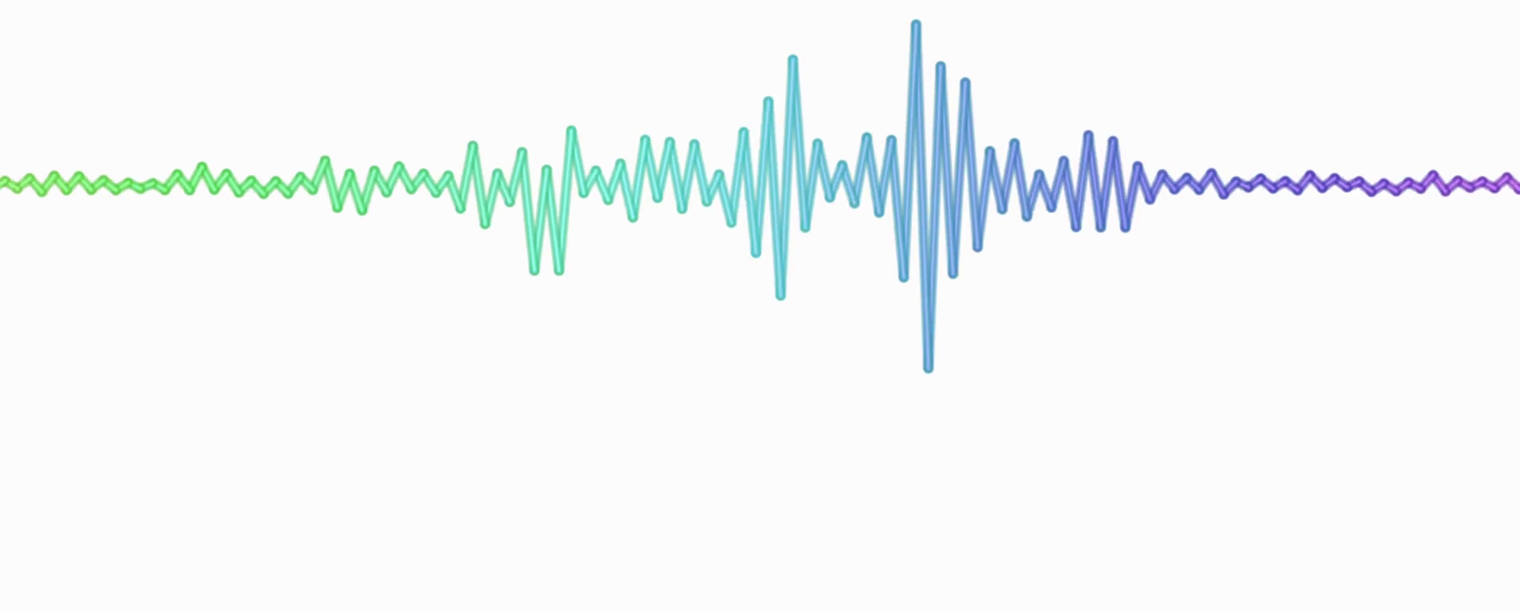
Representing Sound
2.6 – Data Representation

Slide 2
Thursday, 26 April 2018 Representing Sound
Unit 2: Computational Thinking, Algorithms & Programming
Learning Objective: To be able to demonstrate an understanding of how sound is stored in digital form.
Success Criteria:
I can describe how sound is sampled.
I can explain how sound is converted and stored in digital form.
I can explain how sampling intervals and other factors affect the size of a sound file and the quality of its playback.
Key Terms:
Sample size
Bit rate
Sampling frequency

Slide 3
Sound
Unit 2: Computational Thinking, Algorithms & Programming
In previous lessons we have looked at how numbers and images are stored as binary.
This lesson, we will look at how we store sound.

Slide 4
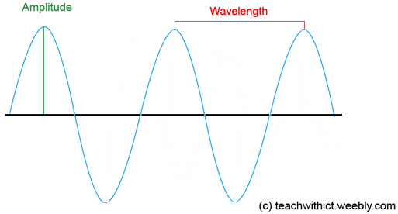
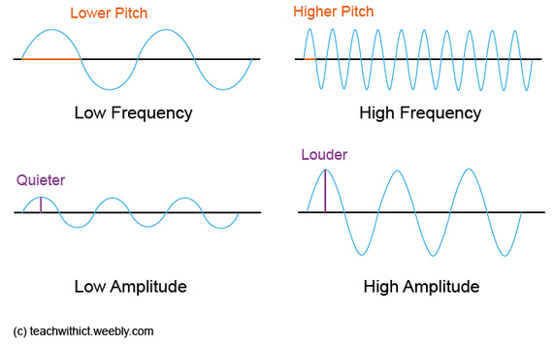
Sound
Unit 2: Computational Thinking, Algorithms & Programming
Sound travels as a wave. Lets look at this example:
Amplitude = how loud the sound is.
Frequency = controls the pitch.
Soundwaves are analogue. In order to store the waves digitally on the computer , we need to convert the waveform into a numerical representation so that the waveform can be stored in binary.
To do this, we use an Analogue-to-Digital Converter (ADC).

Slide 5
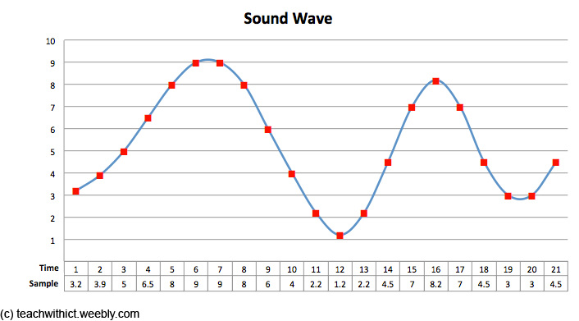
Sound
Unit 2: Computational Thinking, Algorithms & Programming
The ADC works by taking samples of the sound wave at regular intervals.
The quality and size of the file is affected by two factors – sample rate and bit rate.

Slide 6
Sound: Sample Rate
Unit 2: Computational Thinking, Algorithms & Programming
The sample rate refers to the number of samples taken every second and that the greater the frequency of the samples, the better the sound quality.

Slide 7
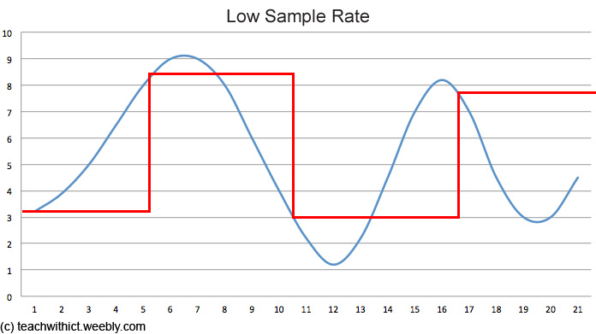
Low Sample Rate
Unit 2: Computational Thinking, Algorithms & Programming

Slide 8
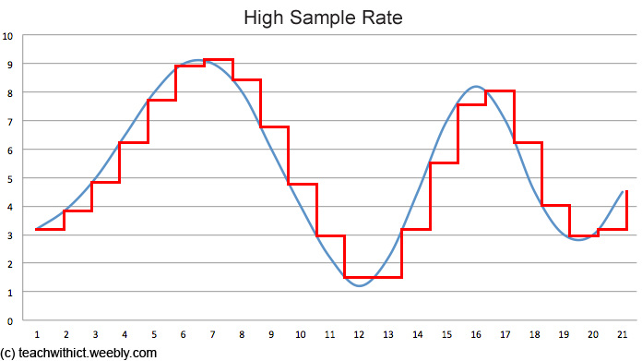
High Sample Rate
Unit 2: Computational Thinking, Algorithms & Programming

Slide 9
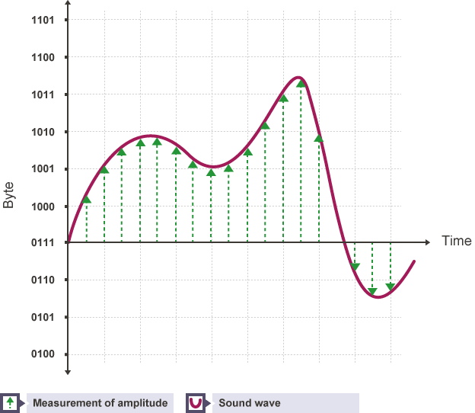
Sample Rate: Converting
Unit 2: Computational Thinking, Algorithms & Programming
Each sample represents the amplitude of the digital signal at a specific point in time. The amplitude is stored as either an integer or a floating point number and encoded as a binary number.
A common audio sample rate for music is 44,100 samples per second. The unit for the sample rate is hertz (Hz). 44,100 samples per second is 44,100 hertz or 44.1 kilohertz (kHz).
BBC Bitesize

Slide 10
Bit Rate
Unit 2: Computational Thinking, Algorithms & Programming
The bit rate of a file tells us how many bits of data are processed every second. Bit rates are usually measured in kilobits per second (kbps).

Slide 11
Calculating Bit Rate
Unit 2: Computational Thinking, Algorithms & Programming
The bit rate is calculated using the formula:
Frequency × bit depth × channels = bit rate
A typical, uncompressed high-quality audio file has a sample rateof 44,100 samples per second, a bit depth of 16 bits per sample and 2 channels of stereo audio. The bit rate for this file would be:
44,100 samples per second × 16 bits per sample × 2 channels = 1,411,200 bits per second (or 1,411.2 kbps)
A four-minute (240 second) song at this bit rate would create a file size of:
1,411,200 x 240 = 338,688,000 bits (40.37MB)

