Slide 1
Representing Images
2.6 – Data Representation

Slide 2
Thursday, 26 April 2018 Representing Images
Unit 2: Computational Thinking, Algorithms & Programming
Learning Objective: To be able to demonstrate an understanding of how images are stored using binary.
Success Criteria:
I can describe how images are stored using binary.
I can explain how colour depth of an image is determined.
I can explain the difference between lossy and lossless compression.

Slide 3
Digital Images
Unit 2: Computational Thinking, Algorithms & Programming
Graphics on a screen are made up of tiny blocks called pixels.
The more pixels on the screen, the higher the resolution.
The higher the image resolution, the more memory will be needed to store the image.

Slide 4
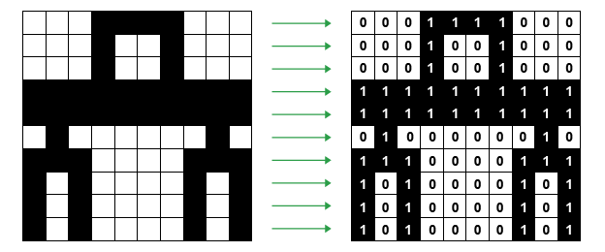
Bitmaps
Unit 2: Computational Thinking, Algorithms & Programming
Bitmap images are organised as a grid of coloured squares called pixels (short for ‘picture elements’).
Each colour of an image is stored as a binary number. Look at the black n white image below:
As each pixel is either black or white, it can be encoded with either a value or 0 for white, or 1 for black.

Slide 5
Colour Depth
Unit 2: Computational Thinking, Algorithms & Programming
The colour depth of an image is measured in bits. The number of bits indicates how many colours are available for each pixel.
In the black & white image, only 2 colours are needed, so it has a colour depth of 1 bit.
A 2-bit colour depth would allow four different values: 00, 01, 10, 11.
Binary code | Colour
00 | White
01 | Light grey
10 | Dark grey
11 | Black
The greater the colour depth (bits per pixel), the more colours are available.

Slide 6
Colour Depth: Examples
Unit 2: Computational Thinking, Algorithms & Programming
This colour here has a 6 digit hexadecimal value (24 binary digit).
Most computers use 24-bit images. This would be 1111 1111 1111 1111 1111 1111 in binary. This means that there are 16 million possible colours per pixel.

Slide 7
Metadata
Unit 2: Computational Thinking, Algorithms & Programming
Metadata means ‘data about data’. Image files usually contain metadata. This usually includes the following information:
Filename
File format (e.g. JPEG, PNG, GIF)
Dimensions
Resolution
Colour depth
Time and date the image was last changed
Camera settings when the photo was taken
GPS (where applicable)

Slide 8
Compression
Unit 2: Computational Thinking, Algorithms & Programming
Images are often compressed to reduce their file sizes (saving storage space). There are 2 main ways of achieving this:
Lossy compression
Lossless compression
You can see a video here that explains the 2 different types of compression.
https://www.bbc.com/education/guides/zqyrq6f/revision/4

Slide 9
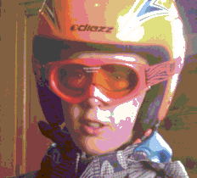
Lossy Compression
Unit 2: Computational Thinking, Algorithms & Programming
This is when the file is compressed but loses some of it’s quality when this happens. The most common way is to reduce the colour depth from 24 bits to 8 bits but this can make the image appear granulated or have unusual colour blocks showing. JPEG is a lossy file compression type.
Original image
Compressed image

Slide 10
Lossless Compression
Unit 2: Computational Thinking, Algorithms & Programming
If we were going to send the following image then there are blocks of similar colour.
Instead of sending the pixels individually for example for the first row they may save it as :
red, red, red, blue, blue, red, red, red
They could reduce the memory this takes up by saving the same line as:
3 x red, 2 x blue, 3 x red

Slide 11
Find out what colours these hexadecimal numbers represent:
Unit 2: Computational Thinking, Algorithms & Programming
Colour Representation
FF0000 1111 1111 0000 0000 0000 0000
00FF00 0000 0000 1111 1111 0000 0000
0000FF 0000 0000 0000 0000 1111 1111
All colours are made up of varying amounts of red, green and blue.
You can see the hexadecimal value of millions of colours on this website:
https://www.w3schools.com/colors/colors_picker.asp

Slide 12
Theory Review
Unit 2: Computational Thinking, Algorithms & Programming
What we have learned:
Images are made up of picture elements called pixels.
Each pixel is stored with a binary code.
The larger the number of bits used for each pixel, the greater the number of colours stored, called the colour depth.
Meta data (colour depth, width & height) is needed so the image can be recreated from the binary code in the image file.

