Slide 1
Virtual Networks

Slide 2
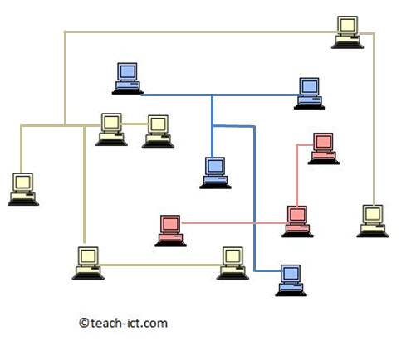
Thursday, 26 April 2018 Virtual Networks
Learning Objectives:
1. Define what a virtual network is and its key characteristics
2. Explain how virtual private networks are used within every day life
Key Terms: Virtual Network, Virtual Private Network, LAN, WAN, data packets, switch, hub, server.

Slide 3
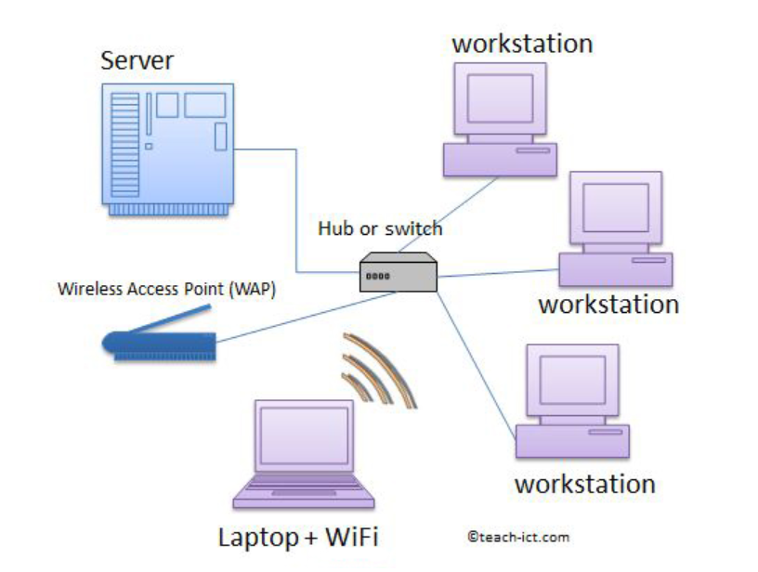
Standard Network
Here's a reminder of a standard network set up.
Typical LANs use physical hardware to connect the hub to the workstations, server and WAP.
The alternative to this is a ‘virtual network’

Slide 4
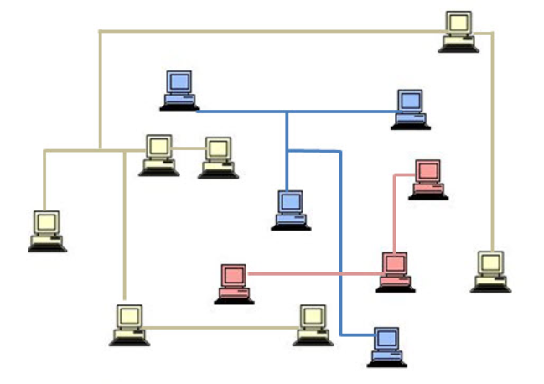
Virtual Network
Sales
Finance
Virtual networks make use of software to divide devices on a LAN into smaller groups.
The whole LAN is still physically connected by cables, but the ‘virtual network’ of devices created through software are restricted from accessing any of the other computers on the LAN. So they appear to be a completely separate network within the larger one.
Manufacturing
The LAN has been subdivided into three virtual networks (VLAN)

Slide 5
Benefits of VLANs
5 minute challenge
Identify all of the advantages you can think of, of using VLAN’s in a large organisation
Teams can have their own VLANs to communicate and share information
Its easier to configure software setups for individual teams.
Reduced network traffic because data is only sent to member of the VLAN
More secure – Information is only shared with the members of the VLAN
REMEMBER: LANs are created using physical hardware (cables). Virtual networks are created using software.

Slide 6
Virtual Private Network (VPN)
Challenge
Identify examples of VPNS that you or your teacher uses
Virtual private networks are similar but work on a larger scale
ALL – Research what a VPN is and how it works
Most – Demonstrate an understanding of how VPNS are used within the world and provide technical understanding and relevant examples.
Some – Use key terminology such as protocols & tunnelling whilst explaining what a VPN is

Slide 7
VPN – Key Points
Similar set up but using a larger WAN such as the internet
Users across the world can log in, work and collaborate on their own private network.
Network is created through software and uses encryption and other software to ensure that all communication is secure
In a VPN, Packets that are sent are placed within an outer packet that only that particular VPN can understand using special protocols. This is the process known as tunnelling.
Simple Example – A class teacher logging on to an area of the school network from home.

