Slide 1
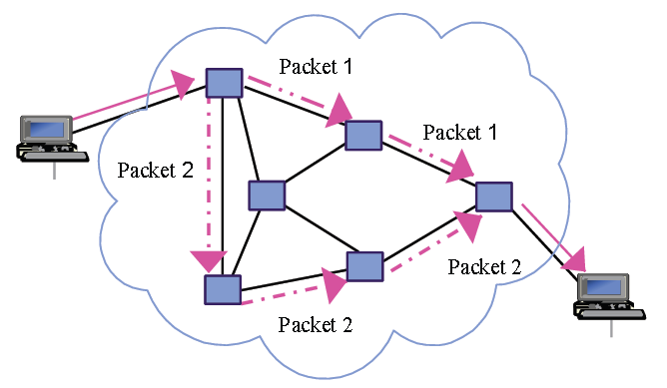
Protocols & Packet Switching

Slide 2
Objectives
Identify a range of network protocols and their purpose
Identify the purpose of a packet switching
Demonstrate an understanding of how packet switching works

Slide 3
Protocols
What is a protocol?
A way or procedure for doing something
An agreed method
A system of rules
A set of rules for how messages are turned into data packets and sent across networks.
Protocols manage key points about a message:
speed of transmission
size of the message
error checking
deciding if the transmission is synchronous or asynchronous

Slide 4
Network Protocols
The protocol used for communicating over the internet is called TCP/IP, or "Transmission Control Protocol / Internet Protocol". It has two parts: TCP and IP.
Notes:
20 mins

Slide 5
What information do data packets have?
source - which computer the message came from
destination - where the message should go
packet sequence - the order the message data should be re-assembled
data - the data of the message
error check - the check to see that the message has been sent correctly

Slide 6
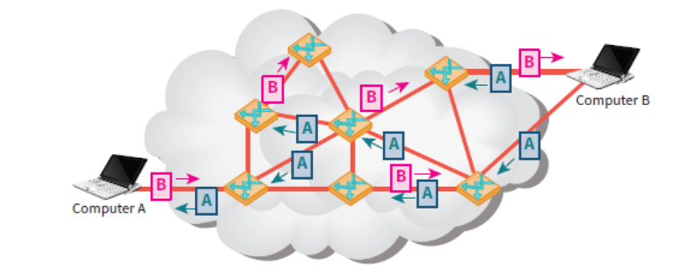
Packet
When devices transmit data, data is broken into small pieces, these are called packets. These are sent individually and then joined up at the end so the message becomes complete again.
Parts of a packet
Header – Contains the source, destination address & position of the packet in the completed message
Body – Part of the message it carries (also referred to as the payload)
Footer – Used for error checking & ensuring the complete packet has been delivered intact (also referred to at the trailer)

Slide 7
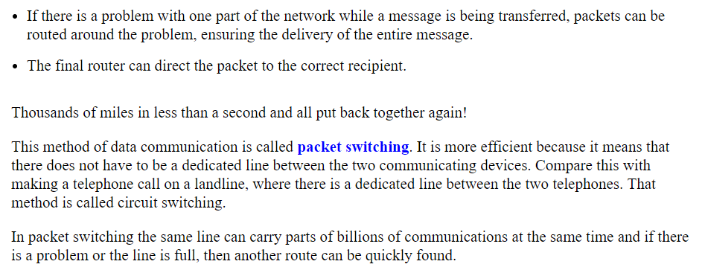
Packet
The packet sent between computer A and B
Take different routes across the network.
Arrive in different order

Slide 8
How does it work?
The file is split into packets with the address IP attached
Split because the transmission of a large file would consume all the bandwidth and slow the network
The packets are sent onto the network using cable or microwaves
Routers on the network inspect each packet and decide the most efficient path for the packet to take on the next stage of the journey
Each router has a configuration table containing information about which connections lead to particular groups of addresses.
The router can balance the load across the network on a millisecond by millisecond basis
If there is a problem with one part of the network while a message is being transferred, packets can be routed around the problem, ensuring the delivery of the entire message.
The final router can direct the packet to the correct recipient
This is the process of packet switching, billions of communications at the same time and if there is a problem then they just use a different route

Slide 9
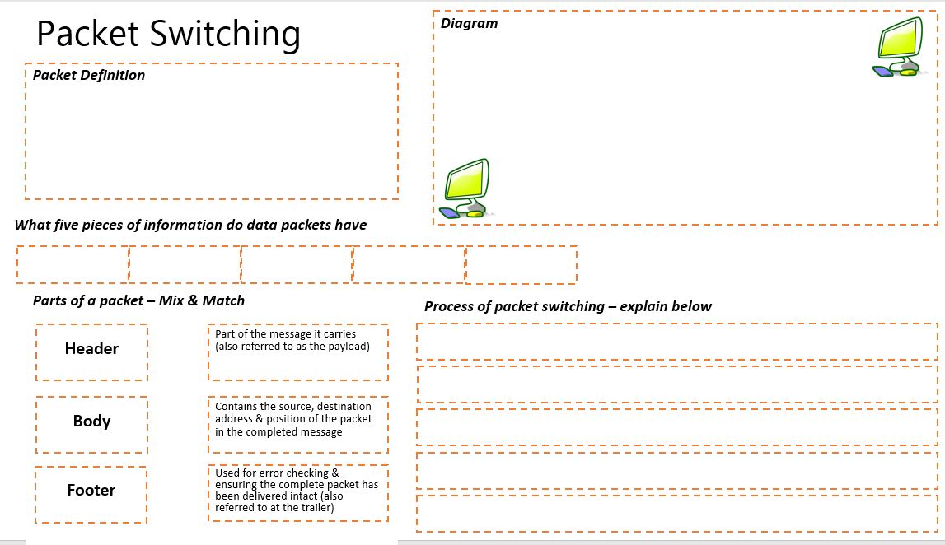
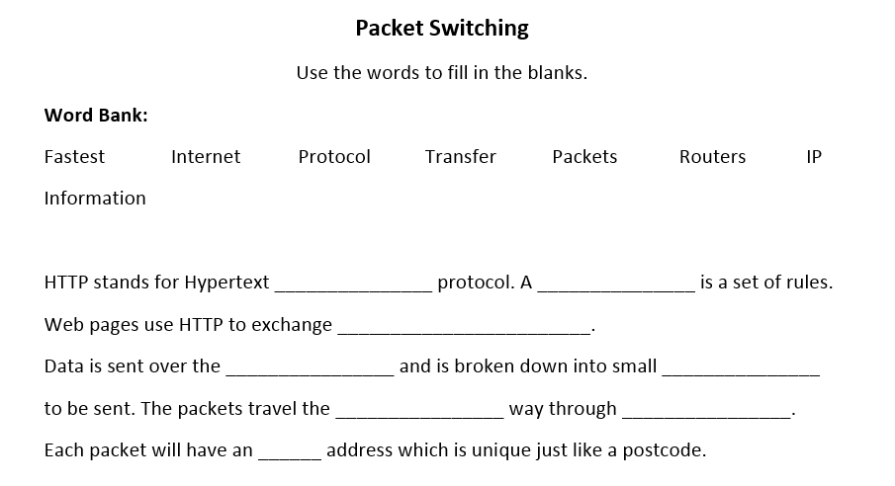
Packets Task
Complete this worksheet. Use your class notes to help you.
Challenge Task1:
Describe the difference between HTTP and HTTPS. How does HTTPS work?
Challenge Task2:
Complete this word fill.
Learning Objective
Identify the purpose of a packet switching
Demonstrate an understanding of how packet switching works

