Slide 1
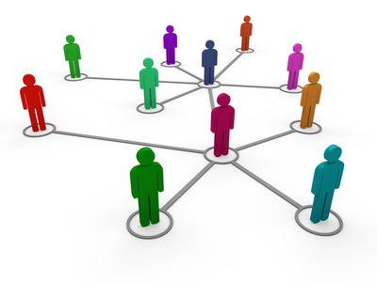
Thursday, 26 April 2018 Types of Networks
1.4 – Wired and Wireless Networks
Learning Objective:
To be able to describe the structure and characteristics of different network types.

Slide 2
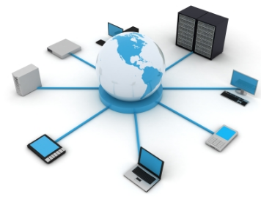
What is a network?
1.4 – Wired and Wireless Networks
A computer network is two or more computing devices connected together in order to share resources.
A device is said to be 'network enabled' when it is capable of joining a network.
Network enabled devices include:
Personal computers
Tablets
Smart phones
Smart TVs
Printers

Slide 3
Local Area Network (LAN)
1.4 – Wired and Wireless Networks
A Local Area Network is one that has two or more network-enabled devices connected within a fairly close geographical area.
For example the LAN may be located:
Within a single building such as a home or business office
It may cover a few nearby buildings as well, such as an University campus, hospital, library or school.

Slide 4
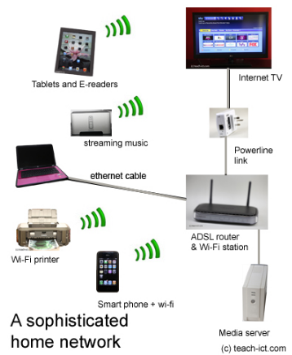
Home LAN diagram
1.4 – Wired and Wireless Networks
Many homes have LANs where many devices can connect together in order to share data.
The key device at the centre of a home LAN is the router which connects all of the devices to each other and the internet.
Using your laptop you could select your music playlist on the internet and at the same time send a document that you have been working on to the printer.
The router can be either wired or wireless.
A wired connection is faster and provides high bandwidth (e.g. Gigabit 1000 Mb/s) use whereas the wireless link is much slower (54Mb/s) but it does offer convenience.

Slide 5
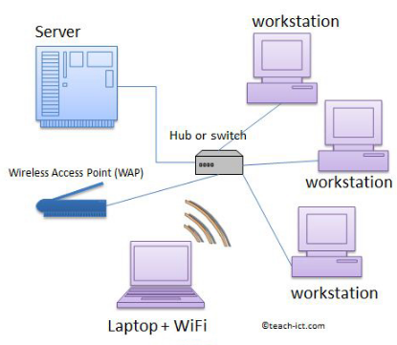
Business LAN Diagram
1.4 – Wired and Wireless Networks
A wireless access point (WAP) is connected to the network so that Wi-Fi devices such as laptops can connect to the network.
This network has a central server connected to a switch.
Computers and devices can be connected by physical Ethernet cables. They can also be connected wirelessly by using Wi-Fi connections.
To log onto a LAN, you usually need a user name and password, just like you do at school.
The user name identifies you to the file server so that it can 'serve' you the correct files. The password ensures that the user name really does belong to you.

Slide 6
Advantages of LANs
1.4 – Wired and Wireless Networks
An user can log on from any computer and still access all of their files.
Reducing costs: Peripherals such as printers and photocopiers can be shared between many users
Resources and files can be shared by users, this means that they can collaborate on a project.
Backups of files and documents can be done centrally rather than needing to do it from each machine
When software needs to be installed it can be done centrally rather than having to go to each computer
An anti-virus and malware check can be carried out from the server to all computers

Slide 7
Disadvantages of LANs
1.4 – Wired and Wireless Networks
Network failure- If there is a problem with the file server then no one will be able to access their files. If the internet server has an issue no one will be able to get onto the internet.
Slow service- If there are a lot of users logged into the network requesting files and jobs then the network can start to slow down. There is only a limited amount of bandwidth
Viruses and malware- If someone does install a virus on the local workstation it could easily spread around the network
Cost- networks are expensive to set up and keep running. The cost of the physical components can be very high.
Expert support required- Business networks will require specialist staff such as technicians who can deal with problems as they come up to keep the network running smoothly.
Security- Although users have their own user names, giving them access to just their files, users can be careless and not log out when they leave their computer. This could give an unauthorised person access to their files or to sensitive documents stored centrally on the network.
Notes:
25 mins

Slide 8
Wide Area Networks (WANs)
1.4 – Wired and Wireless Networks
A wide area network (WAN) connects 2 or more LANs that are in different geographical locations.
For example, a company might have offices in London and also New York, but they want to share a common work area so they can collaborate. In this case the LAN in London is connected to the LAN in New York by a Wide Area Network.
A company normally hires the WAN from a major telecom company because it is so expensive and complicated to set up and maintain.
The WAN involves long distance communications and this can be achieved using Fibre optic lines, including laying undersea cables, Satellite communication links, Leased telephone lines and Microwave links
The largest WAN of all is of course the internet. No single organisation owns the internet itself.

Slide 9
Advantages and Disadvantages of WANs
1.4 – Wired and Wireless Networks
Advantages
Allows LANs to connect to one another.
Allows workers to collaborate over a wide area, even across continents..
Allows files and data to be shared between LANs.
Disadvantages
Can be expensive to hire a WAN service from the telecom operator.
With a WAN, it is owned by a number of external suppliers and so a failure of the WAN is usually beyond the control of the company to fix. For example, when an external DNS server fails, this immediately affects web access in the company.
Notes:
25 mins

Slide 10
Thursday, 26 April 2018 Factors which affect network performance
1.4 – Wired and Wireless Networks
Learning Objectives:
To be able to identify factors that affect the performance of a network and give reasons why.
To be able to explain the main differences between client server and peer to peer networks.

Slide 11
Bandwidth
1.4 – Wired and Wireless Networks
The speed of a network is measured in bits per second which are normally grouped up for convenience.
These groups are:-
Kilobits per second (Kbps), a thousand bits per second.
Megabits per second (Mbps), a million bits per second.
Gigabits per second (Gbps), a thousand million bits per second.
The term for this is the 'bandwidth' of the network. It describes how much data can be transferred over a connection in a given time.

Slide 12
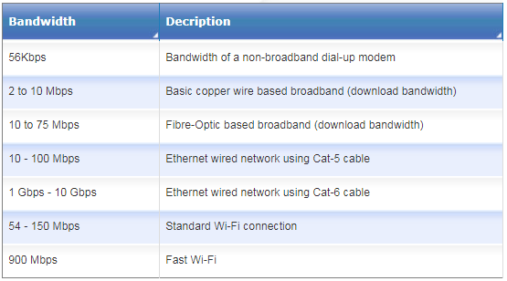
Network Bandwidths
1.4 – Wired and Wireless Networks
The table below shows the bandwidth of various networks
As you would expect, the higher the bandwidth, the more expensive it becomes because of the cost of the cables and equipment.

Slide 13
Sharing Bandwidth
1.4 – Wired and Wireless Networks
If too many people are using the network at the same time, then the network will slow down because the bandwidth has to be shared between all users.
The more bandwidth each person uses, the less is available for everyone else.
For example: a network with 100 Mbps of bandwidth should be sufficient for 50 people, if one of those users hogs the network by streaming video files, the network will seem to slow down for everyone else.

Slide 14
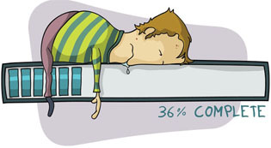
Contention Ratio
1.4 – Wired and Wireless Networks
The Contention ratio is the ratio of users compared to available bandwidth.
For example at six o clock on a Sunday evening, your internet connection might seem slow. This may be because lots of people in your road are trying to connect to the internet at the same time. They all have to share the same physical wire/cable down which the data must travel.
Another time, when there are fewer people online, for example, 7am on a Monday morning, the connection can seem fast and responsive.
Businesses often need a reliable and fast internet connection and so they are willing to pay the telecom company extra money for a low-contention ratio connection.

Slide 15
Wired and Wifi Networks Summary
1.4 – Wired and Wireless Networks

Slide 16
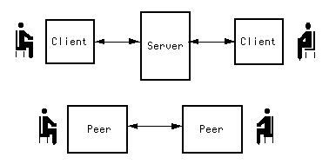
Client-Server and Peer to Peer networks
1.4 – Wired and Wireless Networks

Slide 17
Re-cap
1.4 – Wired and Wireless Networks
A Local Area Network allows computers to share resources and data with each other.
There are two main ways to connect computers on a LAN. These are:
Client-Server
Peer-to-Peer

Slide 18
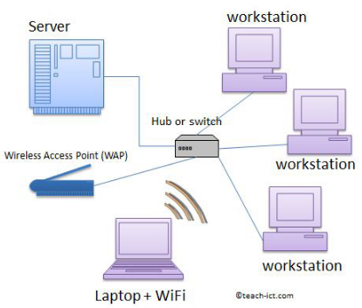
Client-Server LAN
1.4 – Wired and Wireless Networks
In a Client-Server LAN arrangement, most files and data are stored on a server.
All computers on the network connect to this server through a central hub or switch.
The other computers on the network are called 'workstations' or 'clients'.
Users can access files and data from the server using any workstation. They just need to log into their account using their username and password.
If people need to share data then a 'shared network folder' is created on the server by the network manager in order to share files.

Slide 19
Client-Server LAN
1.4 – Wired and Wireless Networks
There may be multiple shared folders on a server with different access rights.
For example, in a school network there will be a shared folder for students where your teacher will store files and resources that you need.
There will be another shared folder for office staff, perhaps containing copies of letters sent to parents and other administrative documents.
All students can see the student shared folder but not the office shared folder. And likewise the office staff can see their shared folder but not the student one.
This is because when your account and login are set up by the network manager you will be given permission to view and use only certain folders.

Slide 20
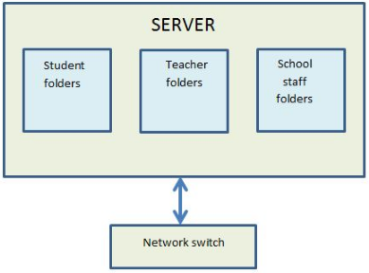
Client-Server LAN
1.4 – Wired and Wireless Networks
Users will have their own private area on the network where they can save their files and documents. No one else can access this area (except the network manager and staff).
A client server network requires a specialist network operating system.
As files are stored on the server and they can be backed up centrally.

Slide 21
Advantages of a Client-server network
1.4 – Wired and Wireless Networks
With a single central server, files can be backed up more easily
Installation of new software to the network is easier and faster
Software only has to be licensed to the server itself
Client machines (workstations) do not need much software or file storage of their own.
Simpler to manage security and permissions for large networks

Slide 22
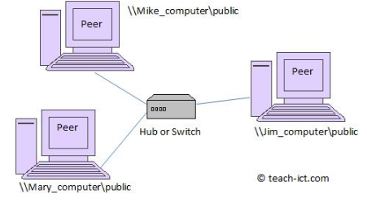
Peer to Peer
1.4 – Wired and Wireless Networks
Peer to peer networks are very common in small offices or at home where there are only a few computers connected together.
With a peer-to-peer network a central server is not required because the files are stored on the hard disks of individual network machines.
Each computer on the network has equal importance and no more privileges than any other.
Each computer is both a client and a server - it acts as a 'host'. And users can access files and peripherals directly from all the other peers on the network.
Example: Playing video from smartphone on TV

Slide 23
Advantages of a peer-to-peer network
1.4 – Wired and Wireless Networks
Cheaper and less secure network model
No single central point of failure. If one peer goes down, the others can continue to function.
Easier to manage with small networks, for example two or three computers in a small office

Slide 24
Summary: Copy Table
1.4 – Wired and Wireless Networks

