Slide 1
RAM and ROM

Slide 2
Thursday, 26 April 2018 Types of Memory
Learning Objectives:
To be able to explain the differences between RAM and ROM and how they are used in computer systems.
To be able to explain what virtual memory is and the advantages and disadvantages of its use.

Slide 3
Memory
Data and programs need to be stored in a computer system.
The technology used to do this is called memory.
Memory can be divided into two types:
Main memory (Primary storage)
Secondary storage.

Slide 4
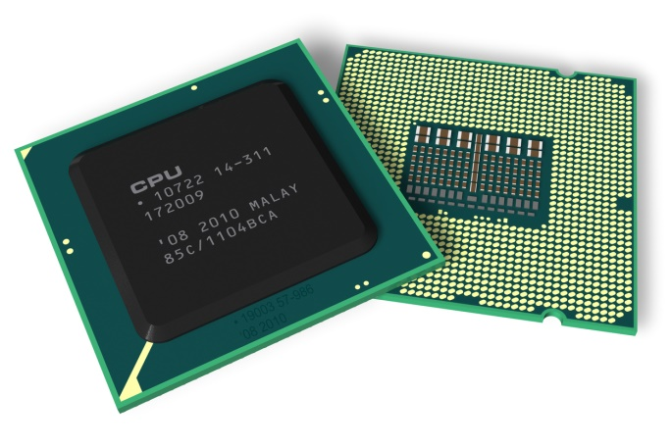
Main memory
For programs to be accessed by the CPU the operating system loads them into RAM
Main memory can be directly accessed by the CPU.
Main memory can hold more than one program at a time, which makes it quicker for the CPU to swap between tasks.
Examples of main memory include:
Random access memory (RAM)
Read Only Memory (ROM)

Slide 5
Volatile memory
How many times have you worked for ages on something and just before you were about to save it the computer crashed or your mate 'accidentally' switched it off? And when you reboot your computer, all of that work is gone forever.
The reason for this is because you were working in Volatile memory (RAM) and didn’t save it in the Hard disk (Non Volatile)
Volatile memory is cleared whenever power is lost.
Non-volatile memory will continue to store data even if power is lost.
Other types of volatile memory include CPU registers and the cache.

Slide 6
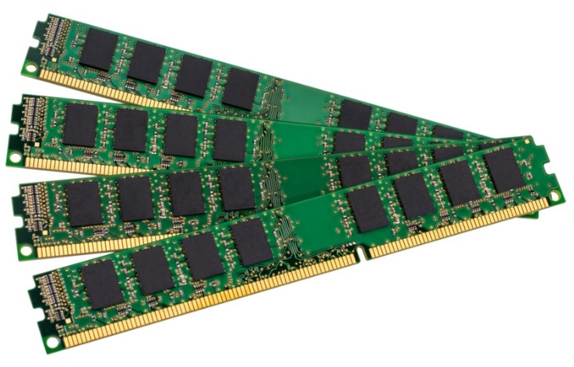
RAM- Random Access Memory
RAM is used as main memory (accessed directly by CPU). It is a temporary store for program instructions and data.
RAM needs constant electrical power. If the computer is switched off it will lose any data it is holding.
It can only store things temporarily because it is volatile
Why do we call it ‘Random Access Memory’?
Because the CPU can access any memory location, at any time, in any order.
Because of this ability, programs held in RAM can run very quickly.

Slide 7
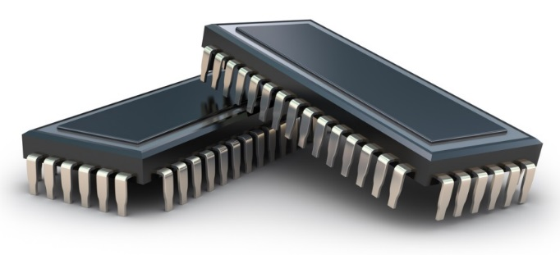
ROM- Read Only Memory
ROM is a type of main memory because it is directly accessed by the CPU.
ROM is Read Only which means that it cannot be changed, overwritten or removed, whereas RAM is read/write memory which means that the contents can be changed.
Secondly, unlike RAM, ROM is non volatile, meaning it keeps its data when there is no power supply.
ROM stores BIOS instructions. When you switch on your computer, the BIOS checks the hardware is installed correctly (e.g.memory, graphics card etc)
It also checks the input/output devices such as the keyboard.
It then loads the operating system.
ROM also stores the MAC Address
Notes:
25 mins

Slide 8
ROM and RAM Summary
RAM | ROM
Read write | Read only
Volatile | Non volatile
Used to hold running programs/ data & instructions | Used to hold basic computer hardware settings e.g. BIOS
Gigabytes of RAM installed | Megabytes of ROM installed
Notes:
20 mins

Slide 9
Virtual Memory

Slide 10
Virtual Memory as a diagram
Draw this example in your books
Less frequently used programs (e.g. webpages that you aren’t viewing at present) will be moved into virtual memory.
Hard Disk
Output available to you
You require all of these applications and processes to be running (or you just don’t realise that some are!), but they don’t fit in the Ram space.
RAM
RAM is full

Slide 11
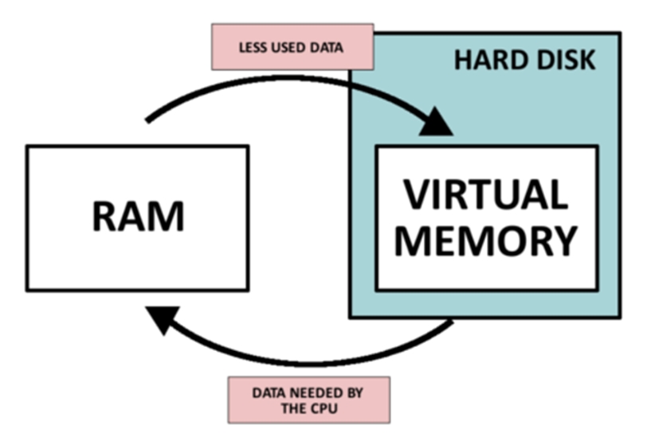
Virtual Memory as a diagram
Draw and example in your books – Add notes to help you understand

Slide 12
Paging (also known as Swapping)
“Paging is where relatively inactive pages are temporarily removed from physical memory and placed into virtual memory.” – Teach ICT.
Paging happens when main memory is getting a bit full. The memory manager will look at the pages in main memory and identify those which haven't been used for a while. They will be moved into virtual memory. When an application needs data held on a page in virtual memory it will be swapped back into main memory and another inactive page may take its place.
In order to manage these pages a 'page table' is created by the memory manager which stores the starting address of each page. The starting address is where the first byte of each page is physically located in memory.

Slide 13
Disadvantages of using virtual memory
The read / write speed of a hard drive is much slower than RAM, and technology of a hard drive is not geared towards accessing small pieces of data at a time.
If the system has to rely too heavily on virtual memory, there will be a significant performance drop.
Often the operating system has to constantly swap information back and forth between RAM and the hard disk, which operates all the time. This is known as ‘disk thrashing’ and significantly slows down the execution of the program.
The more RAM a computer has, the less virtual memory will be required, this is why inserting more RAM massively improves performance.

Slide 14
Flash Memory

Slide 15
Flash Memory
Mini Task
Write a definition of what you consider flash memory to be and where it is commonly used.
Defined
Flash memory is commonly used in portable devices (phone, camera) or as portable secondary storage. This is memory that is programmed electronically but then keeps its data when the power is turned off. Flash memory is ideal for transporting data as they are light and being solid state memory they have no moving parts that could be damaged.

Slide 16
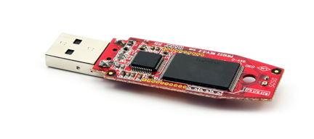
Flash Memory
Advantages | Disadvantages
Very fast access speed, far faster than discs. Small, light and easily portable Quiet Flash memory is said to be ‘solid state’ as it has no moving parts that could be damaged if the device was knocked or dropped and therefore there is less chance of losing data | More expensive than a hard disk or DVD The storage capacity is less than a hard disk drive There is a limited number of erase/write cycles, up to 100,000 for high quality SSDs and so it cannot be used indefinitely

